Slide 1
WHO guideline on the prevention and management of wasting and nutritional oedema (acute malnutrition) in infants and children under 5 years
Notes:
WELCOME SLIDE

Slide 2



Housekeeping
Please ask questions in the Q&A box and not in the chat
A recording of this webinar will be available in due course
Translation is accessible by clicking the globe icon on the bottom of your screen.
La traduction est accessible en cliquant sur l'icône du globe terrestre au bas de votre écran.
Se puede acceder a la traducción haciendo clic en el icono del globo en la parte inferior de la pantalla.
Notes:
Please acknowledge the support of the interpreters by name, XXXX (French), XXXXX (Spanish), XXXX (Arabic), XXXXX (Local language 1), XXXXXX (Local language 2).

Slide 3







Speakers
Speakers
Q&A Moderator
Zita Weise Prinzo
Department of Nutrition & Food Safety,
WHO HQ
Grainne Maloney
Nutrition and Child Development Programme Group, UNICEF HQ
Allison Daniel
Department of Nutrition & Food Safety,
WHO HQ
Jaden Bendabenda
Department of Nutrition & Food Safety,
WHO HQ
Kirrily de Polnay
Department of Nutrition & Food Safety,
WHO HQ
Minh Tram Le
Nutrition and Child Development Programme Group, UNICEF HQ
Grace Funnell
Nutrition and Child Development Programme Group, UNICEF HQ
Notes:
Zita

Slide 4

Objectives
Brief introduction to the recommendations and good practice statements of the management section of the new WHO guideline
Next steps in terms of:
    Operational guidance
    Research gaps consolidation
    Dissemination – country assessments and updates of national protocols/guidelines
Notes:
Zita

Slide 5

Key messages (management section)
Nutritional status must not be seen in isolation. Assessment of an infant’s or child’s health is key for decision-making.
Mothers and their infants less than six months at-risk of poor growth and development must be identified early and cared for as an inter-dependent unit. Sensitive and effective care of infants and their mothers is one of the most effective preventative actions of all.

Slide 6

Key messages (management section)
Not all children with MAM need a specially formulated food to supplement their diet.
    Risk-factors to proritise which MAM children to consider for SFFs (high-risk contexts -such as humanitarian crises- as well as specific individual or social factors)
Children with SAM should receive nutritional treatment with an RUTF that meets the Codex specification.
    Amount RUTF given can be either constant until anthropometric recovery or reduced after reaching MAM (depends on capacity and context)

Slide 7

Key messages (management section)
CHWs can manage children 6-59 months of age with acute malnutrition in the community as long as they are adequately trained and receive ongoing supervision and support.
Countries must be supported to adopt these recommendations taking into account their specific contexts, needs and capacities at national and sub-national levels.

Slide 8

Terminologies
WHO Guideline document title: Prevention and Management of Wasting and Nutritional Oedema (Acute Malnutrition)
WHO Guideline document text:
    wasting and/or nutritional oedema
    moderate wasting
    severe wasting and/or nutritional oedema
UNICEF-WHO Operational guidance:
    MAM
    SAM
See section on Definitions and Terminologies in the Introduction section of the Guideline.
Notes:
Zita

Slide 9
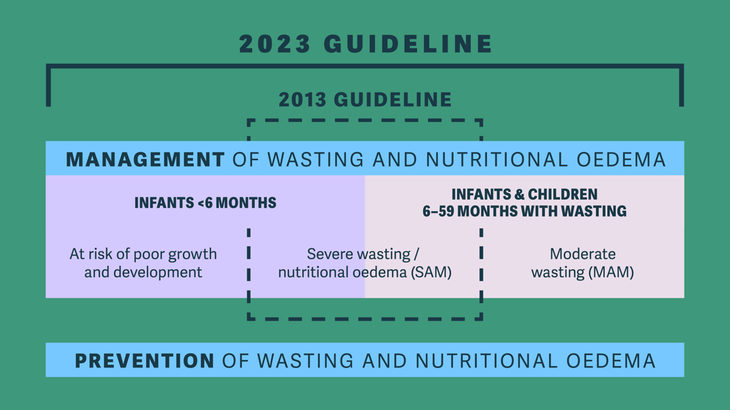
Scope of the guideline
Management section release: July 2023
Full guideline publication (management and prevention): Q3/Q4 2023

Slide 10

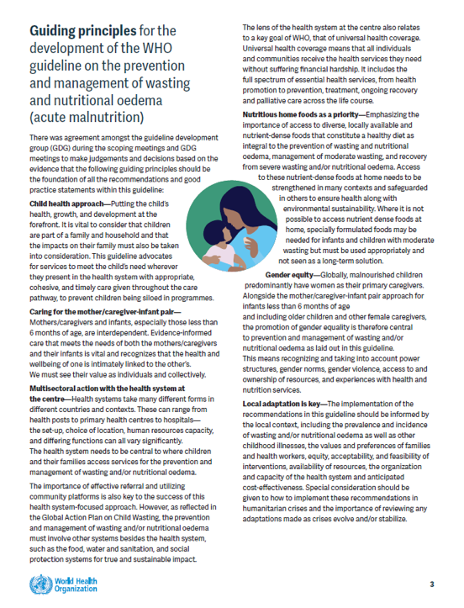
Guiding principles
  Child health approach
  Mother-infant pair
  Multisectoral action – Health system focus
  Nutritious home foods
  Gender equity
  Local adaptation
www.childwasting.org/normative-guidance
Notes:
Zita

Slide 11
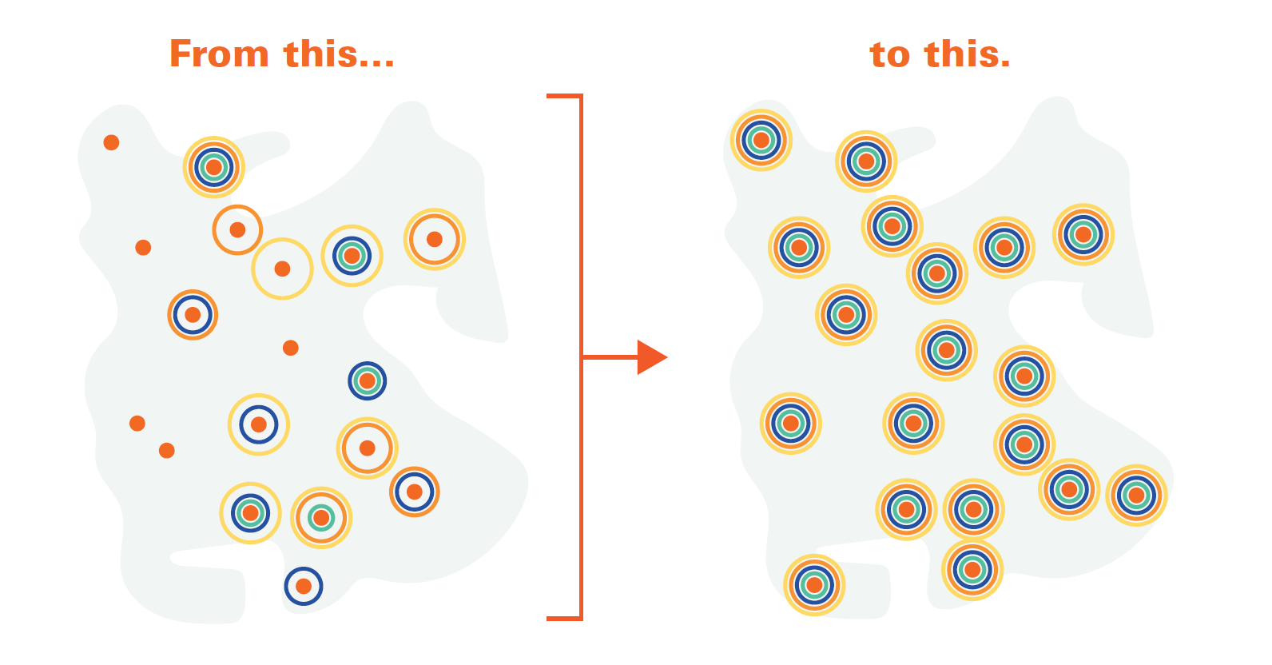
Child health approach
What does the child need?
  Wherever a child presents, they get ALL the services they need.
  We need to work together to support services which work around the child, and not programmes which we try to fit children and their families into.
Notes:
Zita

Slide 12

Sub-sections of the guideline
A. Infants less than 6m of age at risk of poor growth and development
B. Infants and Children 6-59m with wasting and/or nutritional oedema
C. Post-exit interventions after recovery from wasting and/or nutritional oedema
D. Prevention
Notes:
Zita

Slide 13
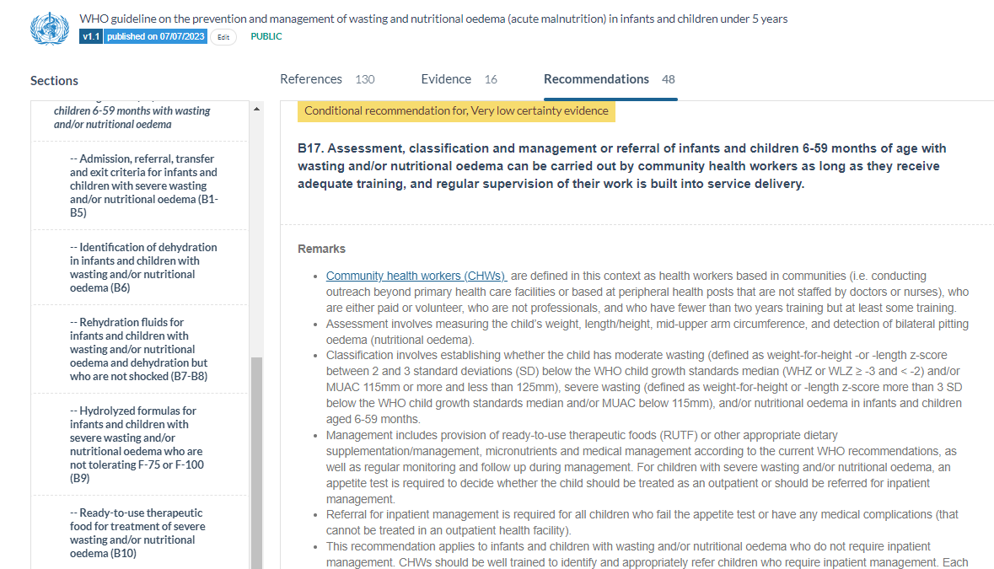

Read the remarks!
Interpretation
Implementation
Notes:
Zita

Slide 14
Section A:
Infants less than 6 months of age at risk for poor growth and development

Slide 15
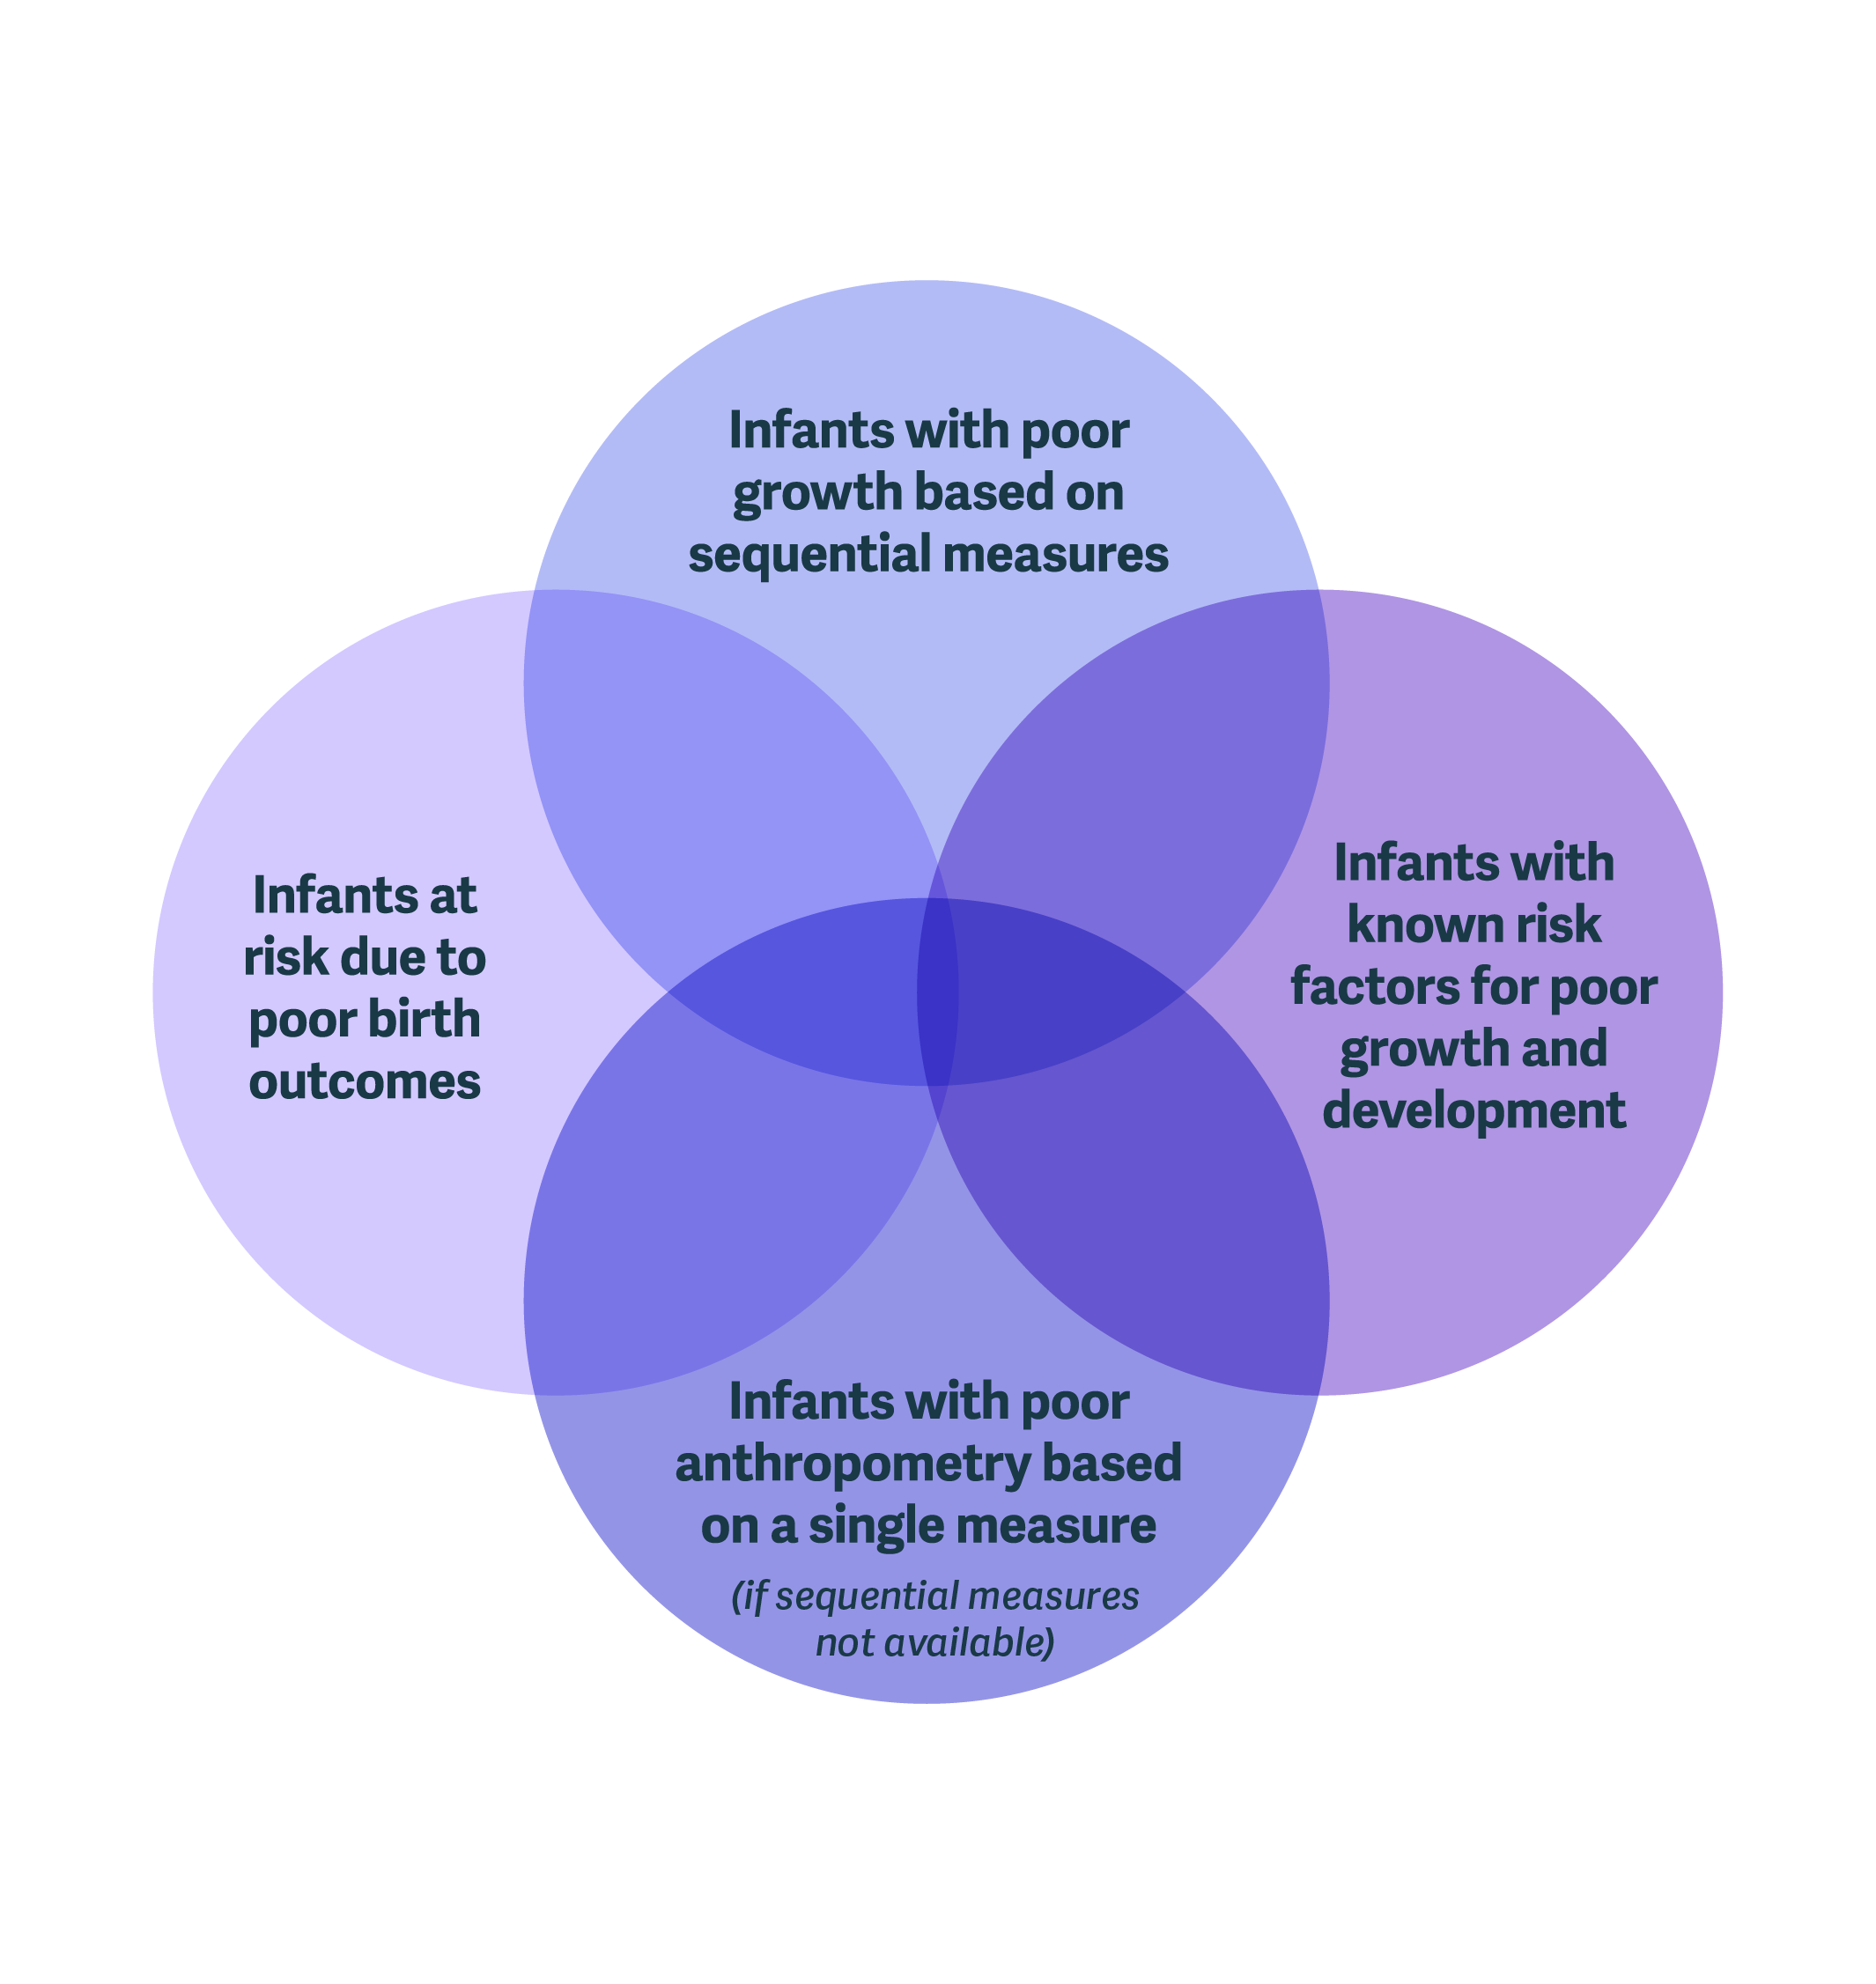
Section A:
Infants less than 6 months of age
at risk for poor growth and development
Criteria NOT definition
LBW
SGA
Preterm
MUAC <110mm 6w to <6m
WAZ <-2
WLZ <-2
Nut oedema
Notes:
Infants with poor growth based on sequential measures
No weight gain or weight loss from one measurement to the next; or
Downward crossing of weight-for-age centile lines¹; or
Insufficient weight gain (velocity standards² or grams/per specific time period³).
Infants with poor anthropometry based on a single measure
Weight-for-age z-score (WAZ) <-2 SD; or
Weight-for-length z-score (WLZ) <-2 SD; or
Nutritional oedema; or
Mid-upper arm circumference (MUAC) <110mm for infants between 6 weeks to less than 6 months of age.
Infants with known risk factors for poor growth and development
Neurodevelopmental concerns; or
Infant feeding concerns; or
Maternal risk (physical or mental health problem(s) affecting caring practices); or
History of hospitalization.
Infants at risk due to poor birth outcomes
Preterm birth; or
Low birth weight; or
Small for gestational age
¹≥1 growth centile space if birth weight <9th centile; ≥2 centile spaces if birth weight 9th-91st centile; ≥3 centile spaces if birth weight >91st centile.
² Less than 2 standard deviations (SD) below the median on the WHO growth velocity standards from one measurement to the next.
³ Approximately less than 500g/month, or if weekly measurements: birth to 3 months, approximately less than 150-200g/week and 3 to 6months approximately less than 100-150g per week.

Slide 16

Summary of recommendations and GPS
Mothers/caregivers and infants receive regular care and monitoring by health professionals
Criteria for:
    Inpatient admission
    Outpatient enrollment
    In-depth assessment (IP/OP?)
Reduced frequency of follow-up and final assessment at 6 months of age
Comprehensive assessments of breastfeeding challenges
Supplemental milk – decisions and types
Maternal support for physical and mental health and well-being
Medical problems defined

Slide 17
Section B: Severe acute malnutrition (SAM)
Notes:
Jaden

Slide 18
A few definitions
Glossary!
Nutritional Supplementation ➔ MAM
We are supplementing a child with MAM’s diet to meet their full nutrient needs for recovery – not providing SFFs to meet their full needs.
Nutritional Treatment ➔ SAM
We are providing RUTF in an amount to meet their full nutrient needs for recovery. We are treating them.
Notes:
Supplementary foods should be given to infants and children 6-59 months of age with moderate wasting to provide 40-60% of the total daily energy requirements (which are estimated to be around 100-130 kcal/kg/day from the normal diet, including breastmilk) to achieve anthropometric recovery.
Supplementary foods
Supplementary foods, for the purpose of this guideline, refer to – in order of preference – local/home foods which can be given to supplement the child’s diet so that they can recover from moderate wasting and continue to grow and develop in a healthy way, and if it is not possible to supply this type of local/home food, to then consider specially formulated foods (SFFs)
This needs to be added to magic app

Slide 19
SAM: Summary of recommendations and GPS
Emphasising importance of triage and overall health assessment
Criteria for:
    Inpatient admission
    Outpatient Enrollment
    In-depth assessment (IP/OP?)
    Transfer Inpatient to outpatient
    Exit from nutritional treatment
Dehydration assessment and type of rehydration fluids
Hydrolysed milks (IP)
Quantity of RUTF (constant or reduced)
Medical problems defined

Slide 20
Section B: Moderate acute malnutrition (MAM)
Notes:
Kirrily

Slide 21


Priorities for moderate wasting
Assessing and treating medical problems
Accessing appropriate specially formulated foods (SFFs)
Accessing nutrient dense home diet for healthy growth
IF NOT POSSIBLE
Notes:
PICO 1, 7, 8, 11, 12, 13, 14, 15, 16 – 8 questions – half
Q13 COVERS CHWS
‘which’ children
Specially formulated foods – optimal type, dose and duration
Dietary treatment of hospitalized children
Fluid management
Who is most at risk in this big group of children?
Who needs what?
Relevance to simplified approaches
Impact on ‘high risk of mortality’ conditions

Slide 22
MAM: Summary of recommendations and GPS
Not all children with MAM need a specially formulated food (SFF) to supplement their diet.
All children with MAM need a health assessment to rule out medical problems that could be the cause or main driver of the MAM.
All children with MAM need access to a nutrient-dense home diet to meet their energetic and nutrient needs.
Some children with MAM have risk factors which make them more likely to die or not recover than others.
These risk factors are related to whether they live in a high-risk context (such as humanitarian crises) as well as specific individual or social factors.
These factors can be used to consider which children with MAM should be prioritized to receive SFFs to supplement their home diet.
SFFs can be RUTF, RUSF or an improved fortified blended food.
All children 6-59m with MAM need ≈100-130kcal/kg/day to recover from MAM (non-malnourished ≈ 80kcal/kg/d). 40-60% of this should be covered by a SFF (if giving a SFF).
Notes:
Supplementary foods should be given to infants and children 6-59 months of age with moderate wasting to provide 40-60% of the total daily energy requirements (which are estimated to be around 100-130 kcal/kg/day from the normal diet, including breastmilk) to achieve anthropometric recovery.
Supplementary foods
Supplementary foods, for the purpose of this guideline, refer to – in order of preference – local/home foods which can be given to supplement the child’s diet so that they can recover from moderate wasting and continue to grow and develop in a healthy way, and if it is not possible to supply this type of local/home food, to then consider specially formulated foods (SFFs)
This needs to be added to magic app

Slide 23
MAM: Summary of recommendations and GPS
Not all children with MAM need a specially formulated food (SFF) to supplement their diet.
All children with MAM need a health assessment to rule out medical problems that could be the cause or main driver of the MAM.
All children with MAM need access to a nutrient-dense home diet to meet their energetic and nutrient needs.
Some children with MAM have risk factors which make them more likely to die or not recover than others.
These risk factors are related to whether they live in a high-risk context (such as humanitarian crises) as well as specific individual or social factors.
These factors can be used to consider which children with MAM should be prioritized to receive SFFs to supplement their home diet.
SFFs can be RUTF, RUSF or an improved fortified blended food.
All children 6-59m with MAM need ≈100-130kcal/kg/day to recover from MAM (non-malnourished ≈ 80kcal/kg/d). 40-60% of this should be covered by a SFF (if giving a SFF).
Notes:
Supplementary foods should be given to infants and children 6-59 months of age with moderate wasting to provide 40-60% of the total daily energy requirements (which are estimated to be around 100-130 kcal/kg/day from the normal diet, including breastmilk) to achieve anthropometric recovery.
Supplementary foods
Supplementary foods, for the purpose of this guideline, refer to – in order of preference – local/home foods which can be given to supplement the child’s diet so that they can recover from moderate wasting and continue to grow and develop in a healthy way, and if it is not possible to supply this type of local/home food, to then consider specially formulated foods (SFFs)
This needs to be added to magic app

Slide 24
Shift in focus
We are not ‘treating MAM’ – need to shift our language, policies and protocols
We are supplementing only 40-60% of the child’s needs – WE NEED TO ENSURE THE OTHER 60-40% IS COVERED!
The most sustainable approach is LOCAL/HOME FOODS ➔ GAP PARTNERS AND FRAMEWORK!

Slide 25
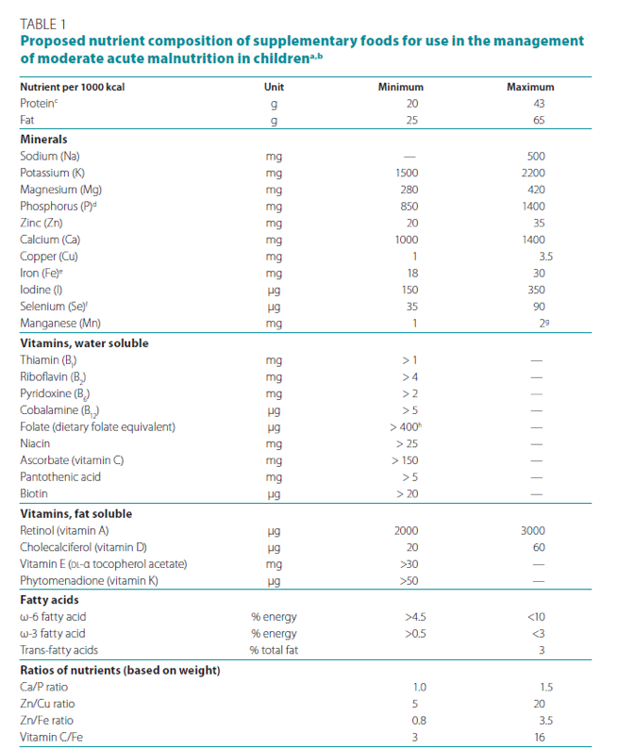
What advice can we give for a nutrient-dense home diet?
Energy:
Total daily energy requirements
100-130 kcal/kg/day to recover
Nutrients:
MAM Technical Note
NutVal? Other programmes?
Food rations?
Local Recipes?
World Health Organisation. Technical note: supplementary foods for the management of moderate acute malnutrition in infants and children 6–59 months of age. 2012
Notes:
PICO 1, 7, 8, 11, 12, 13, 14, 15, 16 – 8 questions – half
Q13 COVERS CHWS
‘which’ children
Specially formulated foods – optimal type, dose and duration
Dietary treatment of hospitalized children
Fluid management
Who is most at risk in this big group of children?
Who needs what?
Relevance to simplified approaches
Impact on ‘high risk of mortality’ conditions

Slide 26
Section B: Management by CHWs
Notes:
Kirrily

Slide 27

Management by CHWs
Recommendation B6 Assessment, classification, and management or referral of infants and children 6-59 months of age with wasting and/or nutritional oedema can be carried out by community health workers as long as they receive adequate training, and regular supervision of their work is built into service delivery.
  No adequate training and supervision = no CHW management of MAM or SAM
  Nutritional Supplementation for MAM
  Nutritional Treatment for SAM
kcal/kg/day
Notes:
CONDITIONAL recommendation
CHWs can ONLY supplement/treat children with MAM/SAM if they receive adequate
TRAINING
REGULAR SUPERVISION
Ops guidance – giving checklist of what needs to be in place BEFORE a CHW can supplement/treat children with MAM/SAM
If not possible, guidance will stand to assess, classify and refer for further management
country assessment
RUTF per kg - weighing

Slide 28
Section C: Post-exit interventions
Notes:
PICO 1, 7, 8, 11, 12, 13, 14, 15, 16 – 8 questions – half
Q13 COVERS CHWS
‘which’ children
Specially formulated foods – optimal type, dose and duration
Dietary treatment of hospitalized children
Fluid management
Who is most at risk in this big group of children?
Who needs what?
Relevance to simplified approaches
Impact on ‘high risk of mortality’ conditions

Slide 29
Post-exit interventions
Reinforcing the importance of a comprehensive approach to post-exit interventions
  Counselling and education
  Support to provide responsive care
  Safe WASH interventions
Psychosocial stimulation starting during treatment and continuing after exit
Cash transfers as an option for children who were admitted/enrolled with SAM to decrease relapse
  Assess feasibility & cost

Slide 30
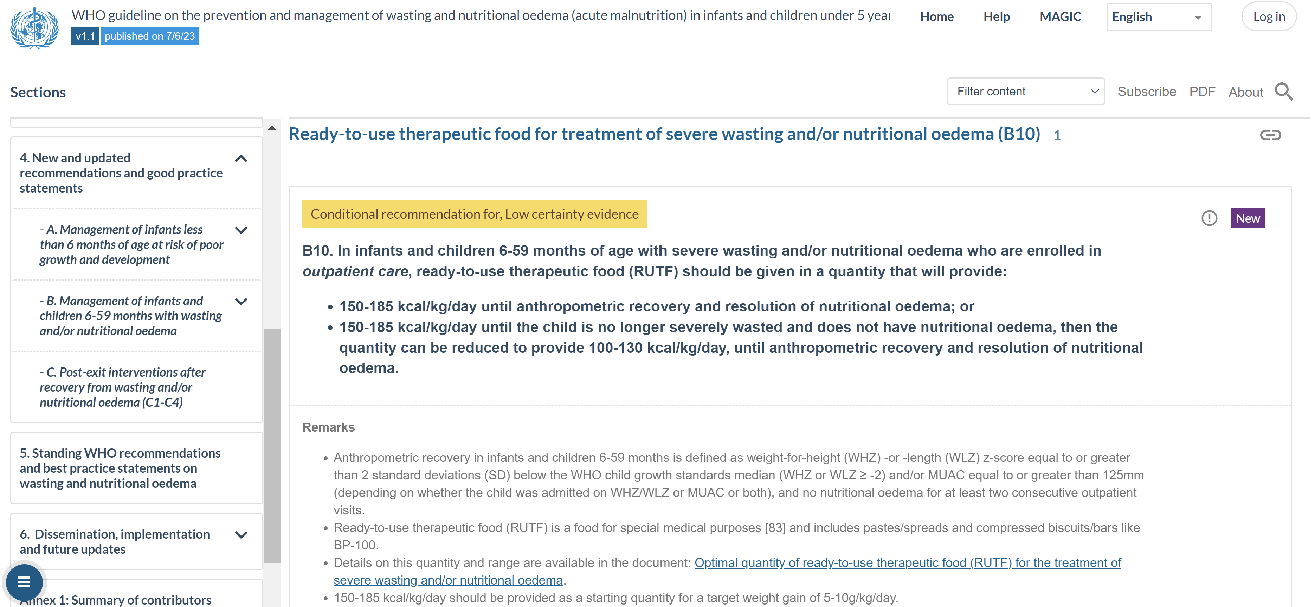
Publication on MagicApp
Full pdf with all sections Q3/Q4
Notes:
Allison

Slide 31
Next steps:
Operational guidance
Research gaps
Dissemination and implementation
Notes:
PICO 1, 7, 8, 11, 12, 13, 14, 15, 16 – 8 questions – half
Q13 COVERS CHWS
‘which’ children
Specially formulated foods – optimal type, dose and duration
Dietary treatment of hospitalized children
Fluid management
Who is most at risk in this big group of children?
Who needs what?
Relevance to simplified approaches
Impact on ‘high risk of mortality’ conditions

Slide 32
Operational guidance
Operational Guidance
Guidance for Policy-Makers
Guidance for Health Care Workers
Guidance for Programme Managers
Regional level
How to assess what is needed/
feasible in a context and implement the recommendations
National level
District level
Policy briefs
Advocacy materials and tools
Setting up and running services
Monitoring quality
Updated Manual in a modular format
Training tools
Clinical decision-making tools
Notes:
Tram

Slide 33
Health Worker Ops Guidance
Inpatient
CHWs
Outpatient
MAM
SAM
Infants <6m
MAM
SAM
Infants <6m
SAM
MAM
Prevention
Prevention
Prevention
Implementation Guidance
LBW/prem GL
Baby-Friendly
Hospital Initiative
INTEGRATION
IMCI
iCCM
WHO Pocket Book
Hospital Management
Notes:
Tram

Slide 34





Research
Identify research gaps
Identify important aspects of protocol design – Evidence to Decision making process (GRADE)
Notes:
Tram

Slide 35
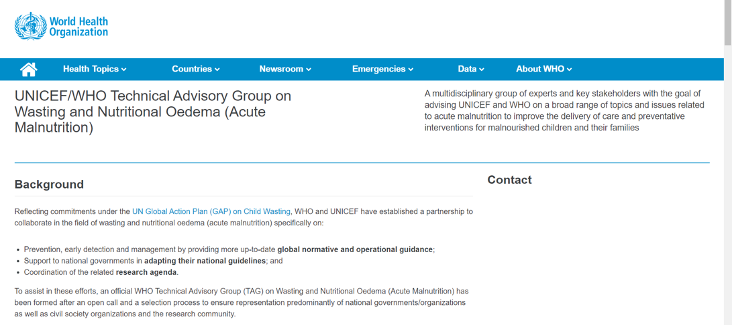
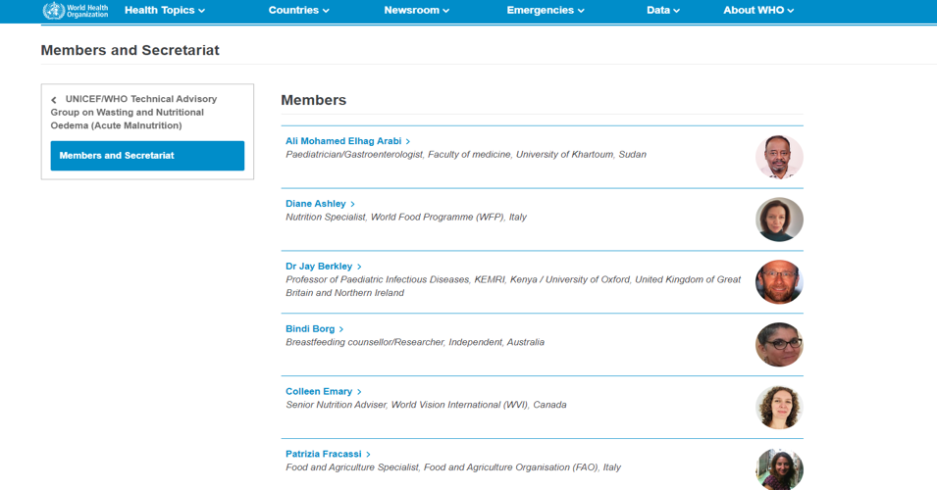
Core group = 19
Country representation and CSOs
Subgroups – ops guidance, research, CHWs, definitions and terminologies
https://www.who.int/groups/unicef-who-technical-advisory-group-on-wasting-and-nutritional-oedema-(acute-malnutrition)
Notes:
Tram

Slide 36
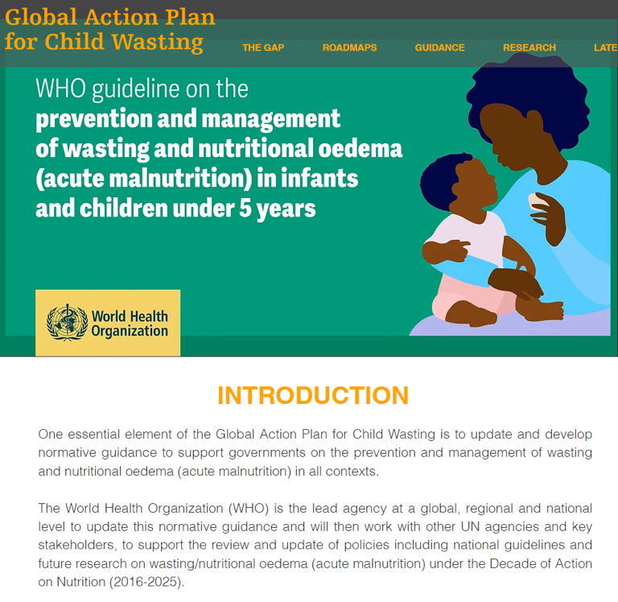


https://www.childwasting.org/normative-guidance
Notes:
Tram

Slide 37

Dissemination and local adaptation
Working with countries to integrate recommendations and operational guidance into national HEALTH AND NUTRITION policies, protocol and guidance (N4G Commitment)
With our UN partners – GAP
Stakeholder meetings regional and country
Notes:
Tram

Slide 38
Thank you for your attention!
Questions?

