Slide 1
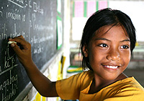
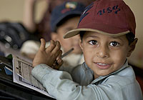

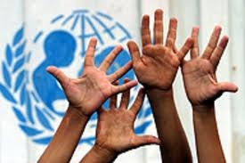
Education for Peacebuilding
June 2013

Slide 2
Why should Educators be interested in peacebuilding?
Over 1 billion children under 18 live in areas affected by conflicts and high levels of violence (often the countries furthest behind on achievement of MDGs)
The impact of conflict on children is multifaceted:
  killing, maiming, mental health
  child recruitment and use
  gender-based violence
  separation, trafficking and illegal detention
  long-term development and well-being
  reinforces inequalities
  long-term exclusion of youth and adolescents
HOWEVER, children and adolescents can make unique contributions to peace building on different levels

Slide 3
Peacebuilding – General Definition
Peacebuilding is essentially about conflict transformation, which means addressing underlying causes as well as consequences of conflict. *
United Nations Children’s Fund, Peacebuilding Literature Review (2011, May).

Slide 4
UN Peacebuilding ‘Areas of Intervention’
Support to basic safety and security
Support to political processes
Support to restoring core government functioning
Support to economic revitalization
Support to provision of basic social services
UNICEF (2011, December). The role of education in peace building. A synthesis report of findings from Lebanon, Nepal and Sierra Leone. New York: UNICEF, p. 9

Slide 6
Education and Peacebuilding
Education
Conflict-sensitive education (do no harm)?
Peacebuilding-relevant education that contributes to the transformation and strengthening relationships
Progressive?

Slide 7
Education: Connector or Divider?
Education is a connector when it contributes constructively to
social development, economic development, political development
identity formation of citizens
social cohesion and state-building
Education becomes a divider when
it is being provided inequitably to different groups
the curriculum is biased
Teachers and teaching methods that reinforce exclusion and stereotypes

Slide 8
Group Exercise
Provide three examples where the Education System serves as a Connector between people and groups
Provide three examples where Education is not conflict-sensitive, or ‘divides’ people or groups rather than ‘connecting’ them; AND suggest a remedy.
Time available: 30 Minutes;

Slide 9
OVERALL GOAL - PBEA
To strengthen resilience, social cohesion and human security in conflict affected contexts, including countries at risk of, or experiencing and recovering from conflict
Strategic Result
Strengthened policies and practices for education and peacebuilding in conflict affected contexts
Outcomes
1
POLICY
Increased inclusion of education into peacebuilding and conflict reduction policies, analyses and implementation.
2
INSTITUTIONAL CAPACITY DEVELOPMENT
Increased institutional capacities to supply conflict sensitive education.
3
INDIVIDUAL CAPACITY DEVELOPMENT of children, parents, teachers and other duty-bearers to prevent, reduce and cope with conflict and promote peace
4
PEACE DIVIDENDS Increased access to quality and relevant conflict sensitive education that contributes to peace
5
RESEARCH Increased contribution to generation and use of evidence and knowledge in policies and programming related to education, conflict and peacebuilding
Target Countries
West and Central Africa: Chad, DRC, Sierra Leone, Liberia, Cote D’Ivoire;
East and Southern Africa: Burundi, Ethiopia, Somalia, South Sudan, Uganda; East Asia & Pacific: Myanmar; South Asia: Pakistan; Middle East and North Africa: Palestine, Yemen

Slide 10
Group Exercise
As to conflict-sensitivity: How does Myanmar Education Policy need to adjust so that it can be called ‘conflict-sensitive?
What kind of learning is required to help education institutions in Myanmar work and perform in a manner that is ‘conflict-sensitive’? What kind of training in what kind of thematic areas?
What kind of education support do teachers, parents and children need to better cope with conflict and work towards peace?
What kind of population groups are most in need of access to education opportunities that facilitate peacebuilding? What kind of education supplies and facilities and resources are needed to strengthen conflict sensitive education?
What kind of peacebuilding challenge is not yet well-understood and should be researched further?
Time available: 30 Minutes

Slide 11
Big Picture
Linkages of education to other spheres
CESR

Slide 12
Education Programming Entry Points (EXAMPLES)
Peacebuilding Dimensions | Focus areas | Types of education programmes
Security | DDR (demilitarization, disarmament, reintegration) Security and police reform Community Safety | Emergency/humanitarian programmes Child protection Refugee/IDP education Schools as safe spaces
Political | Political institutions Truth and reconciliation processes National dialogue efforts Elections Political freedoms | Education sector reforms Education programmes about political / child rights Civic and citizenship education Involve youth in dialogue efforts Participation programmes Media education
Social | Institutional mechanisms for conflict resolution and social cohesion Community conflict transformation | Psycho-social support Education programmes about social and cultural rights Education for Social Cohesion
Economic | Transforming weak economies/”conflict economies” Addressing unemployment as a driver of conflict | Governance: commitment of national budgets for education Skills development Youth employment
Environmental | Scarcity of resources and resulting conflict | Disaster Risk Reducation
Adapted in part from UNICEF (2011, December)

Slide 13
Key elements of conflict analysis
Profile/Situation Analysis - snapshot
Causal Analysis – problem tree
Stakeholder Analysis – actors, relations, opportunities
Analysis of Conflict Dynamics – dividers and connectors, scenario planning
Prioritization process against criteria derived from CA
Notes:
Profile/Situation Analysis: Photograph of a given national or regional context, including political, economic and socio-cultural factors
Causal Analysis: Identifies and classifies existing and potential causes of tension or conflict and their linkage. This includes structural/root causes, proximate causes and conflict triggers. The ‘Problem Tree’ can be used for this exercise.
Stakeholder Analysis: Identifies critical local, national, regional and international actors that influence or are influenced by the conflict, analyses their perspectives (i.e. interests, needs, positions, resources) and their relationships (with one another, and with other entities), determines how to engage with such stakeholders and identify possible opportunities to act. A stakeholder ‘mapping’ and matrix is useful for this exercise.
Analysis of Conflict Dynamics: Analyzes the interaction between of different causes with multiple stakeholders, identifies ‘dividers’ and ‘connectors’ and helps identify windows of opportunity for appropriate programmatic response
Prioritization: A prioritization process is conducted in the context of multi-stakeholder, strategic planning processes. This uses criteria derived from conflict analysis findings. Importantly, this process promotes consensus-building and multi-stakeholder buy-in.
Refer to the fact that all of the above steps will be practiced during the workshop through practical exercises.

Slide 14
The Conflict Mitigation Outreach Pyramid
Level 1 (upper level)
· Military, political and
religious leaders who are
very much in the public eye
· Government representatives
· International organizations
Level 2 (mid-level)
· Respected figures in certain
sections of society
· Ethnic or religious leaders
· Academics, professionals
· Heads of NGOs
Level 3 (grassroots level)
· Local leaders, elders, teachers
· NGOs and social workers
· Women’s and youth groups
· Local health workers
· Refugees’ representatives
· Peace activists
Note: The conflict pyramid is based on the distinction drawn by John Paul Lederach (1997) between the upper, mid and grassroots levels of conflict management and peacebuilding.

Slide 15
Leadership Backup for Sustainable Peacebuilding
Sustainable peacebuilding can only be achieved…
… if change is backed up by leaders at different levels of society (different levels of the pyramid from the previous slide)
… if the interventions and support from the different levels are interconnected in a strategic manner
…if different national and international partners work closely together to achieve a common objective
Conclusion: Ministries needs backup of strategic partners to achieve peace building impact!

Slide 16
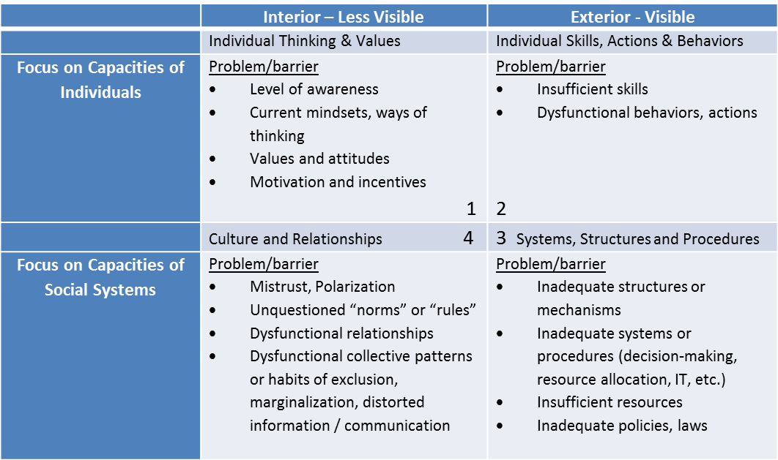
Enhancing Peacebuilding Capacity
Source: PeaceNexus (2010, September)

Slide 17

Questions?
Comments?

