Slide 1
Subnational Conflict and Education Assistance in Myanmar
Myanmar Education Consortium
January 15, 2014

Slide 3
Roadmap
Contested corners of Asia – key findings
Education in subnational conflict areas
Myanmar context – ethnic conflicts and education
Implications for MEC

Slide 4
Overview of the study
Purpose - Improve aid effectiveness in subnational conflict areas
Research Areas:
3 in-depth case studies (Aceh, Mindanao, southern Thailand)
Regional analysis of subnational conflicts and aid to these areas (south and southeast Asia)
Methods:
Perception surveys in SNC areas (n=1600)
Local level case studies, including political-economy analysis
Review of donor practices through interviews and review of project documents
Extensive mapping of SNC conditions

Slide 5
What is a “Subnational Conflict”?
Defined as armed conflict over control of a subnational territory, within a sovereign state
Primarily found in remote, border regions that are home to ethnic minority populations with a history of autonomous self-governance
Conflict usually driven by ethno-nationalist movements, who are in conflict with the central government or its allies and agents in the conflict area

Slide 6
Why subnational conflict matters for Asia
Most widespread form of conflict – affects half of countries in south/southeast Asia, 26 SNCs over past 20 years
Most enduring form of conflict – 45 years duration on average, by far the longest running form of conflict in Asia, among the oldest active conflicts in the world
Most deadly form of conflict– from 1999-2008, more people died in SNCs than all other forms of conflict combined

Slide 7
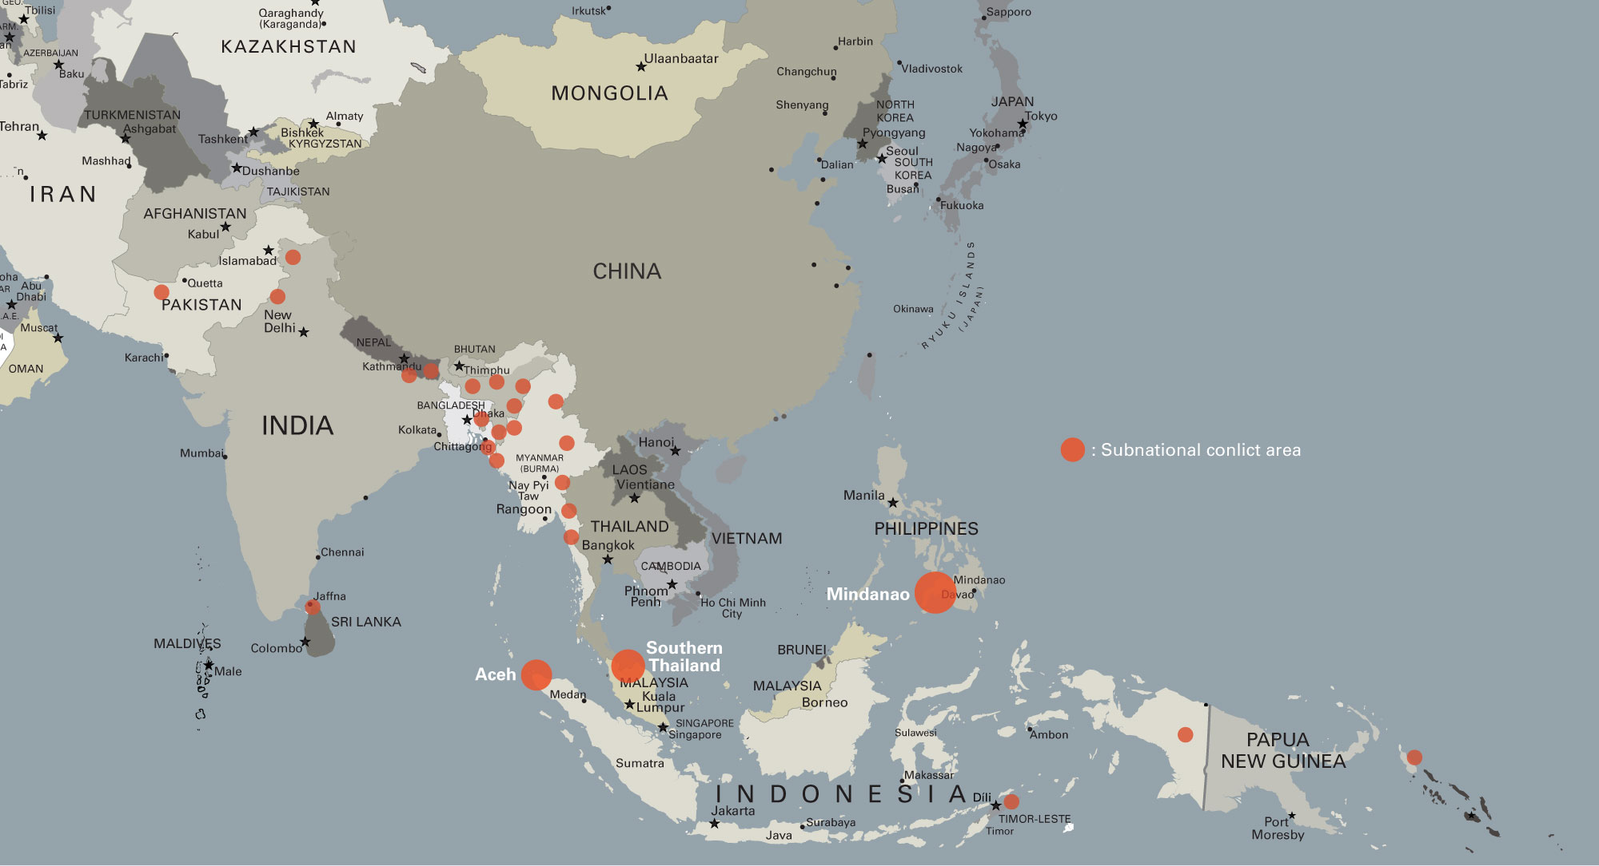
Subnational conflicts in South/SE Asia (1992-2012)

Slide 8
Subnational conflicts are different from fragile states
Key areas of difference:
 | Fragile State | Subnational Conflict
State Capacity | Weak states | Strong and weak states
Contestation fueling violence | Control of central government | Control of subnational territory
Some overlap:
Fragile states often have ethno-nationalist motivated conflicts in their peripheries
Of the 26 SNC’s in this study, only Nepal has clear overlap
Fragile states in the region:
Afghanistan (1979-present), Nepal (1996-2006), Timor-Leste (1999-present) and Cambodia (1970-1998)

Slide 9
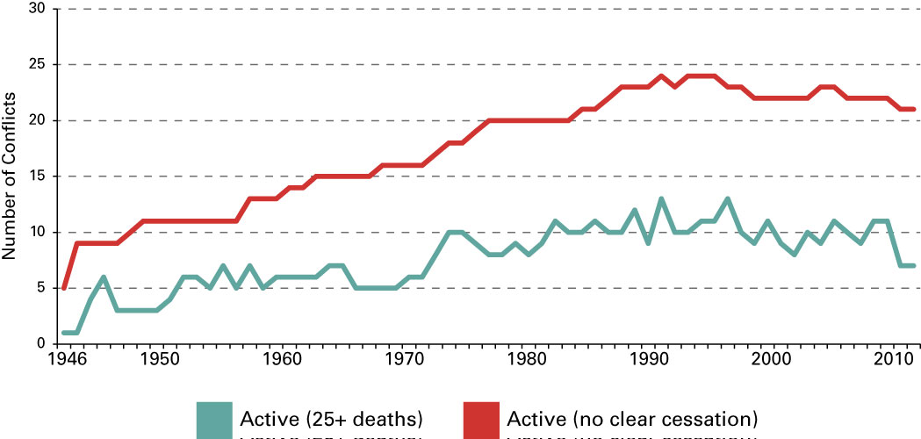
Steady build-up of SNCs over 60 years
Number of Internal Conflicts by Year (1946-2011)
Source: Uppsala Armed Conflict Dataset,
Heidelberg Conflict Barometer

Slide 10
Challenges to Conventional Wisdom
Economic growth, service delivery, democracy, and increased state capacity will NOT end subnational conflicts
State legitimacy—NOT capacity—is a core issue
Aid programs cannot avoid the highly-charged politics of a subnational conflict area
However, even traditional sectoral programs CAN help address conflict through encouraging key government reforms, and adjusting program design based on politics of the conflict

Slide 11
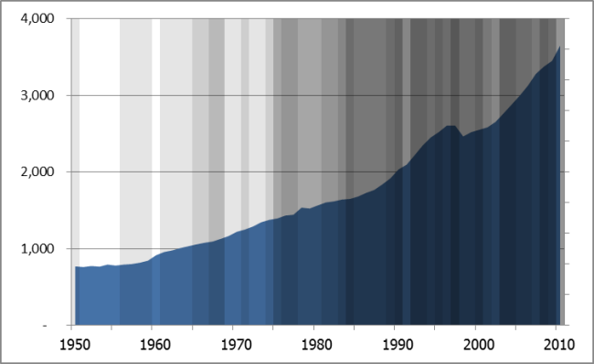
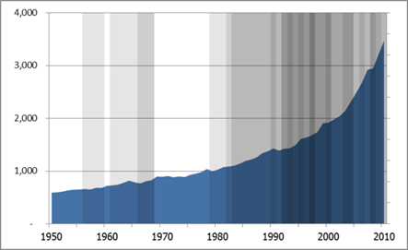
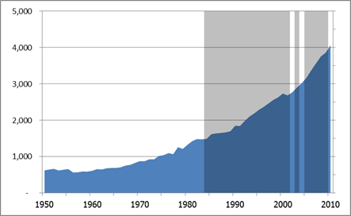
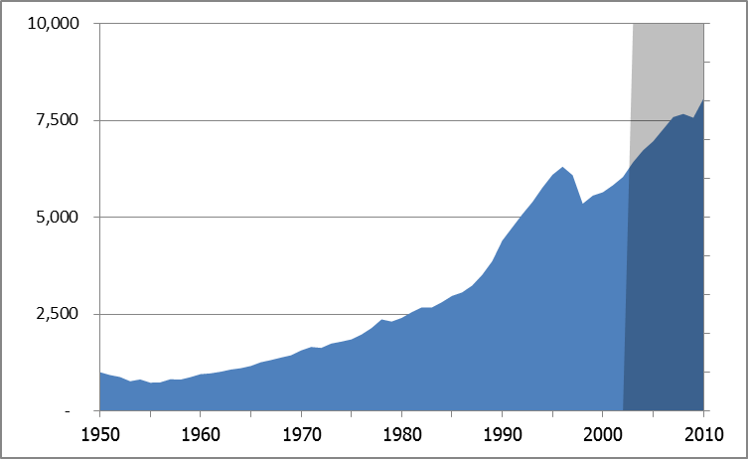
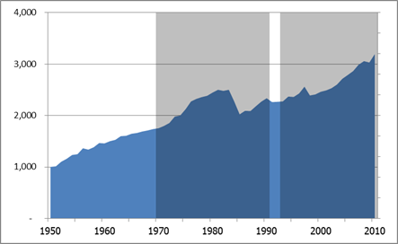
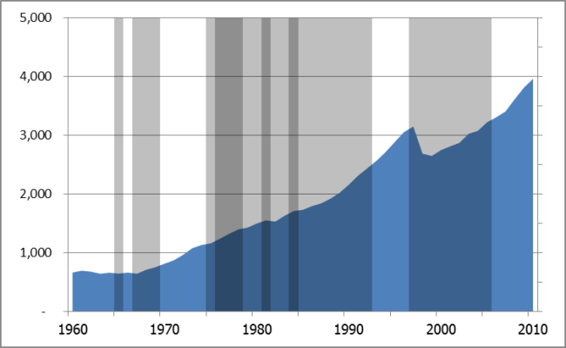
National economic growth has not ended SNCs
Comparisons of National GDP per capita and Active Subnational Conflicts (1950-2010)
Regional Composite
India
Sri Lanka
Thailand
Philippines
Indonesia
Source: Uppsala Armed Conflict Dataset, Penn World Tables (Heston et al.)

Slide 12
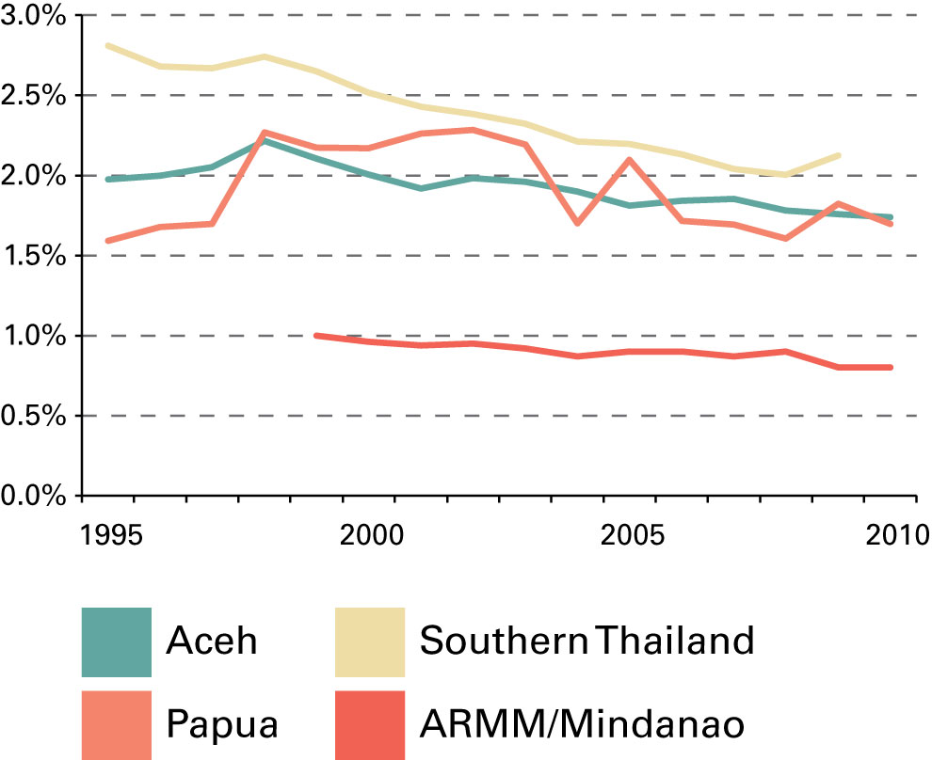
SNCs are not benefiting from national economic growth
Share of National Income (1995-2010), excluding capital city
Most SNCs show a declining share of national income over time
Within SNCs, benefits of growth concentrate in groups with connections to state
Creates perception of unfairness and marginalization

Slide 13
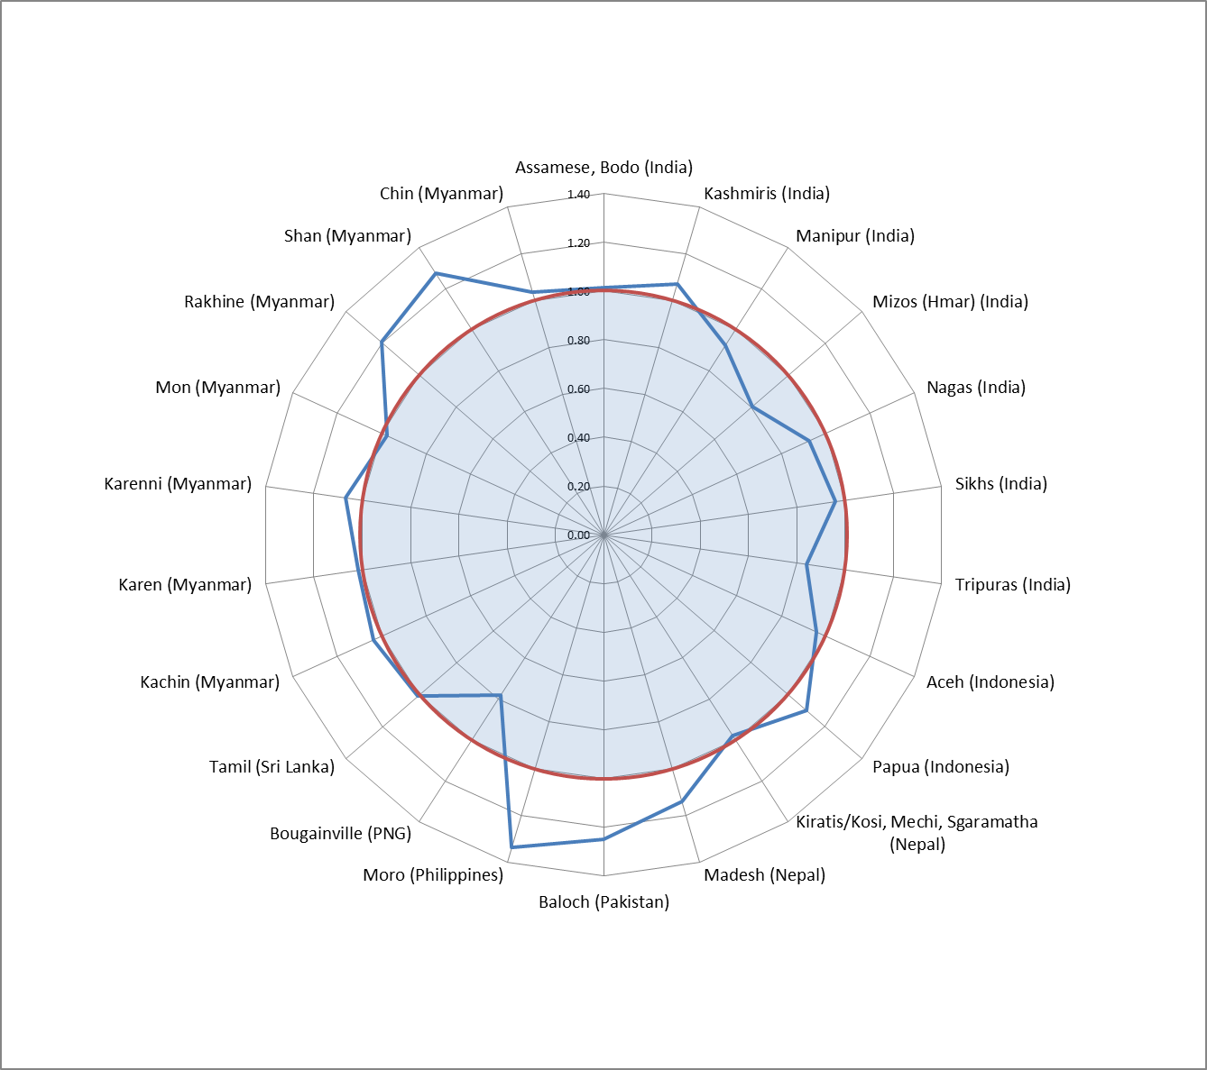
Some surprising results
Literacy Rate: Comparison of National average and SNC average
High levels of government (and local) spending on education
Schools often play a key role in socialization and identity formation

Slide 14
Key Findings (for our purposes today)
Contested Governance – why the ethnic minority areas are different from the rest of Myanmar
Transformational vs. developmental assistance – how programs can contribute to (or undermine) long term peace
Confidence building and stages of transition – why small investments in ethnic education can have a major impact at this critical time in the peace process

Slide 15
Contested Governance
“… active struggle over the presence, role, authority, and legitimacy of government actors and institutions in local governance.”
Contestation over governance is one of the primary drivers of conflict in these regions
A significant portion of the population (in SNC areas) may be unwilling (or unable) to rely on the state for key services
Implications:
Strengthening or extending state capacity is highly problematic
Reaching conflict-affected population usually requires non-state channels of delivery

Slide 16
Transformational vs. Developmental Strategies
 | Strategy | Outcome | Impact on conflict | Risks
Transformational | Confidence-building | Improved confidence in the transition to peace, and increased likelihood that armed actors will stop violence | Direct, immediate impact | Exaggerated expectations that cannot be met
 | Institution-transforming | More legitimate and effective processes, rules or mechanisms for improving security, justice, and jobs | Direct, short to medium-term impact | Backlash by some groups that benefit from status quo
Developmental |  | Reduced poverty, improved health and education (among others) | Indirect, depends on targeting and institutional changes | Benefits may exacerbate conflict if they are concentrated in one group, or lead to competition between local rivals

Slide 17
Transformational strategies
Building confidence of key actors in the transition to peace
Aid programs can play an influential role in shoring up confidence in a transitional process
Buy political space and time for institutional changes to make lasting contributions to stability and peace.
Not necessarily the same as confidence in the state or government
Transforming institutions that are directly related to the sources of conflict.
Adaptation (or establishment) of institutions that can change the dynamics that fuel contestation and conflict
In SNCs, usually related to identity group marginalization, inequitable service delivery, and abusive state practices

Slide 18
Restore Confidence
Transform Institutions
Consolidation
HIGHEST PRIORITY Implement/establish new self-governance institutions (S-M);
Expand local institutions that strengthen trust and social capital (I-E)
Broaden/deepen confidence in transition (S-M);
Local elites more confident in state security provision (I-E)
Accelerated Transition
HIGHEST PRIORITY
Bolster confidence in transition through intl. support (S-M);
Clear commitments to support crucial actors (S-M)
Establish transitional institutions (S-M);
Reform institutions that address local identity (S-M);
Strengthen local security institutions (I-E)
Fragile Transition
HIGHEST PRIORITY
Start politic al transition (e.g., negotiations) (S-M);
Reform key security and justice institutions (S-M)
Expand political space for debate on key issues (S-M);
Encourage public support for transition (S-M)
No Transition
S-M = State-Minority
I-E = Inter-elite

Slide 19
Education programs can be transformational
NOT arguing that all programs focus entirely on transformational outcomes
HOW we work matters as much as what we work on
Conflict sensitive approaches based on deep understanding of local political and conflict dynamics
Key challenges:
Automatic alignment with central government agenda may be problematic
Influencing government and non-state actors may be the most important outcome, but often requires building relationship through developmental approaches first

Slide 20
Education in subnational conflict areas

Slide 21
Why Education is so important in SNC areas
Education shapes identity – used by governments and armed groups to influence loyalties and beliefs of ethnic minorities
Minority language and culture - education can preserve (or undermine) minority language and culture
Reversing marginalization – people in SNC areas have major barriers to participation in national economy and politics

Slide 22
Contestation over education systems
State education system cannot reach some SNC areas – due to control by ethnic armed group, resistance/suspicion by local population, refusal of teachers and administrators to operate
State education policy reflects central government interests – education policy usually requires single language and curriculum
Parallel “ethnic” education systems – many SNC areas have education systems administered by ethnic armed groups
Education politicized and sometimes targeted – examples of state schools and teachers in SNC areas being threatened or targeted
Battles over curriculum – competing versions of history; religious symbolism and lessons

Slide 23
Supporting education in SNC areas
Aid programs cannot avoid the highly-charged politics of a subnational conflict area
Need for balanced assistance
Transformational aid:
Promotes compromise, reform, and engagement between factions
Supports models for compromise and complementary systems
Education that respects ethnic minority identity, culture, and language
Provide opportunities to hard to reach population
What to avoid:
Strengthening or extending state education system, without consent of ethnic minority
Promoting a unified service delivery system while the political negotiations are still ongoing

Slide 24
Myanmar context – Ethnic conflicts and education

Slide 25
Education in border states of Myanmar
Wide diversity of conditions at local level
MIMU map
TBC map
Mix of state and non-state providers
Some regions only covered by ethnic education systems
Most ethnic armed groups have ethnic education departments, with a long history of providing basic education
Ethnic armed groups put a high priority on ethnic education systems
NMSP letter

Slide 26
Types of organizations involved in education
Ethnic education departments - direct association with ethnic armed groups; highly symbolic role
Ethnic civil society organizations - closely affiliated with the ethnic minority group, do not necessarily have formal ties with the ethnic armed groups
External NGOs focused on ethnic minority areas – civil society groups based in Yangon focused on development and peace-building in the conflict-affected minority areas

Slide 27
Myanmar ethnic conflicts
Longest running conflicts in the world – more than 60 years
19 established ethnic insurgent groups
Reform process and the peace process are highly interdependent – failure of one could lead to collapse of the other
Fragile peace process over past 2 years, reaching new stage
Negotiations over a national ceasefire – could be a major turning point
Political negotiations over long-standing grievances seem likely in 2014
Fighting still continues in Kachin and Shan states

Slide 28
Inter-religious and inter-communal conflicts
Rakhine state –
Long-running tensions between Rakhine Buddhists and Rohingya
Overlapping inter-religious and state-minority conflicts
Potential for inter-religious/communal violence is high
2013 Anti-Muslim violence
Anti-Muslim violence across central Myanmar
Deep concerns over potential for more violence

Slide 29
Thank you
Report and data visualization available at:
www.asiafoundation.org/conflictstudy

