Slide 1
Myanmar Floods 2015
As of August 5th:
Sagaing | 101,442
Rakhine | 53,886
 | 38,422
Magway | 20,872
255,400 Affected Population
12 States
77 Townships
Bago
84% of the population in 4 states/regions
Chin – longer term impacts expected. Little information

Slide 2
Most affected Townships
59% of the population in just 10 Townships
Sagaing | Kale | 44,344
Rakhine | Buthidaung | 25,078
Bago | Bago | 13,808
Magway | Pwintbyu | 13,083
Rakhine | Ann | 10,254
Sagaing | Kawlin | 9,561
Bago | Shwedaung | 9,010
Sagaing | Wetlet | 8,387
Sagaing | Sagaing | 8,265
Sagaing | Kanbalu | 8,208

Slide 3
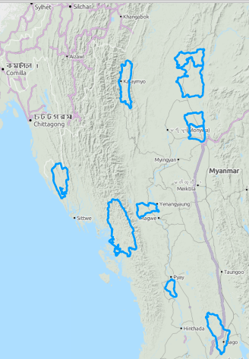
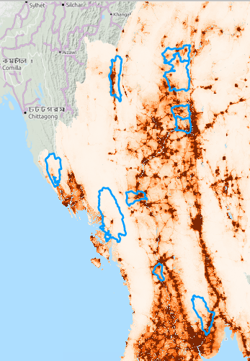
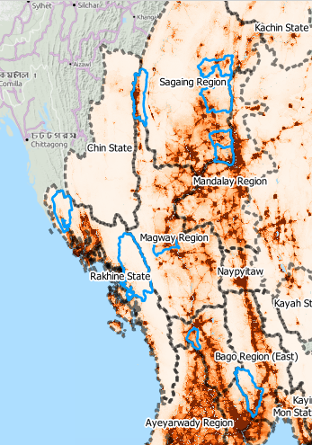
Myanmar Floods 2015
As of August 5th:
High Impact areas remain localized within townships
Floodwaters receding
Key information gaps
  Ann – Rakhine
  Bago
  Ayerwaddy

Slide 4
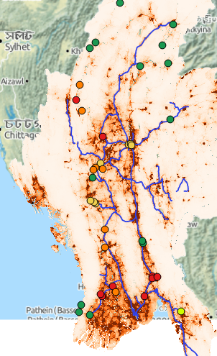
Myanmar Floods 2015
As of August 3rd
Not much rain!
River levels in lower delta increasing.
No new data from www.dmh.gov.mm

Slide 5
Myanmar Floods 2015
Forecasts from 3rd April

Slide 6
Myanmar Floods 2015
Latest
People not staying in camps for more than one week
Exceptions:
  Kale
  Hakha
Govt requests from international community:
  Focus on recovery – immediate needs at evacuation centres being met.
  Think cash assistance
Joint Assessments:
  Ayerwaddy
  Bago

