Slide 1
Village data collection by mobile
Phyo Kyi
ICT/Data Assistant
Myanmar Information Management Unit

Slide 2
Purpose
To collect current or new village location
Why?
Some villages from rural area doesn’t has GPS points yet.
It was around 20 percent
And then…
We make the village mobile app called (VPC) to collect the location (Mainly Village Pcode or Village Name, Latitude and Longitude)

Slide 3
Overview
Server
Written in PHP and Database is Sqlite
Satellite
Server
Internet
Internet
GPS Data
Mobile
SMS Relay
SMS
Mobile
Android 2.3.3 and over
Written in JAVA and Database is Sqlite
Preset Village Data over 60,000 record
Can Export to CSV,TSV,XML and HTML
Language: English, Myanmar (Zawgyi Default and Unicode)

Slide 4
What take?
New Village
Township PCode
Villagetract Name
Village Name
Altitude
Accuracy
Latitude
Longitude
Provider
Speed
Saving Time
Exist Village
Village PCode
Altitude
Accuracy
Latitude
Longitude
Provider
Speed
Saving Time

Slide 5
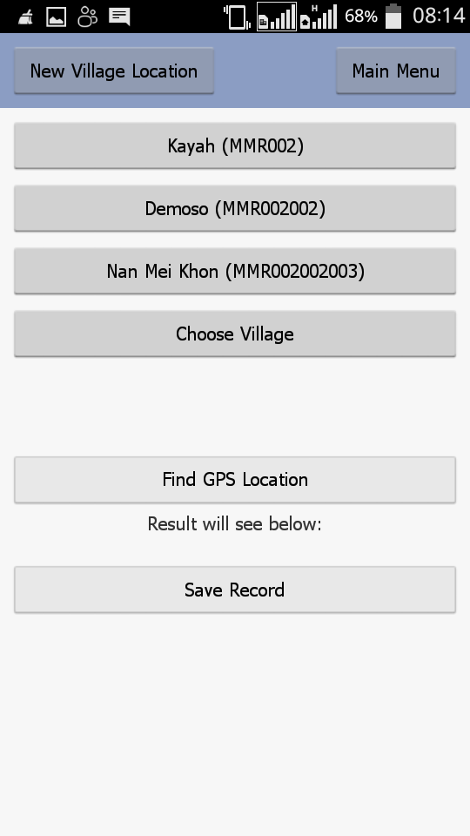
Pcode Lookup
PCode
With Alternate Village Name
Existing GPS Point Include
No GPS Point present yet

Slide 6
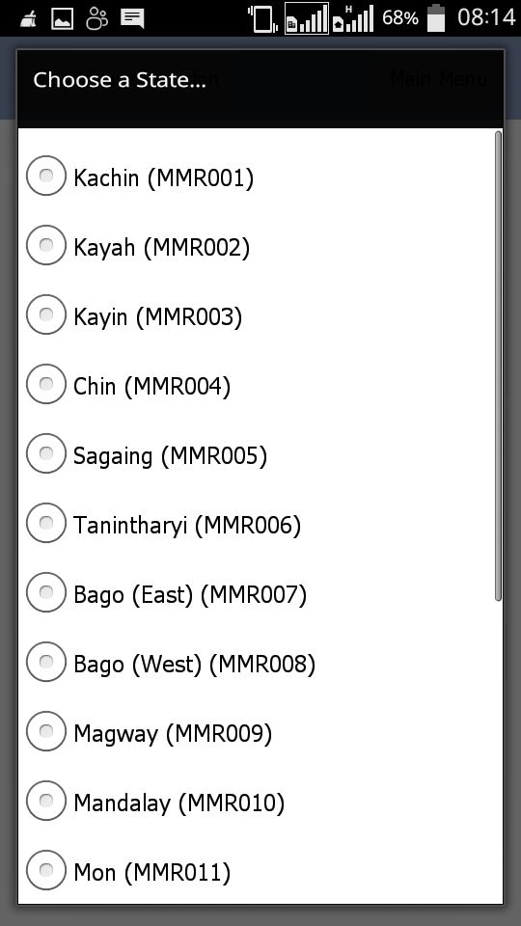
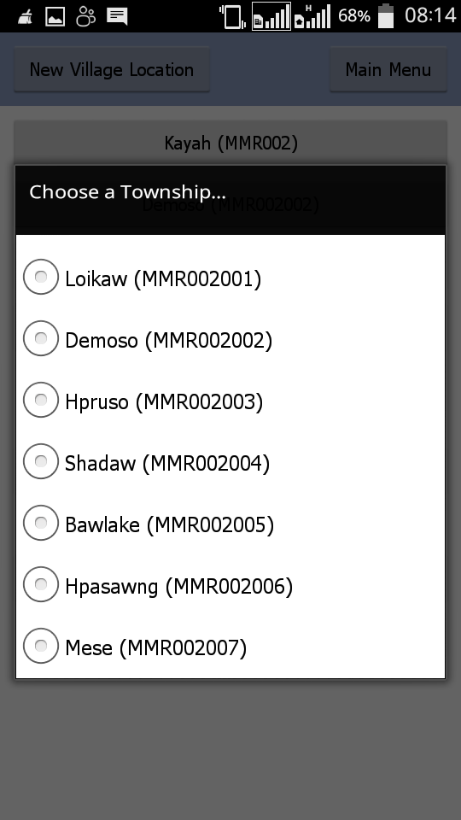
Pcode Lookup

Slide 7
Where can I get?
http://data.themimu.info/vpa/download.html
Note: still on beta version with expiration date and stable version will release at early March

Slide 8
Questions???

Slide 9
Thanks If you have questions or suggestions at future…. phyo.kyi@undp.org info.mimu@undp.org

