Slide 1
School location collector
February 25, 2015

Slide 2
What is it?
Satellite
School Location Collector is mobile tool which design to collect GPS location of schools.
SMS based apps
Programming Language: Java for Phone and PHP for Server
Compatibility: Android Phone Only (version 2.3.3 and over)
Language: English and Myanmar (Zawgyi, Unicode)
Contains preset data of schools (estimate over 50,000 records)
PHP
Server
Get GPS Location
Mobile
SMS or Internet
Android 2.3.3 and over only
Preset School data included
JAVA
English , Myanmar (Zawgyi, Unicode) supported…

Slide 3
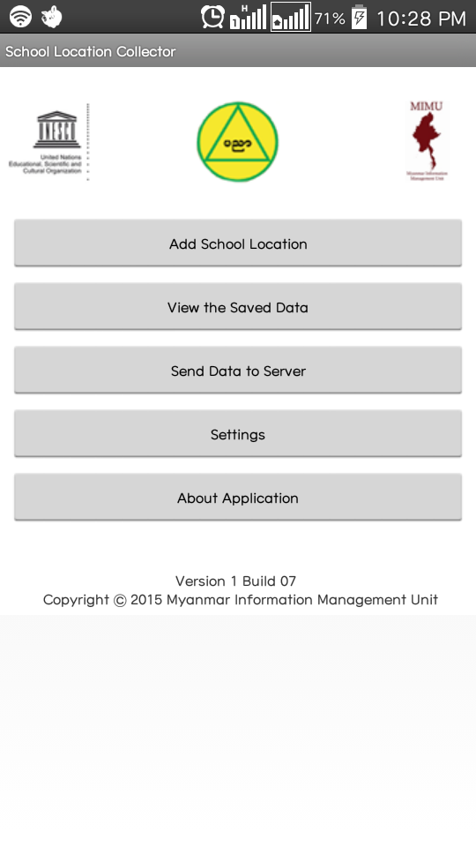
Get GPS location and save to Local Database
Add School Location
View the Saved Data in Tabular Format
View the Saved Data
Main
Sending the data to Server with Internet or SMS
Send Data to Server
Settings
Language Change settings
About
About Application
Activity (Form)

Slide 4
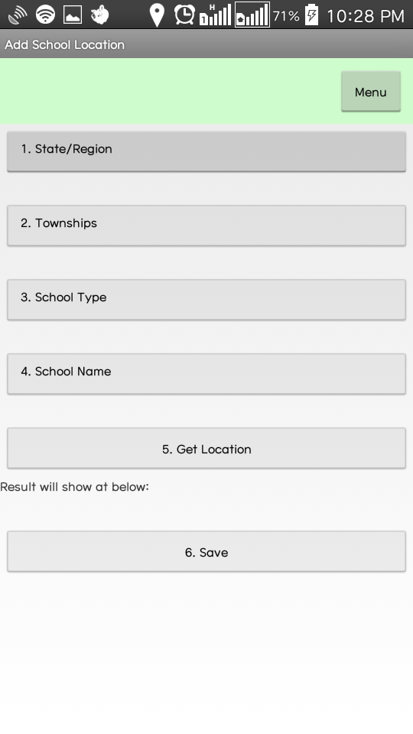
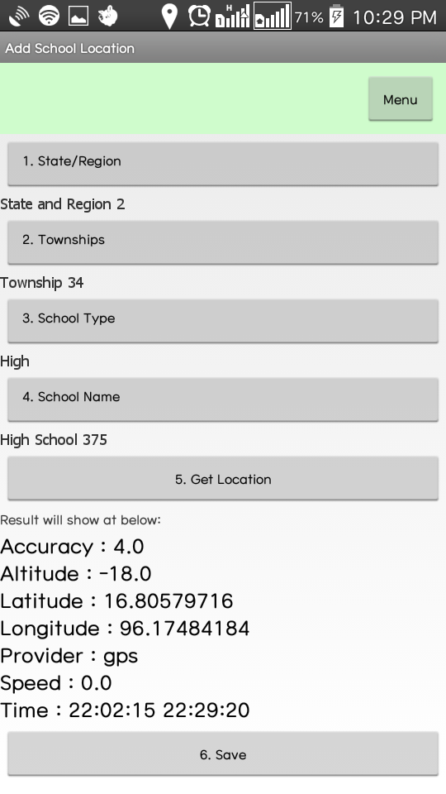
Add Location
Getting School ID (1-4)
Get Location (5)
Save Location (6)
Add
Get School ID from Preset Data
Get GPS Location
Save
Export CSV to System
Create or Update Database (Result.sqlite)
Export CSV to SD Card

Slide 5
View the Saved Data
View
Get Generated HTML from Database
Put the HTML form to web view
Table Chart create with HTML Format
Put web link to view at website (view.php with GET Method)
Put gps coordinate embedded link for Google Maps
Table which store at local database
Link which to view the uploaded files
GPS embedded link which will lead you to google maps

Slide 6
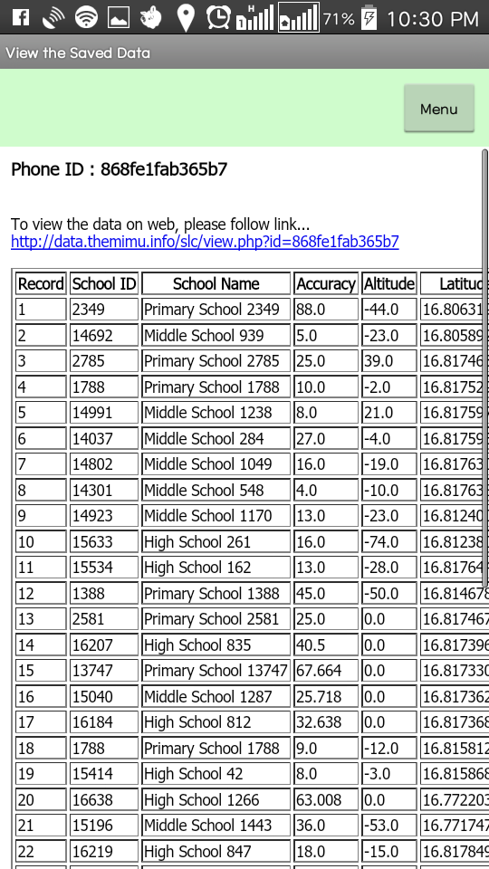
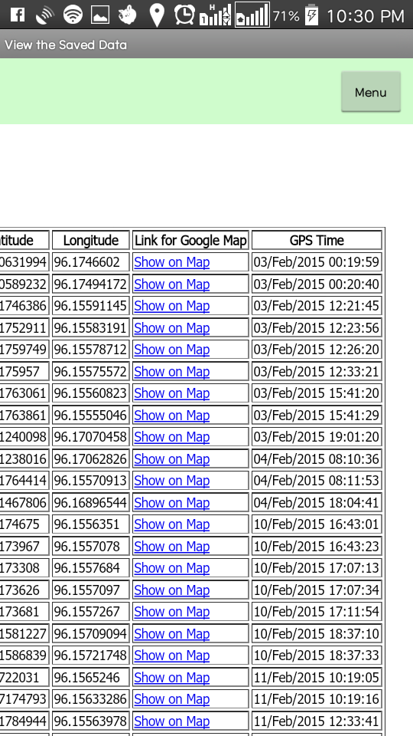

Slide 7
Send the Data
Send
Net
SMS
Upload CSV file
upload-net.php with POST Method
Export Data
All
SMS Server
upload-sms.php with GET Method
Separate Record
Export Data
Get Fom and To
SMS Server
upload-sms.php with GET Method
Export Data
Three ways
  Network (WIFI or Mobile)
    Mobile upload files
    Server (PHP) export dataset
  SMS
    Mobile send SMS to SMS Server
    redirect message to Server(PHP)
    Server(PHP) export dataset
  CSV
    Get CSV file from Phone’s SD Card
    Send email by manually
    Manually export dataset

Slide 8
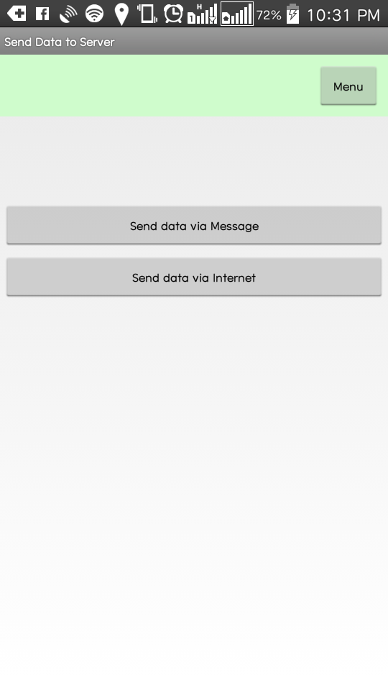
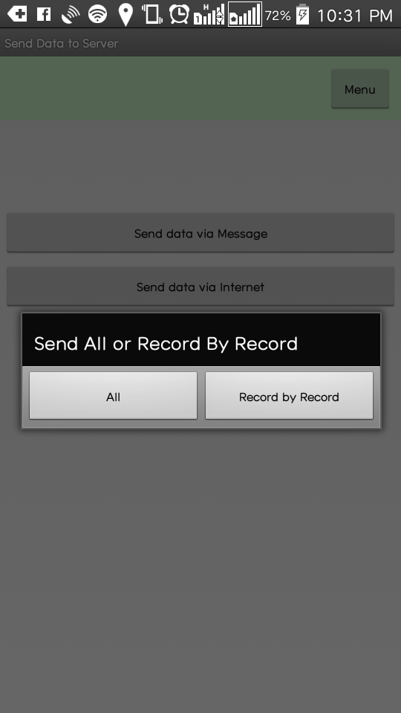
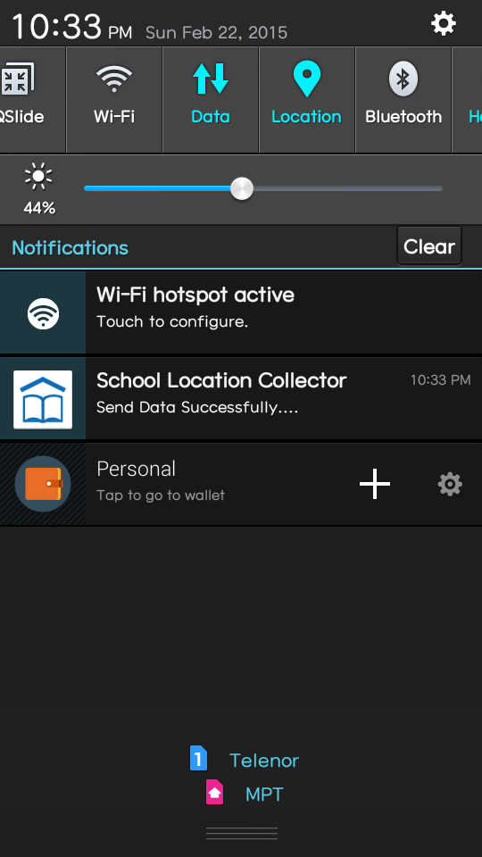
Send Activity (Form) with Two Button one for Internet and Another one for SMS
SMS Send method choose: All or Record by Record
Notification shown when sending via Internet success

Slide 9
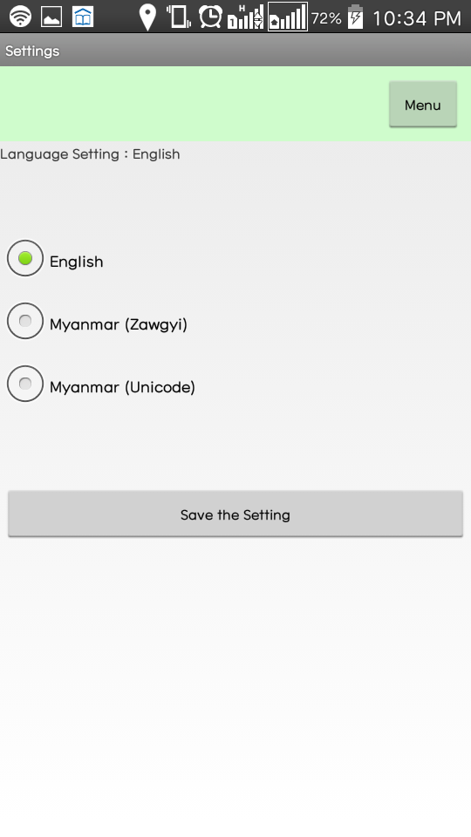
Language Setting
English
Myanmar (Zawgyi)
Myanmar (Unicode)

Slide 10
Future Development
Delete function to view page
“Add New School” Function for new or change schools
User Log In Screen
Verify List sync with Server

Slide 11
Any Question?

Slide 12
Thanks !!!

