Slide 1

Results MEMS
Nay Pyi Taw, 29 May 2018
John Rand, Finn Tarp, Neda Trifkovic

Slide 2
Introduction
Towards inclusive development in Myanmar
Myanmar Enterprise Monitoring System (MEMS) – Strong focus on MSMEs
Evidence supporting the government in implementing relevant industrial policies
Results presented are based on the first quantitative survey of manufacturing enterprises in Myanmar and their employees – matched employer-employee data.
Breadth of information unprecedented

Slide 3
Sample
A representative sample of 2,496 enterprises and their 6,722 employees
  176 rice mills; 381 informal firms; 1,939 formal firms
  Covering 35 townships in all states/regions.
The sample is statistically representative of more than 71,000 manufacturing firms in Myanmar.
Formal and informal firms
Matched employer-employee dataset
Face-to-face interviews took place in June and July 2017 – re-visits during the fall 2017

Slide 4
Types of constraints to growth

Slide 5
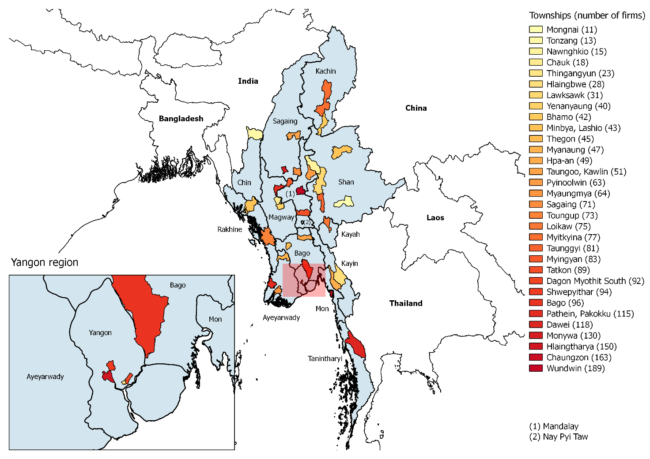
Proximity
Manufacturing activity follows the topographical circumstances of the country
Enterprises appear to be taking advantage of agglomeration benefits in the form of industrial zones and clusters
But significant infrastructure challenges identified

Slide 6
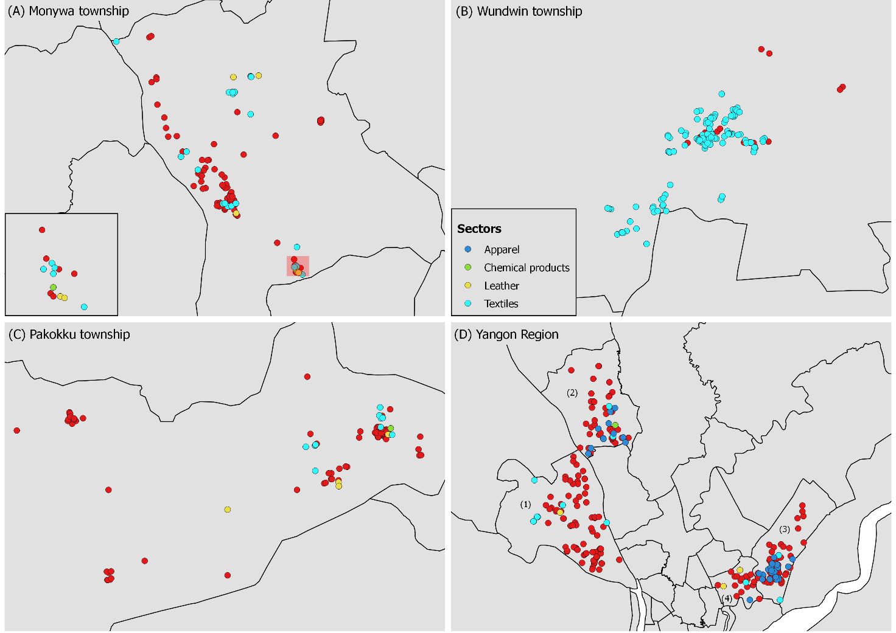
Fragmented Value Chains
Apparel and textiles firms are rarely located close to each other (and limited range of activities in the garment sector
Metallic and non-metallic mineral production are more prone to industrial clustering
Cut-make-pack versus free-on-board production systems?

Slide 7
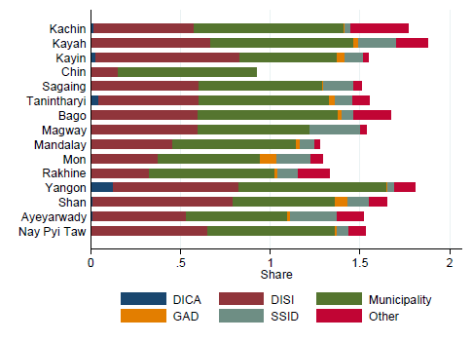
Informality and Taxes
The regulatory environment is complex and dispersed among several institutions
Formalization rates quite high (84%) – but the rate of registration with the Directorate of Investment and Company Administration (DICA) relatively low
Taxes and formality? 68% informal firms (instead of 16%) if “pay corporate taxes” is added to the definition.
95% pay fees (municipal level) – but adherence to tax regulation is weak
Most employees do not have labor contracts

Slide 8
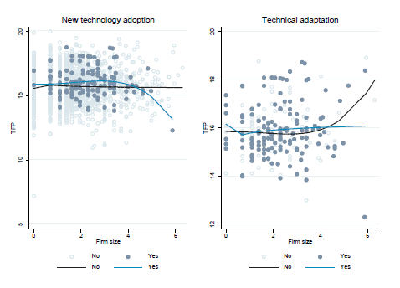
Innovation and knowledge transfers
High levels of specialization – vulnerability?
Innovation rates low. (6 per cent)
New technology adoption and technical adaptation not related to productivity improvements.
Utilized technology relatively basic – Fewer than 20 per cent of the enterprises have acquired technology through imports.
Scope for international knowledge transfers significantly lower than in many other Asian countries.

Slide 9
Risk, Gender and Investments
80% of surveyed firms are owned by men.
Females display lower willingness to take risk.
  Risk strongly correlated with investment probabilities and firm performance
Business practices, measured as a combination of marketing, buying, record keeping, and financial planning practices, are found to positively affect firm productivity.
  Female entrepreneurs are less likely to rely on business practice upgrading.

Slide 10
Access to Credit
Compared to other comparable Asian countries very little unfulfilled demand for formal finance is met through informal loans.
Most new investments come through retained earnings.

Slide 11
Market Structure and Concentration

Slide 12
Wages by Firm Size and Formality Status

Slide 13
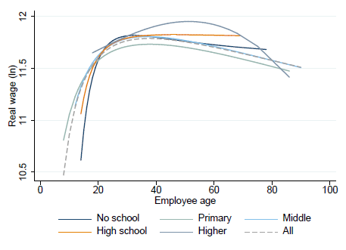
Wages and Education
Employees with post-secondary education earn higher wages than others.
No difference between uneducated and workers with primary school education.
Only premium for skills over lower-level formal education in the labor market.

Slide 14
Gender Gap in Wages
Female employees receive on average 23 per cent lower wages.
Most of the gap is unexplained suggesting significant wage discrimination against women in the labor market.
Unobserved firm level differences (fixed effects) can account for the differences in wages between female and male employees.

Slide 15
Conclusion/Policy Recommendations (1)
1. Reduce bureaucratic obstacles and improve coherence among different government authorities.
Streamline procedures for business registration, which requires great coordination effort of different line ministries.
Have different licensing and registration services under one or as few government authorities as possible with ‘one-window’ offices in all townships to facilitate business registration.
  Where not available, establish at least movable offices to assist businesses with registration and tax payment.
Create a culture of trust in the government by showing a return for taxes paid. (Transparency)

Slide 16
Conclusion/Policy Recommendations (2)
2. Improve access to services.
Improve access to credit
  simplify procedures and conditions for obtaining loans, introducing longer-term loan options, cutting the loan-processing time, activating more loan programs aimed at small and medium enterprises (SMEs), and opening additional bank branches in smaller townships.
Increase efforts related to disseminating information about loan opportunities and requirements throughout the country to improve equality of opportunity.
Strengthen the formalization of property rights, such as in relation to private property ownership and land titles, which would improve both access to formal loans and investment security.
Scale up investments and improve access to public goods, such as electricity, water, and transport infrastructure.

Slide 17
Conclusion/Policy Recommendations (3a)
3. Support technical and innovative capacity of firms to improve growth and foreign market access.
Improve access to modern technology
  streamline import procedures or opening special lines of credit or grants for this purpose to yield more efficient production processes.
Subsidize R&D efforts or provide tax deductions for purchases of new technology, new product development, and certification according to international standards. Positive externalities may be significant
Support development of industry clubs or associations that could link more and less-successful entrepreneurs in sharing knowledge and market information.
Simplify export procedures related to registration, licensing, and customs requirements, preferably by relaxing existing product-specific restrictions and opening a ‘single-window’ service.

Slide 18
Conclusion/Policy Recommendations (3b)
Improve dissemination of information about export and import procedures, permits, and licenses.
Support logistics services and infrastructure, as well as use of internet and online commerce platforms through public investment, service-sharing initiatives, and training.
Overcome geographic dispersion and language barriers by establishing an intermediary body between international customers and producers within Myanmar

Slide 19
Conclusion/Policy Recommendations (4)
4. Facilitate development of better working conditions.
Support for better working conditions, education, and employee training should become a key part of policies for improving enterprise performance.
Continue the expansion of social security, public health insurance, and pension programs.
Improve efforts for disseminating information about social protection, insurance programmes, and labor laws, so both employees and employers become better informed about their rights and obligations.
Increase support for higher education, vocational programs, and off-the-job training targeted at developing industry-relevant skills and more general management and public administration knowledge.
Introduce tax exemptions for firms that pay for the education and training of their employees – especially if the training is embedded within the worker (and not specific to the firm).
Develop and support gender-based training initiatives to address the challenges facing female-owned firms.

