Slide 1
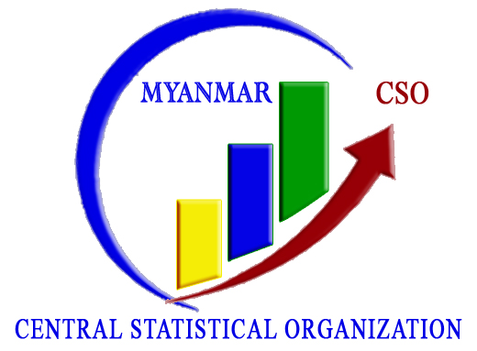
Outline and Objective of MSME Survey (2017)
Dr. Wah Wah Maung
Director General
Central Statistical Organization
29th May 2018
Office No. 32, Nay Pyi Taw

Slide 2
Background
The Role of Private Sector in Myanmar Economy
Important and vital for the Myanmar economy
Support the inclusive and sustainable growth of economic statistics in Myanmar.
98% of the enterprises are MSMEs in Myanmar
Myanmar Sustainable Development Plan ( MSDP), 12 Points Economic Policies
Helping the Data Base and Policy Analysis : necessary preparation for the implementation of Myanmar Enterprise monitoring System (MEMS)
Part of the NSDS
To conduct 2 qualitative Micro, Small and Medium Enterprises (MSMEs) Surveys and 2 quantitative (MSMEs) Surveys for this project
Implementation led by Central Statistical Organization in cooperation with UNU-WIDER, with support of th Government of Denmark ( Aid Effectiveness and Development Effectiveness)

Slide 3
Objectives
Objectives of MSME:
To develop the necessary national capacity for data collection and analytical activities related to the SME sector in Myanmar
To identify the SWOT of SMEs and improve policy making on MSMEs and the Economy especially (GoM’s capability to appropriately address key development challenges associated with the country’s SME development)
To establish database of the SMEs information and capacity building

Slide 4
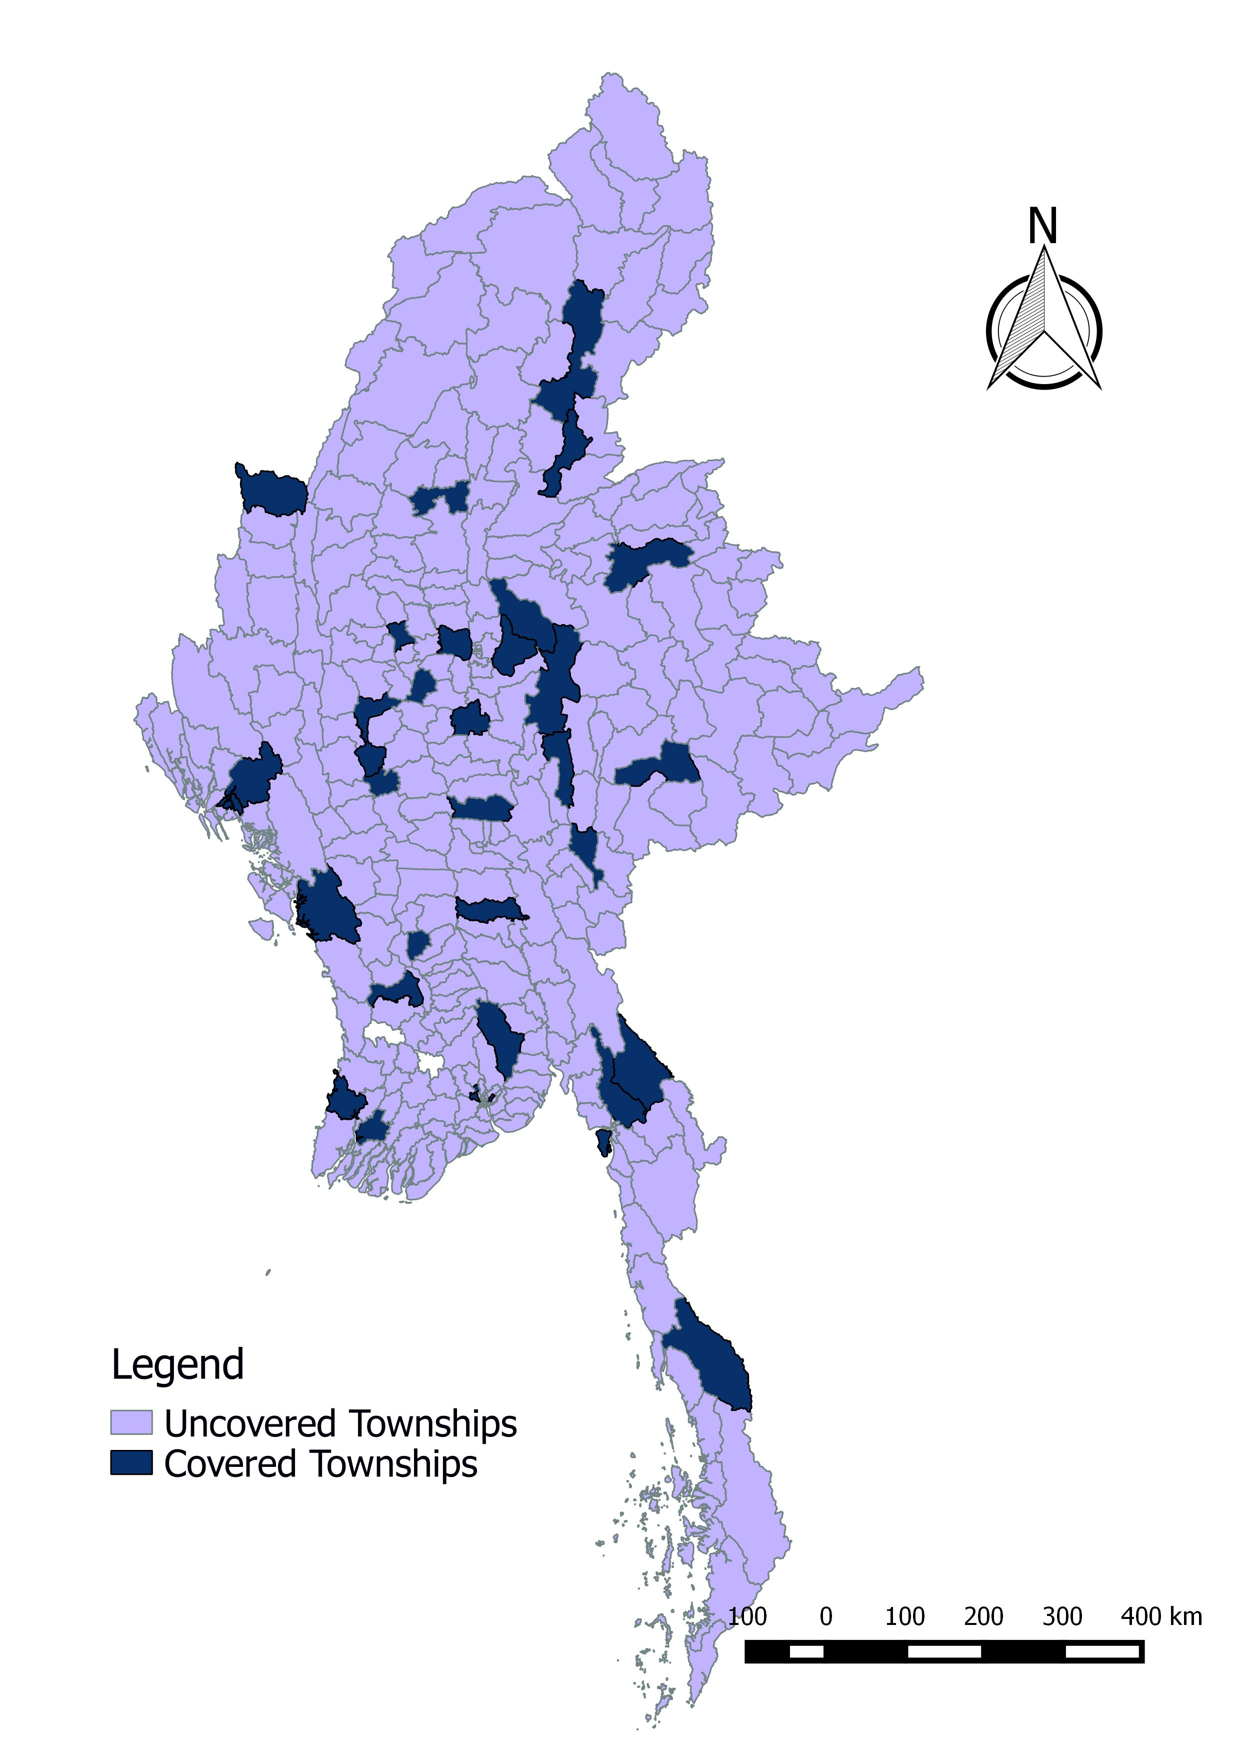
Key technical facts & figures
Covers manufacture sector the entire country, all states and regions as well as the Nay Pyi Taw Union Council
Nationally representative sample of almost 2688 firms in manufacture sector
Data collection in June/ July 2017
35 field townships within15 States & Regions (15 supervisors, 75 enumerators)
Data entry 2496 Firms and their 6722 employees in manufacture sector

Slide 5
Preparation of the Survey and data collection process
The questionnaire used in the survey contained question on:
Business practices; Owner characteristics ; Production and technology characteristics;
Sales and cost structure; Access to finance;
Taxes, Employment, Networks;
Economic constraints and potentials
The pilot test was conducted in Yangon, Mandalay, Pyay, Nay Pyi Taw
Supervisors from all 15 regional CSO branch offices were trained by UNU-WIDER experts on the methods of data collection through quantitative survey.
The core survey team comprised 15 supervisors from CSO regional offices and 76 enumerators.

Slide 6
Challenges
Enumerators faced a lot of replacement issues due to outdated information on the frame lists
Difficult to make an appointment with the firms' owner or manager
Take time to ask the respondents due to the questionnaire is long
Necessary to take more time for the training and pilot survey

Slide 7
MSMEs survey results highlight the status of the businesses
Characteristics of the business
Challenges
Financial status
Customers-suppliers relationship
Business management
Constraint in business development
Labor force
Sales structure

Slide 8
Summary of Findings (1)
Topographical Circumstances: Most of economic activity is concentrated in the central lowland strip down to the coast in the south
Infrastructure conditions: 13 percent of firms are not access to electricity and 80 percent of firms are not access to public water. Only 5 percent of firms are access to internet.
Business Registration: Rate of registration with the DICA is only 3.5 percent.
Taxes: Only one-third of enterprises pay the corporate income tax.
Informal employment: Wage and productivity level of informal firms are lower performance with formal firms.

Slide 9
Summary of Findings (2)
Technology Characteristics: Rely on hand tools and old, second-hand machinery. Enterprises tend to specialize in producing a single product. 3 percent introduce new products and 12 percent improve the existing ones.
Ownership and Management Characteristics: About 80 percent managed by men. Females are lower performance of their enterprises than males.
Labor market structure: Only 2.6 percent of firms normally train workers. Highest wage level for production workers is in Mon State.
Credit: Around 40 percent of firms are credit rationed or constrained. 12 percent of small and medium firms apply for credit.

Slide 10
Future Work Plan(2018-2019) (1)
Period | Activities | Implementing Agencies
'30-5-2018 to 1-6-2018 | TOT training for Hand-on Experience Workshop | CSO
Second week of June | Training for enumerators (State & Region) for1 day
25-6-2018 to 29-6-2018 | Implementation of Qualitative survey / Interview transcription and translation (5 day) | CSO & UNU-WIDER
July | Game Intervention Training and pilot for 3 days | CSO & UNU-WIDER
'12-8-2018 to 18-8-2018 | Implementation of Qualitative survey / Interview transcription and translation (1 week) | CSO & UNU-WIDER
9/1/2018 | Game Intervention (2 week) | CSO & UNU-WIDER
9/26/2018 | Steering Committee Meeting | Organized by CSO

Slide 11
Future Work Plan(2018-2019) (2)
Period | Activities | Implementing Agencies
9/1/2018 | Interview Transcription (1 week) | CSO & UNU-WIDER
10/18/2018 | Qualitative Interview based on Quantitative Survey (5 Days) | CSO & UNU-WIDER
Oct-18 to Feb-19 | In depth study | CSO & UNU-WIDER
Nov-18 | Kobo Toolbox Training and preparation of the survey instrument for the 2019 quantitative survey (1 week) | CSO & UNU-WIDER
Nov-18 | Statistics training | CSO & UNU-WIDER
Feb-Mar 2019 | Mail Out (Implementation of the randomized intervention experiment) | CSO & UNU-WIDER
Feb-Mar 2019 | Steering committee meeting | Organized by CSO
Feb-Mar 2019 | 2018 launching of the qualitative data report, policy brief, in depth study | Organized by CSO

Slide 12
Future Work Plan(2018-2019) (3)
Period | Activities | Implementing Agencies
First half of May 2019 | Training of enumerators for quantitative survey (5 Days) | CSO & UNU-WIDER
Mid-May to mid-June 2019 | Implementation of Quantitative survey | CSO & UNU-WIDER
June, July, August 2019 | Data entry and cleaning | CSO
Aug-19 | Clean data send to UNU-WIDER | CSO
Sep-19 | Steering Committee meeting | Organized by CSO

Slide 13
Thank you for your kind attention!

