Slide 1

The Republic of the Union of Myanmar
Ministry of Immigration and Population
With support from UNFPA

Slide 2


The 2014 Myanmar
Population and Housing Census
Census Report Volume 2-B
Occupation and Industry

Slide 3

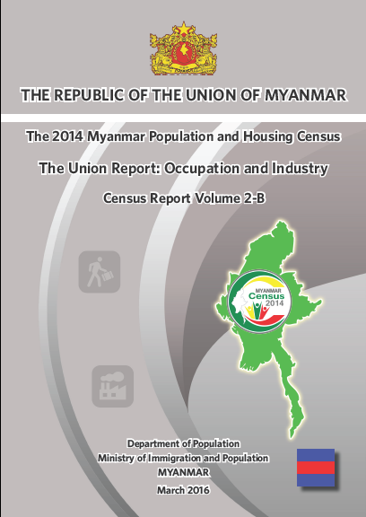
Census Report Volume 2-B
Occupation and Industry

Slide 4
Outline
Background
Coding of the information
Labour Force Framework (ILO)
Highlight of the Results
Next Steps

Slide 5
Background
Census enumeration took place in March/April 2014
Provisional results (Census Volume 1) were released in August 2014
Main Results were launched by H.E. President in May 2015; the reports were:
  Union Report, Volume 2
  Highlights of the Main Report, Volume 2-A
  15 State/Region Reports, one for each State and Region, Volume 3 –(1-15)
  Wall Chart with indicators down to District level

Slide 6
Background
This report on “Occupation and Industry: Census Report Volume 2-B” is part of the Union Report
It contains 2 of the 4 outstanding data from the census
In progress are dissemination and utilization of census results at State/Region as well as district levels; done in all States/Regions and in 70 out of 74 districts
Process of preparing 13 Thematic Reports is in progress and will be published during year 2016

Slide 7
Coding of Occupation and Industry

Slide 8
Coding of Occupation and Industry
Occupation and Industry were written as free text during enumeration, hence cannot be captured using OMR or ICR technology
Census Office developed the coding index for occupation and industry based on international guidelines (ISCO 2008 and ISIC Revision 4)
To improve quality of coding, each questionnaire was coded by two operators (“double-blind” coding)
If the two operators coded differently, the questionnaire automatically went to the supervisor to make a determination on the correct code

Slide 9
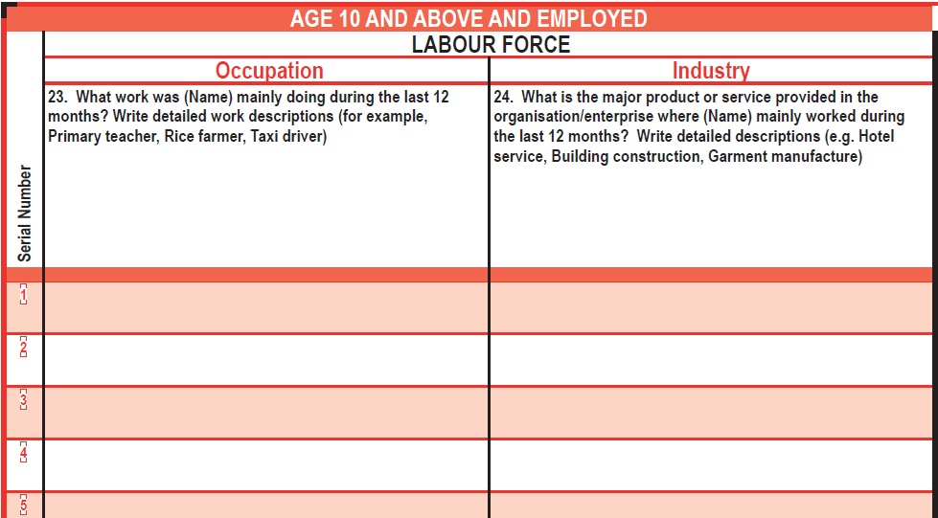
Occupation and Industry Report

Slide 10
Data Collection and processing
Information on occupation and industry was collected only for those who were working.
Occupation data was collected and processed based on the International Standard Classification of Occupations (ISCO 2008) at a 3 digit level.
Industry data was collected and analyzed using the International Standard Industrial Classification of All Economic Activities (ISIC Rev 4) at a 2 digit level.
Notes:
ISCO 2008 and ISIC Rev 4: are international classifications of recording and reporting occupation and industry in all countries and it enables comparisons within and between countries. These have been deigned by the United Nations and revised from time to time to incorporate the changing times

Slide 11
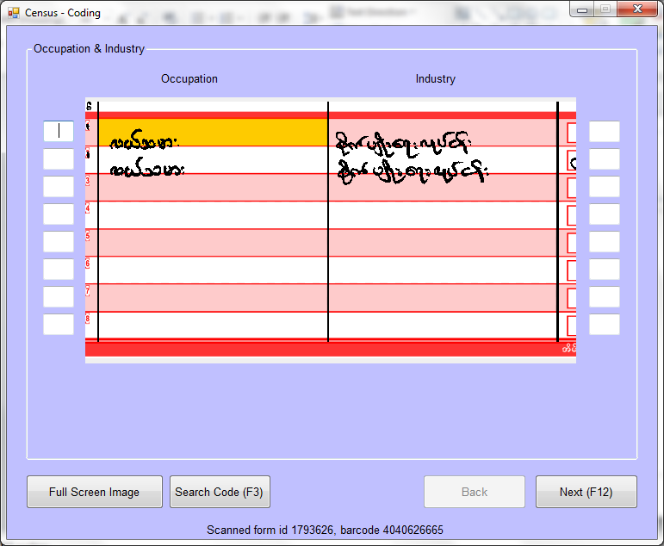
A typical operator coding screen

Slide 12
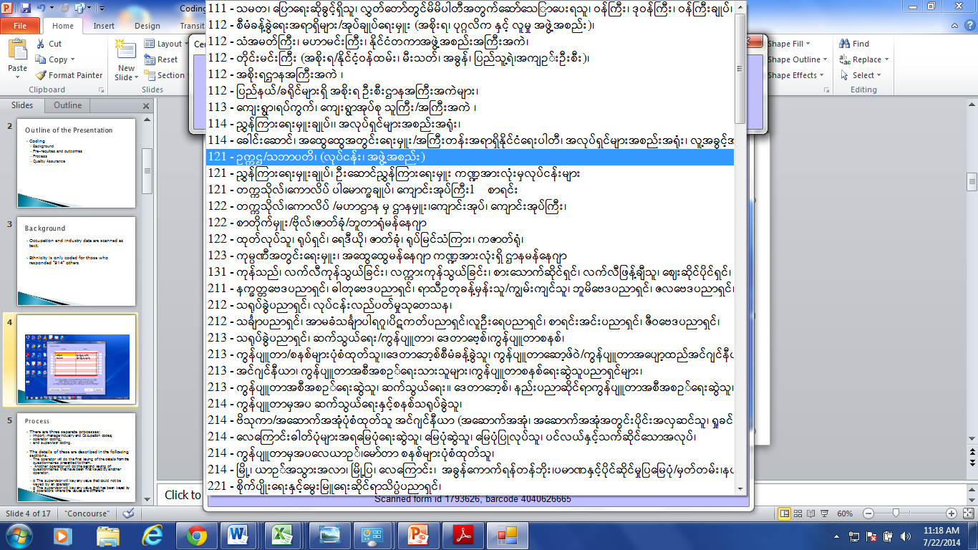
Operator coding screen

Slide 13
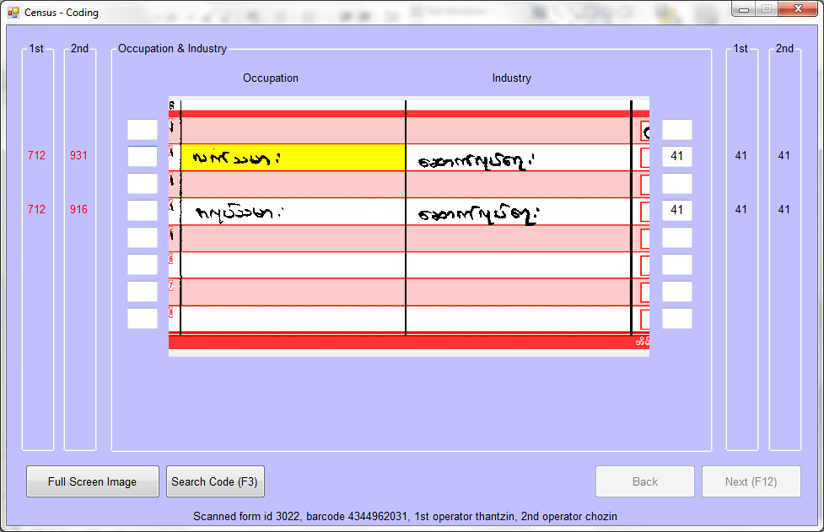
A typical supervisor coding screen

Slide 14
Labour Force Framework (ILO)
The analysis of economic characteristics data collected in the 2014 Census uses the standard labour force framework, as prescribed by the International Labour Organization (ILO)
This framework categorizes the population aged 15 years and over into two mutually exclusive groups:
  the economically active population or ‘labour force’, and
  the economically inactive population

Slide 15
Labour Force Framework (ILO)
The economically active population or ‘labour force’ consists of the population aged 15 years and above who were working during the reference period, and also those who were not working but were actively seeking a job
The economically inactive population covers the population aged 15 years and above who neither work nor are seeking to work, e.g. those incapacitated to work, unpaid household workers, retired, full-time students and those who sat at home but not looking for work

Slide 16
Labour Force Framework (ILO)

Slide 17
Occupation and industry groups
Data on occupation and industry in this report are presented by major groupings (this is referred to as 1 digit level by ILO) i.e. the major grouping is defined as a set of jobs whose tasks and duties are characterised by a high degree of similarity
Major groups are summarised from detailed sub-groups for both occupation and industry,
  This is annexed in the Report

Slide 18
Occupation categories example
All 3 digit occupations below are recorded as the 1 digit occupation ‘Skilled Agricultural, Forestry and Fishery Workers’

Slide 19
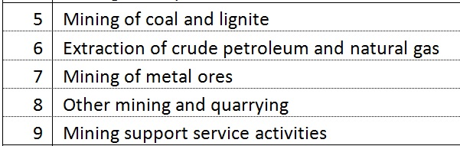
Industry categories example
All of the 2 digit industries below are recorded as the 1 digit industries ‘Mining and quarrying’

Slide 20
HIGHLIGHTS OF THE RESULTS

Slide 21
Economic Activity Status
According to the employment status, 21.9 million people aged 15 years and over are employed in Myanmar. This is out of 35.9 million people in that age range.
  Of these 39 per cent (8.5 mil) were employees (both government and private organizations);
  44 per cent (9.7 mil) were self-employed (employers and own account workers); and
  17 per cent (3.7 mil) were contributing family workers

Slide 22
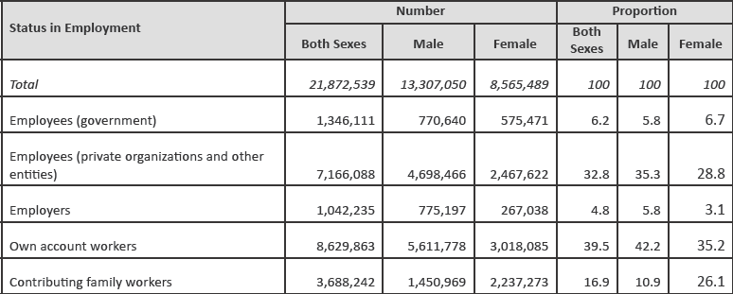
Economic Activity Status
Most people were own account workers, at over 40%
Many females were unpaid family workers 26% compared to 11% for males

Slide 23
Labour Force Participation Rate
Labour Force Participation Rate is the percentage of employed and unemployed people to the total population.
Total population include:
  employed,
  unemployed and
  economically inactive people
Labour Force Participation Rate is 67 per cent at the Union level, this means that 67 per cent of people aged 15-64 years were either employed or actively looking for a job during the year before the census
Also, that 23 percent of the population were economically inactive

Slide 24
Labour Force Participation Rate
There is a clear difference between LFP rates for women and men although the difference decreases by old age

Slide 25
Labour Force Participation by S/R
LFP rate in Shan is almost 20% higher than in Rakhine, why?

Slide 26
Employment-to-population ratio
A more robust measurement of employment is the employment-to-population (ETP) ratio
ETP ratio is the proportion of employed people to the total population. Total population include, employed, unemployed and economically inactive people
The employment-to-population ratio is 64.4 per cent at the Union level, this means that 64 per cent of people aged 15-64 years were employed during the reference period at the Union level

Slide 27
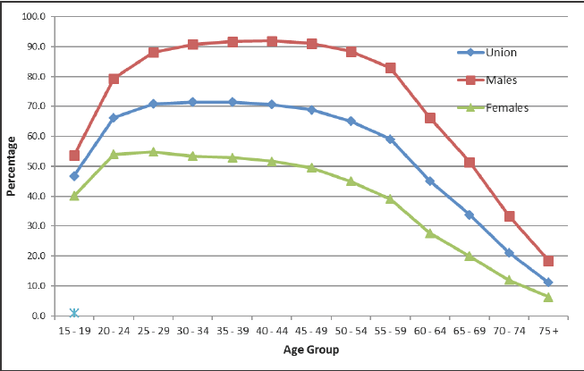
Employment-to-population ratio
The ratio is much higher for males at 81% than for females at 48%.
Females mostly do unpaid household work (39% compared to 1% of men).

Slide 28
Employment-to-population ratio by State/Region
 | Employment-to- Population Ratio (15-64)
 | Total | Male | Female
UNION | 64.4 | 81.9 | 48.4
Urban | 59.6 | 76.4 | 44.6
Rural | 66.6 | 84.5 | 50.2
Kachin | 64.6 | 82.6 | 44.0
Kayah | 72.3 | 85.7 | 58.9
Kayin | 56.2 | 75.1 | 38.3
Chin | 61.4 | 73.0 | 51.3
Sagaing | 69.7 | 84.5 | 56.8
Tanintharyi | 61.3 | 82.7 | 40.1
Bago | 59.2 | 81.4 | 39.5
Magway | 69.0 | 84.1 | 56.4
Mandalay | 65.7 | 82.8 | 50.7
Mon | 57.2 | 76.2 | 40.3
Rakhine | 52.6 | 75.6 | 33.2
Yangon | 60.5 | 78.3 | 44.6
Shan | 75.9 | 86.8 | 65.1
Ayeyawady | 61.6 | 82.9 | 41.8
Nay Pyi Taw | 67.8 | 84.5 | 52.1
The ETP ratio is higher among
males 82%, than females 48%
Highest in Shan state 76%,
lowest in Rakhine 53%

Slide 29
Unemployment rate
Unemployment rate, as defined by ILO, only takes into account people aged 15 – 64 years who are not working but are actively looking for job, as a percentage of people who are economically active (employed, unemployed)
The unemployment rate at the time of the census was 4 per cent
Unemployment rates for males and females are almost similar at the Union level, at 3.9 per cent and 4.1 per cent, respectively

Slide 30
Unemployment rate by age
The youth (aged 15-24) unemployment rate at 9.4%, is more than double that of the Union average (4%)

Slide 31
Employment by industry
The percentage of employed people working in the industry of “Agriculture, Forestry and Fishing” was highest among both males (55.4%) and females (47.4%).
  It was 52.2% nationally and employed 10.7 million people
The second highest industry was “Wholesale, retail trade including spare parts for repair of motor vehicles and motorcycles” at 7.2% for males and 12.6% for females.
  It employed 1.9 million people

Slide 32
Employment by industry (contd.)
Third highest industry was “Manufacturing” at 6.8% both sexes, it employed 1.4 million people
Fourth was “Accommodation and Food Services Activities” that employed 4.7% or 962 thousands people
Fifth industry was “Construction” with 4.6% or 940 thousand people
About 616,000 people (3%) reported to be under “Public Administration including Civil Servants”
An estimated 390,000 and 112,000 people (1.9% and 0.5%) were in “Education” and “Health” industries, respectively.

Slide 33
Employment by industry and gender
Examining the sex composition, males work mostly in:
  “Agriculture forestry and fishing” (55.4%)
  “Wholesale and retail trade; repair of motor vehicles and motorcycles” (7.2%)
  “Construction” (6.8%)
  “Transportation and storage” (6.4%)
  “Manufacturing” (4.9%)

Slide 34
Employment by industry and gender
Examining the sex composition, females work mostly in:
  “Agriculture, forestry and fishing” (47.4%)
  “Wholesale and retail trade; including sales spares of motor vehicles and motorcycles” (12.6%)
  “Manufacturing” (9.7%)
  “Accommodation and food service activities” (7%)
  “Education” (3.9%)

Slide 35
Agriculture, Forestry and Fishing
Over 70% of those employed in Chin work under this category as opposed to 52% at the Union level and only 16% in Yangon

Slide 36
Wholesale and retail Trade
Most of the wholesale and retail trade occurs in Yangon at 16%, followed closely by Kachin with 12%

Slide 37
Manufacturing
Yangon and Mandalay are the only Ss/Rs where manufacturing is at a higher level than the whole Union with 15% and 11%, respectively

Slide 38
Construction
Construction is highest in Ss/Rs with larger urban areas although unexpectedly Mon ranks second highest at over 6%

Slide 39
Accommodation and food service
Shan and Kayah, as well as Chin record the lowest percentages of employees in this sector at well below average 2% and 0.5%, respectively

Slide 40
Child Labour (aged 10-17 years)
An estimated 1.54 million children aged 10-17 years reported working according to the census; 840,000 males and 700,000 females
About 43% or 670,000 worked for pay
By industry of those in employment, 61% (816,000) were in “agriculture” while 10% (136,000) in “Manufacturing”
6.4% (87,000) in wholesale and retail” and 5.4% (74,000) in construction
4.5% (61,000) in accommodation and service industry

Slide 41
Employment by occupation
The proportion of employed persons aged 15 and over by occupation was highest in “Agricultural Forestry and Fishery Workers” at 42.9% -8.8 million people
This was followed by “Elementary occupations” (16% or 3.3 million people )
  Elementary “occupations” consist of simple and routine tasks which mainly require the use of hand-held tools and often require some physical effort. Because of the physical strength required many more males are in this category

Slide 42
Employment by occupation
The third occupation is “Service and sales workers” (13% - 2.6 million people)
“Craft and related trade workers” was also high, reportedly employing 12 % 0r 2.4 million of all employed persons.
The “Managers, Senior officials and Legislators” were only 0.6% or 128,000 people
“Professionals” were about 490,000 accounting for 2.4%

Slide 43
Employed persons by occupation (Union)
The number of skilled Agricultural Forestry and Fishery workers are highest among employed persons.

Slide 44
Employed persons by occupation by sex
The number of services and sales workers and Professionals are much higher for women

Slide 45
Employed persons by occupation by urban/rural
The number of services and sales workers are much higher in urban areas as can be observed,
Only agricultrual and elementary occupations are higher in rural

Slide 46
Next Steps
The Report released today will be distributed in print copies and online
Published census reports can be accessed online at: www.dop.gov.mm and http://myanmar.unfpa.org/census (all publications and tables in Microsoft excel)
Additional data to be requested by letter, email to Director General, Department of Population

Slide 47
Next Steps
  In the coming months, 13 thematic reports will be release as soon as are ready
  The topics addressed in these detailed reports are: Fertility and Nuptiality, Mortality, Maternal Mortality, Migration & Urbanization, Education, Disability, Population Projections, Housing, Children and Young People, Elderly, Labour Force, Gender and lastly Census Atlas

Slide 48
Labor force participation rate
Age-specific labor force participation rate

Slide 49
Employment-to-population ratio

Slide 50
Unemployment rate
Age specific unemployment rate

Slide 51
  THANK YOU

