Slide 1



Vulnerability in Myanmar
A Secondary Data Review of Needs, Coverage and Gaps
June 2018

Slide 2
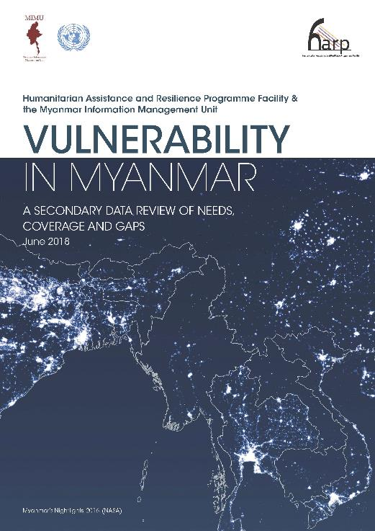
Why focus on Vulnerability?
2030 SDGs: leaving no one behind in the country’s development
Unresolved development need leads to critical needs in emergencies
→ must meet needs of the poorest and most vulnerable
Who in Myanmar is vulnerable and where are they?
Little information on needs, vulnerability and resilience
No cross-sectoral analysis of needs across the country
New data making countrywide analysis possible (Census)

Slide 3
What is Vulnerability?
No single defining trait
→ A diverse range of characteristics
→ Individuals, groups - different vulnerabilities at different times
→ Differs among townships even in a state/region
→ Need information at the lowest possible level to understand who is affected
Main overlapping factors limiting equitable development and resilience building
  Exposure to Climate and Hazard risks
  Conflict
  Under-investment, under-development and lack of strong social protection

Slide 4
Methodology
Desk review of available reports
Analysis of published national datasets for 2014-2016 - Census, administrative data, ACLED
  Vulnerability Index > 30 models
  Township Clusters – 13 characteristics → 8 differing types of townships
Technical review of methodology
Validation of results
Limitations
Index - not an absolute measure
Gaps in the Census and available data
  poverty - proxy indicators
  health, nutrition, hazard and climate risk – lack of publicly available data
Gender dimensions not explored in depth

Slide 5
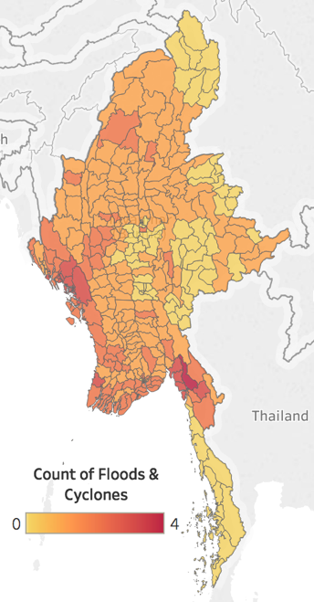
Climate Risk and Disaster Management
One of 3 countries most vulnerable to extreme weather events
3% Myanmar’s annual GDP lost through disasters / natural hazards
Affecting especially the most vulnerable.
DRR - 4% of the reported 3W activities in the past four years
Long term impacts
BUT lack of information
Need further research to identify climate risks and address the
massive human and economic toll
Significant flooding and cyclones (2008-2015)

Slide 6
Ayeyarwady Delta - Environmental Degradation & Vulnerability
One of the most populated and vulnerable parts of the country
Major climatic shocks and stresses
Human activity exacerbating the impact
Areas affected by previous events
National Action plan 2021-2050
increasing temperature,
higher annual rainfall,
longer dry spells

Slide 7
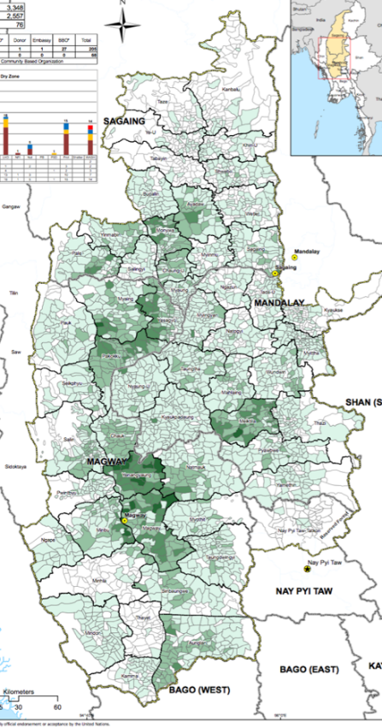
Dry Zone - Water Resources Management & Vulnerability
10.4 million residents, 12.8% of the Union’s land area (56 TS)
Contributing factors
Low capacity to manage variability in water resources
Changing climate
Soil erosion and land degradation
National Water Resources Committee
Investments
Climate change adaptations → protective and productive investments
- $ 1 on preparedness = seven dollars saved in aid expenditures (2016, UN)

Slide 8
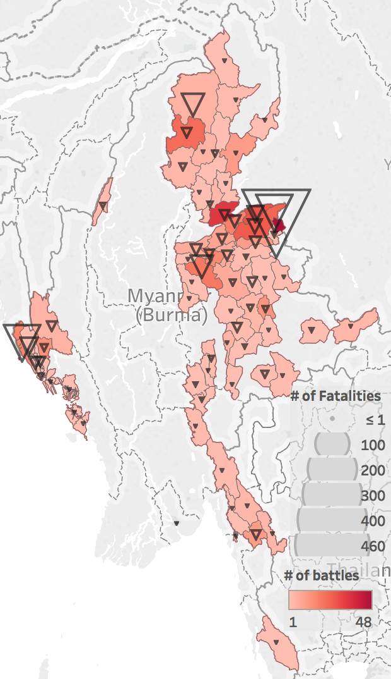
Conflict and Vulnerability
1/4 Myanmar’s population – live or latent conflict (TAF,2016)
2015-2016 Active conflict (ACLED, government data)
538 day/clashes, 1095 fatalities - 13.5% non-combatants
262 day/protests
644,000 IDPs – some for shorter periods

Slide 9
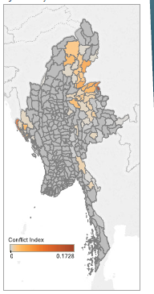
Conflict affected TS in 2015-2016
  2x children never attended school (20% vs 10%).
  2x population with no educational attainment (35% vs 17%)
  Lower living and housing standards
  Wide variation in living conditions in conflict-affected areas
Conflict index
- clashes, violence against civilians, fatalities and displacement
Needs
development aid,
protracted support to chronically-displaced
Development alone wont bring peace

Slide 10
Underinvestment and Underdevelopment
Institutional Capacity
Aid and Civil society
Shelter and Housing
Water Resource Management and Sanitation
Health and Nutrition
Education
Livelihoods and Household Consumption
Agriculture and Food Security

Slide 11
Education
89.5% of people over 15 are literate – disparities by age, gender, and geographic locations
No Formal Educational Attainment
4.5 million persons
Remote and isolated areas, older people
Shan State - 18/19 TS with over half of children who never attended school.
  Highest % - Mongkhet (85%)
  Highest numbers - Tangyan and Narphan
Also TS in Kayin, Magway and Rakhine

Slide 12
School Completion and Dropout
School completion and dropout
  95% of children – at least one grade primary school,
  4/5 complete primary school,
  2/5 finish middle school,
  1/5 eventually pass the matriculation exam
Geographical differences
% of Youth not completing Primary School
Number of Primary completers not completing Middle School
Approximate economic corridors

Slide 13
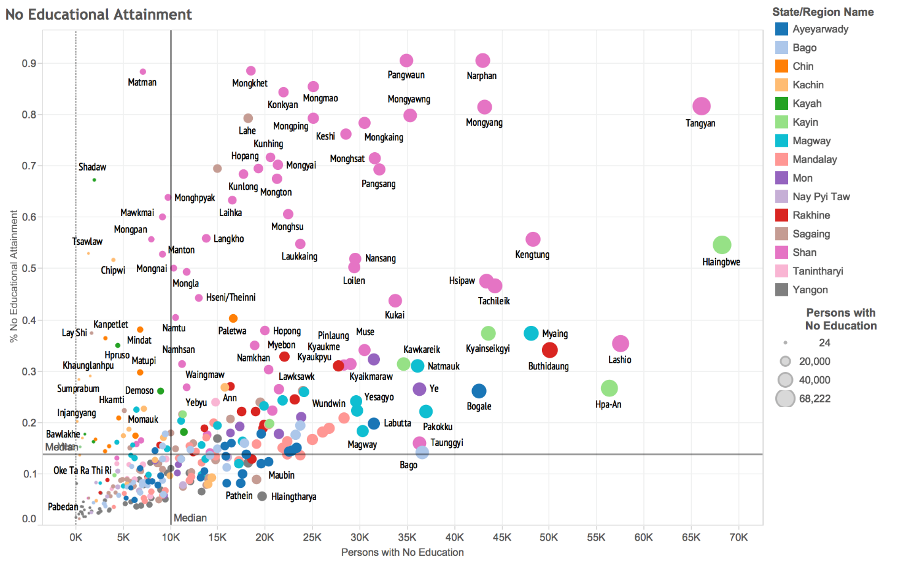
Ratio of Persons with No Educational Attainment (→ decreasing)
Maungdaw township > 91,000 persons with no formal education among the enumerated population in the 2014 Census.

Slide 14
 | Major indicators of vulnerability considered in the Analysis | Vulnerability Index components
Demographics | % of persons with no formal Identity documents Child dependency ratio Old dependency ratio % of persons with disabilities | % of persons with no formal Identity documents Child dependency ratio
Housing and Amenities | % of houses with bamboo or thatch roofing % of houses with bamboo, earth or wood walls % of houses with earth or bamboo floors % of households with electricity Number of Communications Devices per Household | % Bamboo and thatch roofs Rate of electrification
Education | % of men and women who are literate % of persons with no formal education % of persons with a middle school education % of persons with a high school education % of children not attending school % of children who have never attended school | Female literacy rate % with a middle school education
Water and Sanitation | % of households who use an improved drinking water source % of households with safe sanitation % of households with no toilet | % with safe sanitation
Labour and Employment | % of persons who are unpaid family workers Labour force participation rate
Conflict and displacement | % of the chronically displaced population % of clashes % of incidents of violence against civilians % of conflict fatalities | Conflict Index (indices of clashes, violence against civilians, fatalities and displacement)
Vulnerability Index
Major indicators of
Vulnerability
considered
in the Analysis

Slide 15
Vulnerability by TS
Vulnerability Index
44% some form of vulnerability
housing materials
education/educational attainment
safe sanitation, drinking water
direct exposure to conflict
Vulnerable persons
highest number - Shan and Ayeyarwady
lowest number – Yangon, Nay Pyi Taw, Mandalay
Low High

Slide 16
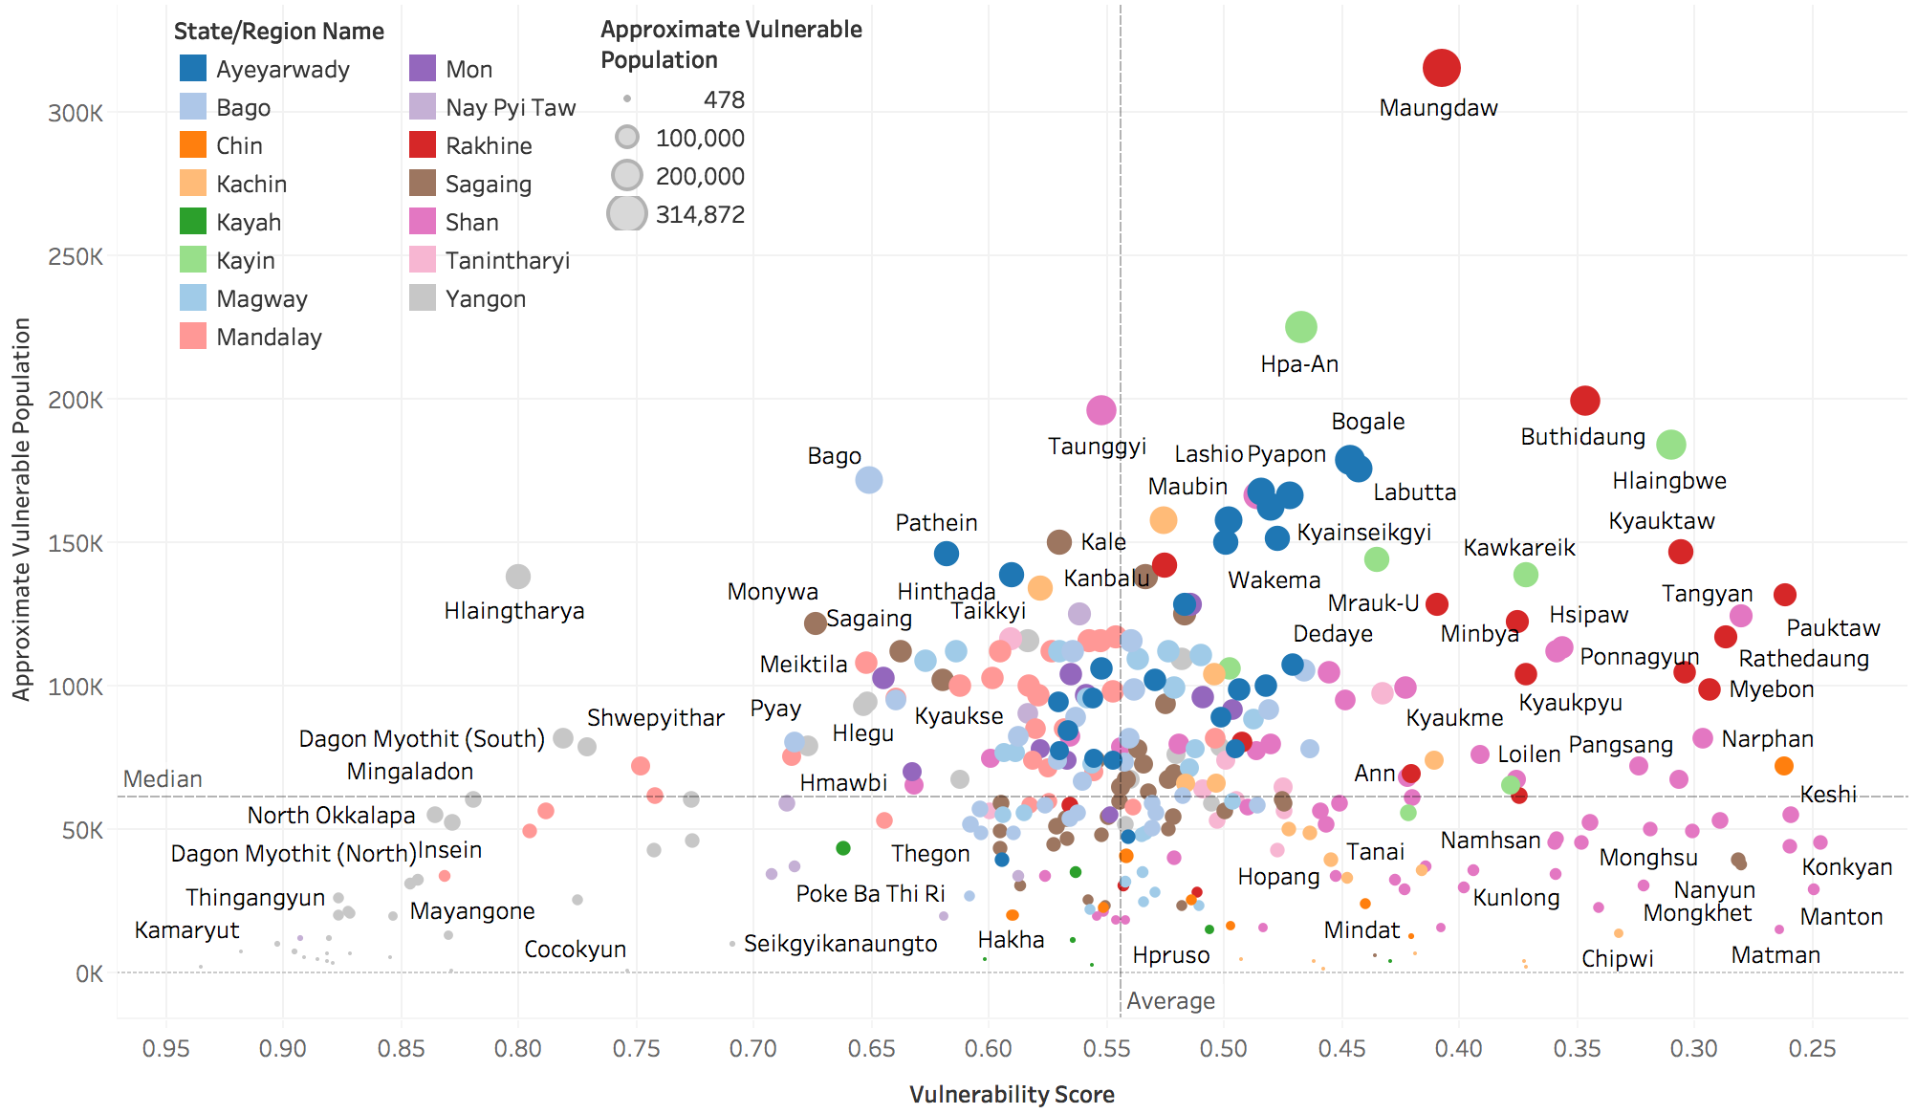
→ increasing levels of vulnerability

Slide 17
Vulnerable populations across Townships

Slide 18
Clustering to 8 Township Types
Band |  | Count of Townships per Band | Literate (%) | Child Dependency Ratio (%) | Highest Education: None (%) | Highest Education: At least Middle school (%) | Absence of ID Total (%) | Safe sanitation (%) | Improved Drinking water source (%) | Conflict Sub-Index | Floor type: Bamboo or Earth (%) | Roof type: Thatch/ bamboo roofing (%) | Urban Population (%) | Electricity (%) | Approximate Vulnerable Population (no. of persons)
1 | Extreme Outliers in development needs and/or exposure to conflict | 36 | 50.87% | 58.80% | 59.06% | 15.64% | 52.69% | 35.17% | 41.85% | 43.79% | 49.44% | 42.01% | 12.15% | 19.02% | 2,733,320
2 | Conflict-affected areas with poor human development | 25 | 67.35% | 58.67% | 42.56% | 27.87% | 26.29% | 57.50% | 44.33% | 41.67% | 53.89% | 35.68% | 20.47% | 22.63% | 1,519,749
3 | Hubs in conflict-affected areas | 21 | 70.09% | 52.09% | 36.83% | 32.00% | 23.72% | 74.79% | 61.48% | 70.99% | 23.65% | 25.51% | 28.33% | 34.24% | 1,402,254
4 | Very low access to services and basic infrastructure | 74 | 91.86% | 53.41% | 14.25% | 33.43% | 28.62% | 68.53% | 57.82% | 91.22% | 27.47% | 52.62% | 14.97% | 11.62% | 5,817,188
5 | Agricultural townships with highest profits per capita | 64 | 94.47% | 39.72% | 12.05% | 31.17% | 23.84% | 73.84% | 73.63% | 96.29% | 42.28% | 40.20% | 12.00% | 15.23% | 4,484,117
6 | Agricultural areas with secondary cities and towns | 65 | 92.78% | 42.30% | 12.69% | 39.29% | 23.84% | 80.45% | 75.88% | 87.26% | 34.89% | 30.05% | 28.21% | 40.44% | 4,957,216
7 | Peri-urban and urban areas | 11 | 95.49% | 38.91% | 7.42% | 51.84% | 25.49% | 89.18% | 73.71% | 93.72% | 27.95% | 21.90% | 64.66% | 61.64% | 734,867
8 | More affluent, densely populated city centres | 34 | 97.74% | 25.65% | 3.51% | 76.15% | 14.14% | 96.65% | 96.99% | 97.25% | 6.13% | 4.11% | 97.24% | 94.76% | 1,026,422

Slide 19
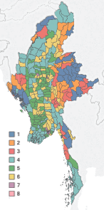
Each township → one type
Type 1: Extreme outliers in terms of development needs and/or exposure to conflict
Type 2: Conflict-affected areas with poor human development
Type 3: Hubs in conflict-affected areas
Type 4: Very low access to basic services and Infrastructure
Type 5: Agricultural townships with the highest profits per capita
Type 6: Agricultural areas with secondary cities and towns
Type 7: Up-and-coming peri-urban and urban areas
Type 8: Affluent, densely populated city centres

Slide 20
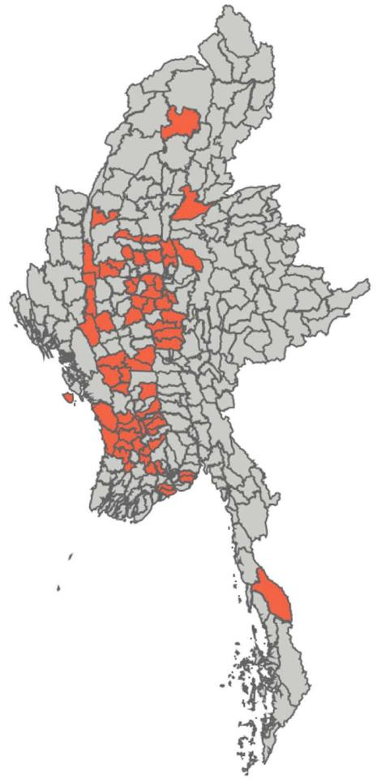
Type 5: Agricultural townships with the highest profits per capita
Key characteristics – 4.5 million vulnerable people in 64 TS
above average literacy, safe sanitation, improved drinking water
best average return per capita on crops
low urbanization, electrification
significant diversification from paddy – better returns
Types of interventions which may be relevant
Consider less water intensive livestock to improve resilience
Increase mechanization, electrification for larger returns in farming
Increase loan limits for small farming implements (tractors)
Increase financing for non-farm livelihoods
Environment guidelines and consolidated plans for droughts, water shortages

Slide 21
Products of the Analysis
MIMU website
Executive Summary – MMR, ENG
Report - ENG
Dataset
Questions?

