Slide 1



Vulnerability in Myanmar
A Secondary Data Review of Needs, Coverage and Gaps
November 2018 : IM Network
Notes:
WHY
Have info on population, services (what being done), → but little on needs, no cross sectoral analysis
Unresolved development need leads to critical needs in emergencies
SDGs – must meet the needs of the most vulnerable – leave no one behind
→ Who in Myanmar is vulnerable and where are they

Slide 3
What is Vulnerability?
No single defining trait
→ A diverse range of characteristics
→ Individuals, groups - different vulnerabilities at different times
→ Differs among townships even in a state/region
→ Need information at the lowest possible level to understand who is affected
Main overlapping factors limiting equitable development and resilience building
  Exposure to Climate and Hazard risks
  Conflict
  Under-investment, under-development and lack of strong social protection
Notes:
S/R information can mask the differences across townships

Slide 4
Methodology
Desk review of available reports
Analysis of published national datasets for 2014-2016 - Census, administrative data, ACLED
Tools to compare vulnerability
  Vulnerability Index > 30 models
  Township Clusters – 13 characteristics → 8 differing types of townships
Technical review of methodology
Validation of results
Limitations
Index - not an absolute measure
Gaps in the Census and available data
  poverty - proxy indicators
  health, nutrition, hazard and climate risk – lack of publicly available data
Gender dimensions not explored in depth
Notes:
DESK REVIEW
2014-2016 – 2 main sources – Census and ACLED
Gaps in available information

Slide 5
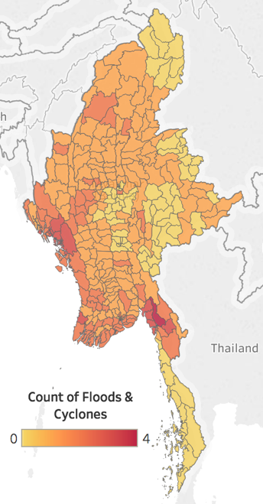
Climate Risk and Vulnerability
One of 3 countries most vulnerable to extreme weather events
3% Myanmar’s annual GDP lost through disasters / natural hazards
Affecting large numbers, especially the most vulnerable.
Long term impacts
BUT lack of information to track impact
Need further research to identify climate risks and address the
massive human and economic toll
Significant flooding and cyclones (2008-2015)
Notes:
UN Global Assessment Report on Disaster Risk Reduction 2015
one of the 3 most vulnerable countries → MAP
Climate change
- severe threat and severe impacts
Can affect very large numbers of people (1.6 million IDPs in 2015 floods)
Long term impacts

Slide 6
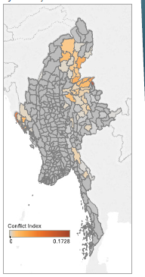
Conflict and Vulnerability
1/4 Myanmar’s population – live or latent conflict (TAF,2016)
2015-2016 Active conflict (ACLED, government data)
538 day/clashes, 1095 fatalities - 13.5% non-combatants
262 day/protests
644,000 IDPs – some for shorter periods
Conflict affected TS in 2015-2016
  2x children never attended school (20% vs 10%).
  2x population with no educational attainment (35% vs 17%)
  Lower living and housing standards
  Wide variation in living conditions in conflict-affected areas
Conflict index
- clashes, violence against civilians, fatalities and displacement
Notes:
Myanmar – longest running conflict - widespread displacement, contamination by unexploded ordnance, and violence against civilians in conflict areas.
Armed Conflict Location and Event Data Project (ACLED) dataset which is designed for disaggregated conflict analysis and crisis mapping
This period - conflict in the northern and eastern parts of the country, and in Rakhine.
note that clashes/protests refer to event/days, as such a 2-day clash/protest will be recorded as two events, one on each day.
Protests
- National Education Bill;
Mining, Envirt and Land Rights,
Labour rights
An estimated 644,000 internally displaced persons (IDPs) fled their homes in Myanmar due to conflict and communal violence in 2016.
- Most were in Rakhine, Kachin, Northern Shan and Kayin.
- Some were displaced for shorter periods and were able to return
IDPs - negative impacts of displacement (IDPs, host communities)

Slide 7
Underdevelopment/investment and Vulnerability
Institutional Capacity
Aid and Civil society
Shelter and Housing
Water Resource Management and Sanitation
Health and Nutrition
Education
Livelihoods and Household Consumption
Agriculture and Food Security
Notes:
2014 Population and Housing Census data
Reports,
Government sector plans
areas with different vulnerabilities
Consider also WHERE investments are needed
→ larger urban centres offer opportunities for income and education
→ smaller urban centres play an important role in rural and regional development → poverty reduction and resilience
Rural areas also require private as well as public investment to address existing disparities. need for household- and community-level interventions in rural areas to ensure existing disparities are not exacerbated

Slide 8
Education
89.5% of people over 15 are literate – disparities by age, gender, and geographic locations
No Formal Educational Attainment
4.5 million persons
Remote and isolated areas, older people
Shan State - 18/19 TS with over half of children who never attended school.
  Highest % - Mongkhet (85%)
  Highest numbers - Tangyan and Narphan
Also TS in Kayin, Magway and Rakhine
Notes:
LITERACY
Lower in rural areas than urban areas,
Persons living in urban areas are more literate (95%) than those in rural areas (87%),
Varies significantly across states and regions.
highest in Yangon, Nay Pyi Taw and Bago,
lowest in Chin, Kayin and Shan with levels below 80 per cent.

Slide 9
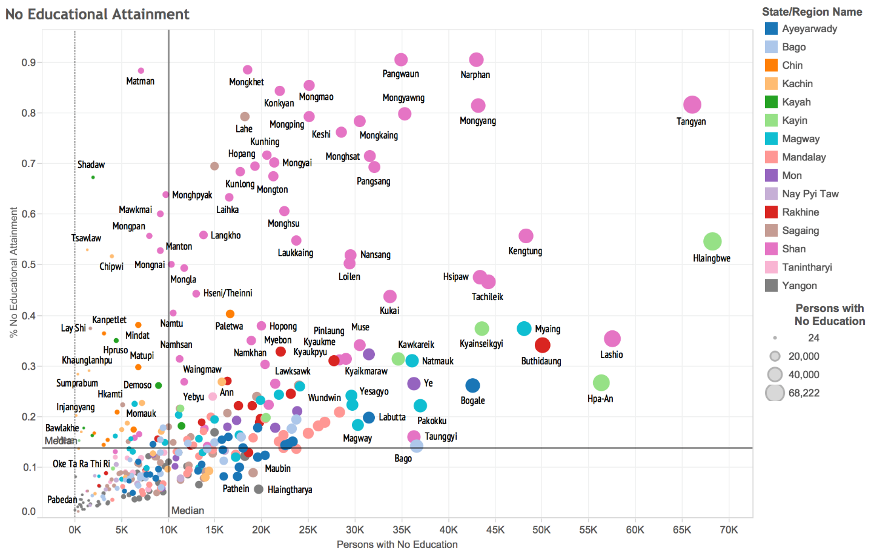
School Completion and Dropout
School completion and dropout
  95% of children – at least one grade primary school,
  4/5 complete primary school,
  2/5 finish middle school,
  1/5 eventually pass the matriculation exam
Geographical differences
% of Youth not completing Primary School
Number of Primary completers not completing Middle School
Approximate economic corridors
Notes:
School completion and dropout
2014 Census, 2010 IHLCS
Geog differences
E Shan – low primary completion but those completing tend to go through middle school
Sagaing – better primary school completion but less likely to complete middle school

Slide 10
 | Major indicators of vulnerability considered in the Analysis | Vulnerability Index components
Demographics | % of persons with no formal Identity documents Child dependency ratio Old dependency ratio % of persons with disabilities | % of persons with no formal Identity documents Child dependency ratio
Housing and Amenities | % of houses with bamboo or thatch roofing % of houses with bamboo, earth or wood walls % of houses with earth or bamboo floors % of households with electricity Number of Communications Devices per Household | % Bamboo and thatch roofs Rate of electrification
Education | % of men and women who are literate % of persons with no formal education % of persons with a middle school education % of persons with a high school education % of children not attending school % of children who have never attended school | Female literacy rate % with a middle school education
Water and Sanitation | % of households who use an improved drinking water source % of households with safe sanitation % of households with no toilet | % with safe sanitation
Labour and Employment | % of persons who are unpaid family workers Labour force participation rate
Conflict and displacement | % of the chronically displaced population % of clashes % of incidents of violence against civilians % of conflict fatalities | Conflict Index (indices of clashes, violence against civilians, fatalities and displacement)
Vulnerability Index
Major indicators of
Vulnerability
considered
in the Analysis

Slide 11
Vulnerability by TS
Vulnerability Index
44% some form of vulnerability
housing materials
education/educational attainment
safe sanitation, drinking water
direct exposure to conflict
Vulnerable persons
highest number - Shan and Ayeyarwady
lowest number – Yangon, Nay Pyi Taw, Mandalay
Low High

Slide 12
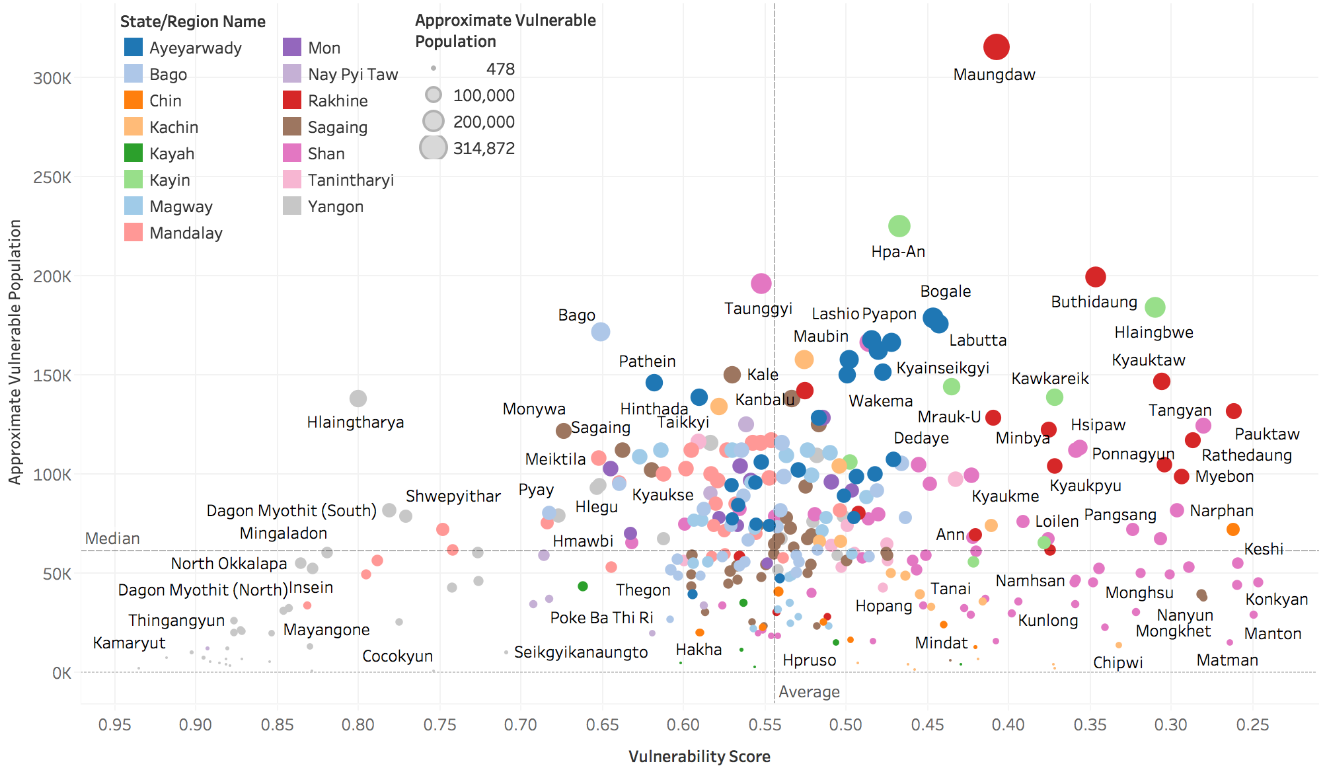
→ increasing levels of vulnerability

Slide 13
Vulnerable populations across Townships

Slide 14
Clustering to 8 Township Types
Band |  | Count of Townships per Band | Literate (%) | Child Dependency Ratio (%) | Highest Education: None (%) | Highest Education: At least Middle school (%) | Absence of ID Total (%) | Safe sanitation (%) | Improved Drinking water source (%) | Conflict Sub-Index | Floor type: Bamboo or Earth (%) | Roof type: Thatch/ bamboo roofing (%) | Urban Population (%) | Electricity (%) | Approximate Vulnerable Population (no. of persons)
1 | Extreme Outliers in development needs and/or exposure to conflict | 36 | 50.87% | 58.80% | 59.06% | 15.64% | 52.69% | 35.17% | 41.85% | 43.79% | 49.44% | 42.01% | 12.15% | 19.02% | 2,733,320
2 | Conflict-affected areas with poor human development | 25 | 67.35% | 58.67% | 42.56% | 27.87% | 26.29% | 57.50% | 44.33% | 41.67% | 53.89% | 35.68% | 20.47% | 22.63% | 1,519,749
3 | Hubs in conflict-affected areas | 21 | 70.09% | 52.09% | 36.83% | 32.00% | 23.72% | 74.79% | 61.48% | 70.99% | 23.65% | 25.51% | 28.33% | 34.24% | 1,402,254
4 | Very low access to services and basic infrastructure | 74 | 91.86% | 53.41% | 14.25% | 33.43% | 28.62% | 68.53% | 57.82% | 91.22% | 27.47% | 52.62% | 14.97% | 11.62% | 5,817,188
5 | Agricultural townships with highest profits per capita | 64 | 94.47% | 39.72% | 12.05% | 31.17% | 23.84% | 73.84% | 73.63% | 96.29% | 42.28% | 40.20% | 12.00% | 15.23% | 4,484,117
6 | Agricultural areas with secondary cities and towns | 65 | 92.78% | 42.30% | 12.69% | 39.29% | 23.84% | 80.45% | 75.88% | 87.26% | 34.89% | 30.05% | 28.21% | 40.44% | 4,957,216
7 | Peri-urban and urban areas | 11 | 95.49% | 38.91% | 7.42% | 51.84% | 25.49% | 89.18% | 73.71% | 93.72% | 27.95% | 21.90% | 64.66% | 61.64% | 734,867
8 | More affluent, densely populated city centres | 34 | 97.74% | 25.65% | 3.51% | 76.15% | 14.14% | 96.65% | 96.99% | 97.25% | 6.13% | 4.11% | 97.24% | 94.76% | 1,026,422
Notes:
Applied 13 characteristics - each TS to ONE TYPE
similar characteristics

Slide 15
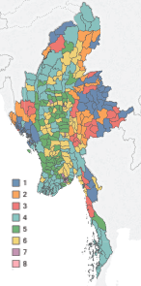
Township typologies
Type 1: Extreme outliers in terms of development needs and/or exposure to conflict
Type 2: Conflict-affected areas with poor human development
Type 3: Hubs in conflict-affected areas
Type 4: Very low access to basic services and Infrastructure
Type 5: Agricultural townships with the highest profits per capita
Type 6: Agricultural areas with secondary cities and towns
Type 7: Up-and-coming peri-urban and urban areas
Type 8: Affluent, densely populated city centres
Notes:
Vulnerability in Myanmar available through the MIMU website, includes data

