Slide 1

Information Management for Refugees
& Displaced Persons from Myanmar
Lyndy Worsham
Information Management Coordinator
Notes:
Today I will first provide a brief overview of TBC and then zoom in to discuss key programs in TBC that have a major IM component and then discuss some of the challenges in IM along the Thailand-Myanmar border. Lastly I will discuss new IM initiatives on the horizon.

Slide 2

What is TBC?
• TBC is an alliance of partners working together with displaced and conflict-affected people of Myanmar to address humanitarian needs and to support community driven solutions in pursuit of peace and development.
TBC provided food, shelter and capacity building support to 120,000 refugees in Thailand and 95,000 internally displaced persons and others affected by conflict in rural areas of South East Myanmar during 2013.
Notes:
The Border Consortium is a non-profit, non-governmental organisation, working together with displaced and conflict-affected people of Myanmar to address humanitarian needs and to support community driven solutions to peace and development.
TBC provided food, shelter and capacity building support to 120,000 refugees in Thailand and 95,000 internally displaced persons and others affected by conflict in rural areas of Southeast Myanmar in 2013.
TBC has been working in Thailand for the past 30 years and we opened an office in Yangon last year due to the changing political and humanitarian context.

Slide 3
TBC’s Main IM Initiatives
• Population Database from Refugee Camps in Thailand
• Programmatic Data from South East Myanmar
• Poverty, Displacement and Protection Data in South East Myanmar
Notes:
TBC has 3 Main IM initiatives or projects that result in information products that inform decision making within the organization, improve operational efficiency by targeting aid to the most vulnerable populations, and help us understand and communicate a story on the ground.
I will first define each initiative and then delve into a discussion of each initiative separately to provide more details on what the data tells us.
1. TBC has developed its own online population database to determine ration needs in the refugee camps in Thailand. This includes all registered refugees checked against UNHCR’s data base and new records created by TBC for all unregistered people including photographs. These records are updated on a monthly basis for births, deaths, departures for resettlement, for new arrivals and other transfers/movements.
2. Monitoring data from TBC’s relief and rehabilitation programmes in Southeast Myanmar are compiled into spatial and non-spatial relational databases. These data are analyzed and visualized through maps and charts in annual programme reports for donors. This remains sensitive as TBC works through community-based partners and does not have permission from Naypidaw to access conflict-affected areas. But we are increasingly sharing information with MIMU for integration with the Who/What/Where maps an effort to promote inter-agency collaboration.
3. TBC has been collaborating with ethnic community-based organisations (CBOs) to document the conditions in Southeast Myanmar on an annual basis since 2002. Our poverty assessments from 2010-2012, which surveyed over 4,000 household representing 24,000 people, were developed in consultation with humanitarian agencies based in Yangon to ensure that vulnerability indicators are standardized. Last year we conducted a village level assessment of 209 villages in SE Myanmar to assess poverty, displacement and local governance indicators.

Slide 4
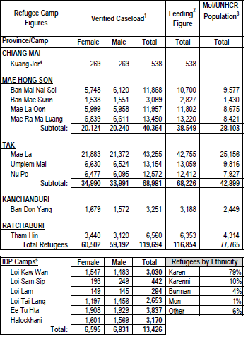
Refugee & IDP Camp Populations
Notes:
Let’s start with refugee population data. TBC publishes this map on a monthly basis to summarise different figures from data sources.
The “verified caseload” data includes all persons who are confirmed by TBC and camp committees as living in the camps and eligible for rations.
The “feeding figure” includes all people who collected food assistance rations during the previous month. As rations are only provided to those who are physically present, the “feeding figure” is generally slightly less than the verified caseload.
The MOI/UNHCR population column are registered refugees who have passed screening procedures conducted by UNHCR and the relevant Thai government agency. However there has not been an effective screening process since 2005, so most new arrivals since then have not been registered. Almost half of the refugees in camps are now unregistered, which does not affect access to assistance but does limit access to protection.

Slide 5
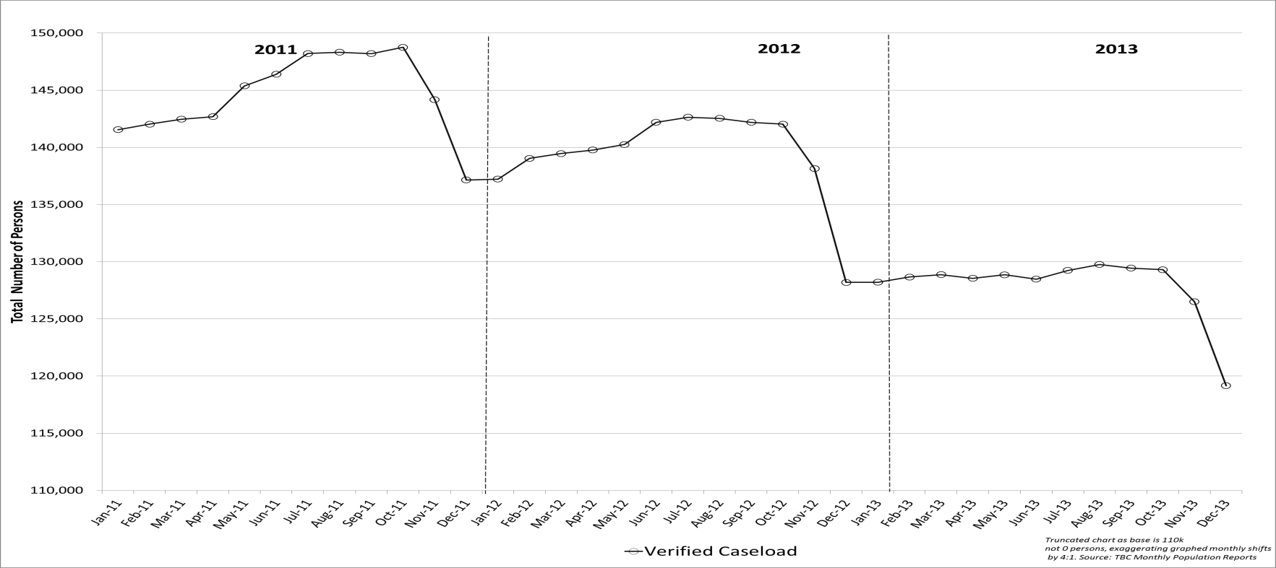
Tracking Border Wide Camp Population Trends
• December 2012 = 128,200 persons.
• December 2013 = 119,156 persons.
• A net annual decrease of 9,044 persons or -7.1%.
Notes:
Now let’s take a look at border wide camp population trends that we’re also getting from our refugee population database.
So, overall, here we are seeing a decrease in border wide camp populations as this chart shows. It represents that number of refugees provided with food assistance each month over the past three years.
In December, 2012, the camp population was over 128,000, whereas in December, 2013, the camp population stood at just over 119,000. That’s a decrease of over 9,000 people or 7% of the total population.
Trends
Population decrease over past 3 years
Large end of year decreases – This reflects an annual population verification process which occurs in November and December to account for people who are no longer residing in the refugee camps.
Mid-year net population increases (2011,2012)
But, no mid-year net increases (2013)

Slide 6
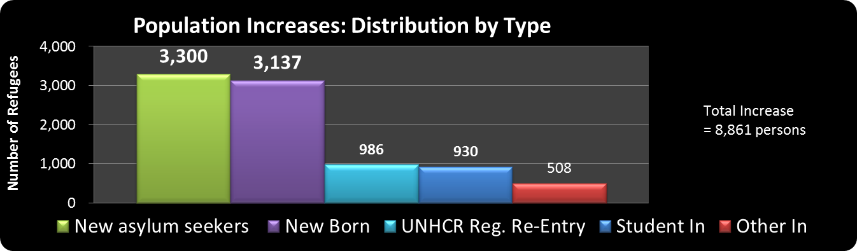
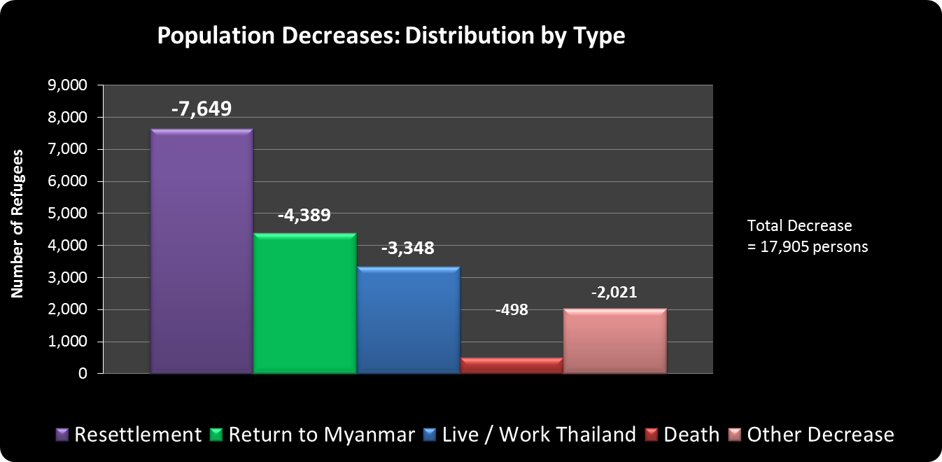
Border Wide Camp Population Increases & Decreases
Notes:
Continuing along wit the data from our population database we can see here that NET population changes in the camps are a function of both population increases and decreases.
Increases were 8,861 as shown in the top chart and mostly due to new asylum Seekers and new borns.
Decreases shown in the lower chart are due mainly to resettlement but also significant numbers are returning to Myanmar or leaving to live/work in Thailand.
Of those who returned to Myanmar, 70% of all departures consisted of only 1 to 2 person / household. So, the typical departure pattern is for 1 or 2 people to go “look and see” conditions in areas of potential return while the majority of the household remain in camp.
If we extrapolate from this data, we can see that excluding death and resettlement, if there is a voluntary return, we are looking at only a little more than half of the refugees will likely return to Myanmar.

Slide 7
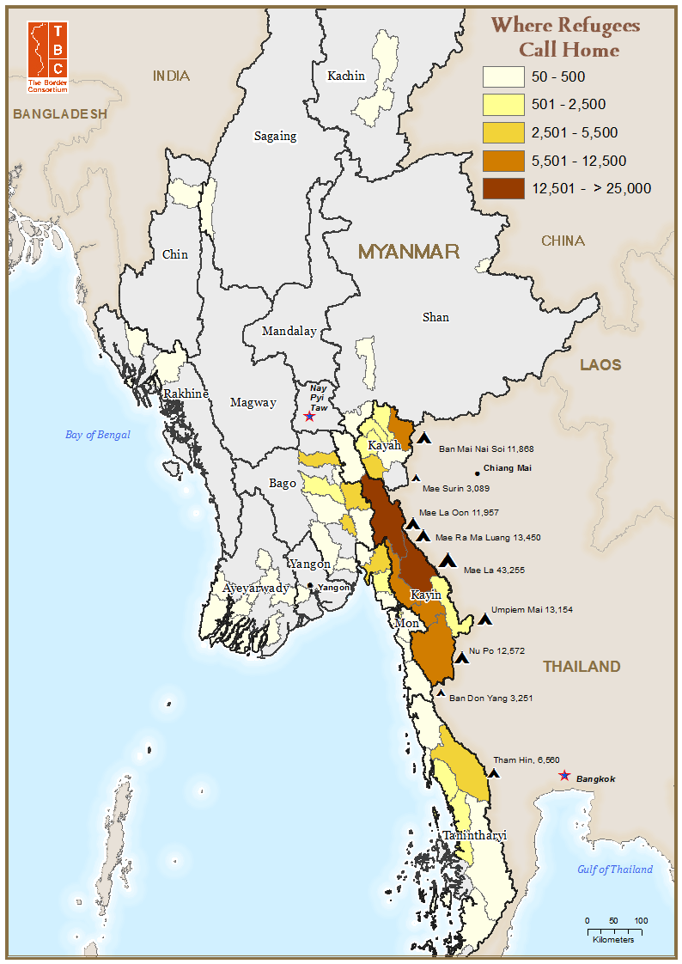
Information Management, Displaced Persons & Potential Return
• TBC’s annual population verification process asks refugees to identify where they call home.
• Use MIMU p-coder tool to matches the township code with the township name in our database.
• Access to information for refugees & communities in areas of potential return builds preparedness for voluntary return & reintegration.
Notes:
The last information product that comes out of our annual population data set is this map that shows where refugees call home.
Here we can see that Hpapun and Hlaingbwe townships in N. Karen State have the greatest density of refugees who call these areas “home.”
This map is produced by running the p-coder tool to match the township code with the township name in our database. I can then link our population database with the MIMU township admin boundaries for importing into our GIS.
Access to information for refugees and resident communities in areas of potential return is essential to building preparedness for voluntary return & reintegration.

Slide 8
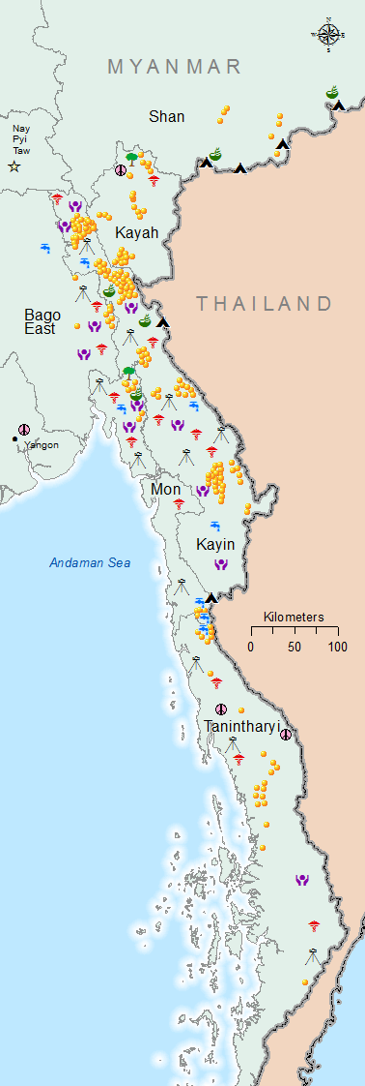
TBC’s Myanmar Programme Reach
• Emergency assistance in the form of cash transfers to respond to livelihood shocks for 42,000 civilians in Myanmar in 2013
• Food aid to 13,000 internally displaced persons in 6 camps in Myanmar
• Small grants for community-based rehabilitation projects with 40,000 civilians in Myanmar in 2013
Notes:
So, I just covered briefly our refugee population database and some of the key information products that are created based on that information. Now, I would like to focus on information that is collected and created as an essential part of TBC’s work in SE Myanmar. The map shows all of these various projects using different symbology.
The first one is relief assistance in the form of cash transfers to respond to livelihood shocks or chronic poverty for 42,000 civilians in Myanmar in 2013. This is represented by the little yellow dots on the map. Each dot is an assisted village.
Second is food aid to 13,000 internally displaced persons in 6 camps in Myanmar. The IDP camps are all marked on the map with a black triangle close to the border. As a part of our monitoring activities in IDP camps, we also do an annual survey in the IDP camps to track demographic and health changes over time.
Third, TBC provides small grants for community-based rehabilitation projects with 40,000 civilians supported in Myanmar in 2013. Rehabilitation projects include support in the areas of women and child health, water and sanitation, human rights education, and animal raising. These projects are shown on the map with various symbols according to project type.

Slide 9
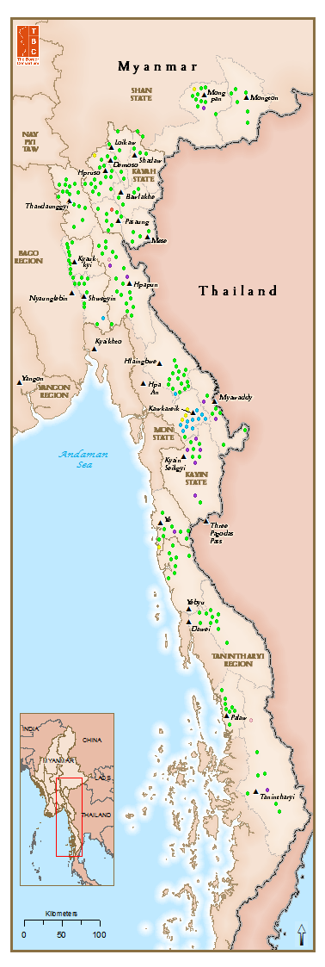
Civilian Protection
• Majority of households have citizenship cards in 59% of villages
• 3% of villages reported the Myanmar Police force as the main mechanism for dealing with disputes
• Radio is main mechanism for learning about rights, followed by NSAGs and village leaders.
• Landmines reported around 61% of villages, but clearly demarcated for just 3%.
Notes:
The added value of TBC’s survey relates to the assessment of protection and local governance issues. All the surveys found needs were widespread across all sectors and all geographic areas, but TBC’s survey highlights the importance of addressing protection concerns during this period of reform.
In terms of civilian protection issues the 2013 survey found that:
Majority of households have citizenship cards in 59% of villages
3% of villages reported the Myanmar Police force as the main mechanism for dealing with disputes
Radio is main mechanism for learning about rights, followed by NSAGs and village leaders.
Landmines reported around 61% of villages, but clearly demarcated for just 3%.

Slide 10
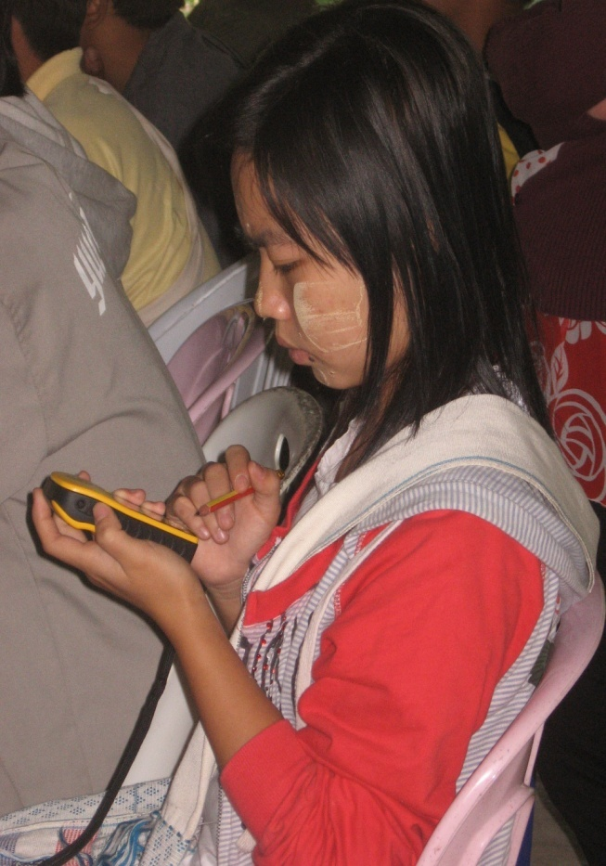
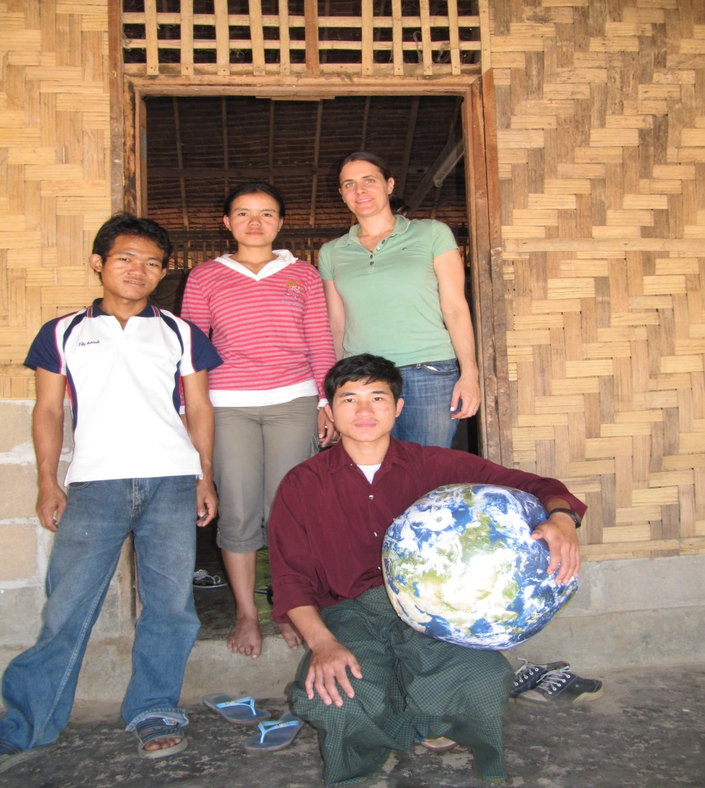
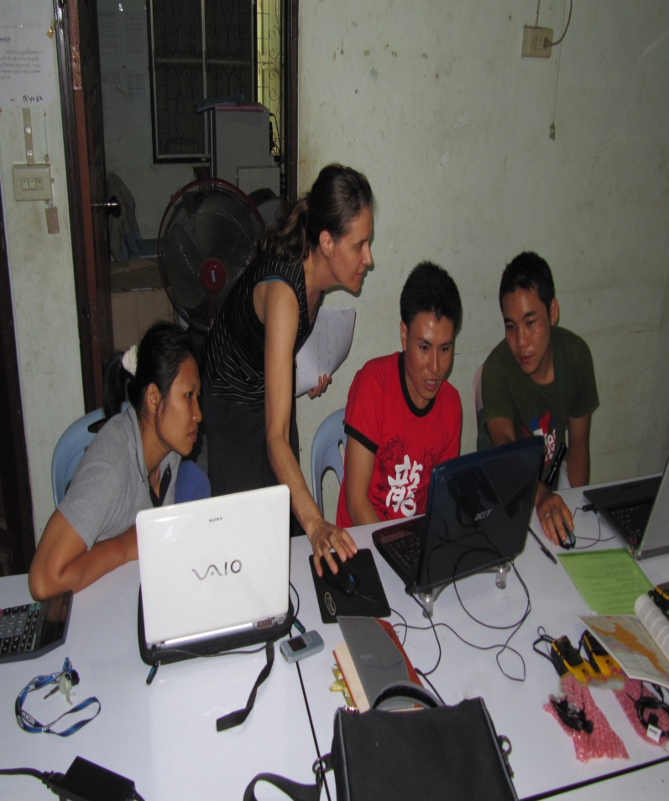
TBC Implements Programs Through Its Partner Agencies While Teaching IM & GIS Skills
Notes:
In to carry out these projects and research in SE Myanmar that I just discussed TBC works closely with a dozen community based ethnic organizations along the Thailand-Myanmar border.
As a part of our work with these civil society organizations, TBC aims to develop local capacities so that they carry out their own research and have their own GIS programs using the skills that we teach them.

Slide 11
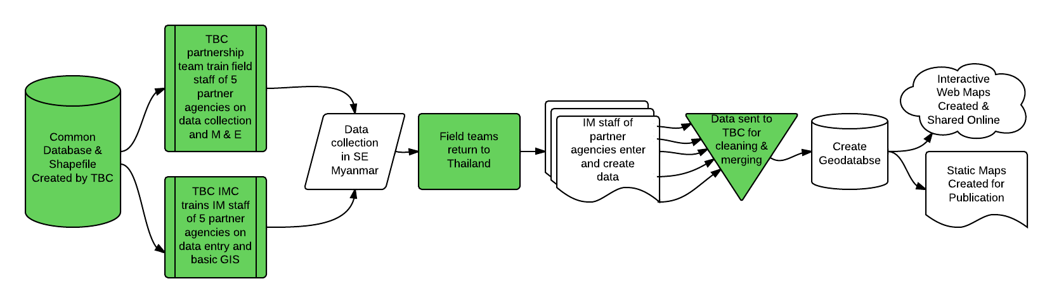
TBC’s Community Mapping Data Flow Diagram
Notes:
This data flow diagram just shows the process of how TBC works with partner agencies to document displacement and poverty in SE Myanmar.
The chart just shows data flow and does not show the process of consulting with partner and international agencies about the survey design. The consultation process is a separate process and obviously a very important part of our work.

Slide 12
IM Challenges
• Reluctance of individuals to share information impedes information flows
• Lack of verified village level data in SE Myanmar
• Ensuring that international agencies build on local capacities Lack of verified village level data in SE Myanmar
• Differing boundary demarcations used by KNU & Myanmar government in Karen/Kayin areas
Notes:
Reluctance of individuals to share information impede information flows (but we also must recognize the legal and security constraints of information sharing whether real or perceived and a general lack of confidence about the peace process)
Lack of verified village level data in SE Myanmar (Kayah 75%, Bago E 74%, Mon 66%, Kayin 63%, Tanin. 61%, Shan S 60%, Shan E 33%)
As opportunities to expand humanitarian access into conflict-affected areas increase, the challenge will be to ensure that international agencies build on the local capacities of community-managed approaches.
Differing boundary demarcations used by KNU & Myanmar government in Karen/Kayin areas . See next slide for map.
Other challenges not highlighted:
1. Lack of organizational understanding about the need to integrate sufficient planning into the development of GIS, resulting in a system that doesn’t meet expectations.
2. Maintaining software and hardware in 6 office to support GIS technology
3. Human and data resources within organizations are weak
4. Frequent change of partner staff due to resettlement and low pay impedes long term capacity building

Slide 13
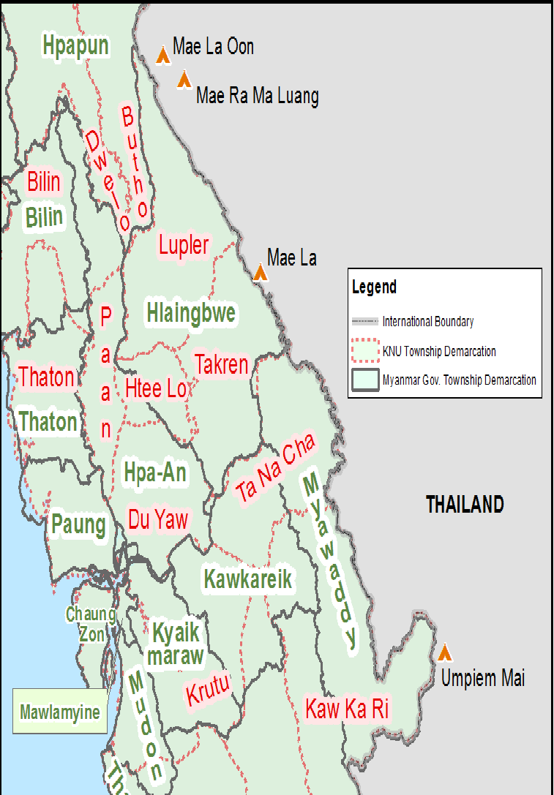
Map Showing Differing Boundary Demarcations in Kayin Areas
Notes:
KNU and Myanmar boundaries. Let’s focus on Hlaingbwe township. You can see if we zoom in here a bit, that the area called Hlaingbwe by the Myanmar government, is referred to by the Karen as four three different townships, including Lupler, Takren, and Htee Lo. Even among the Karen the spellings of Karen townships differ.
There is an effort to harmonize the transliteration of Karen place names among border CBOs but it doesn’t seem to be recognized widely by all groups.

Slide 14
New IM Initiatives in 2014
• Develop new website that will that will use cloud services for interactive mapping
• Share and integrate our 2013 survey data with data collected by other agencies in the SE to create common mapping platform hosted by MIMU
• Produce 22 township level base maps in SE Myanmar for use by CBOs working in conflict affected areas
Notes:
New Web site using interactive mapping through arcgis online-will allow us to embed thematic and reference maps into our web site. Publish 2013 survey data on the web to give web users a cool and engaging experience-allow users to compare thematic data through various story telling widgets. Help with cross-organizational collaboration. Give access to mapping tools to non-Gis users. Online mapping is fast becoming the de-facto format for sharing geospatial information
Develop 22 base maps at the township level, by referencing MIMU and UNHCR for roads, rivers, topography, towns and key villages and adding villages from TBC's 2013 survey.

Slide 15
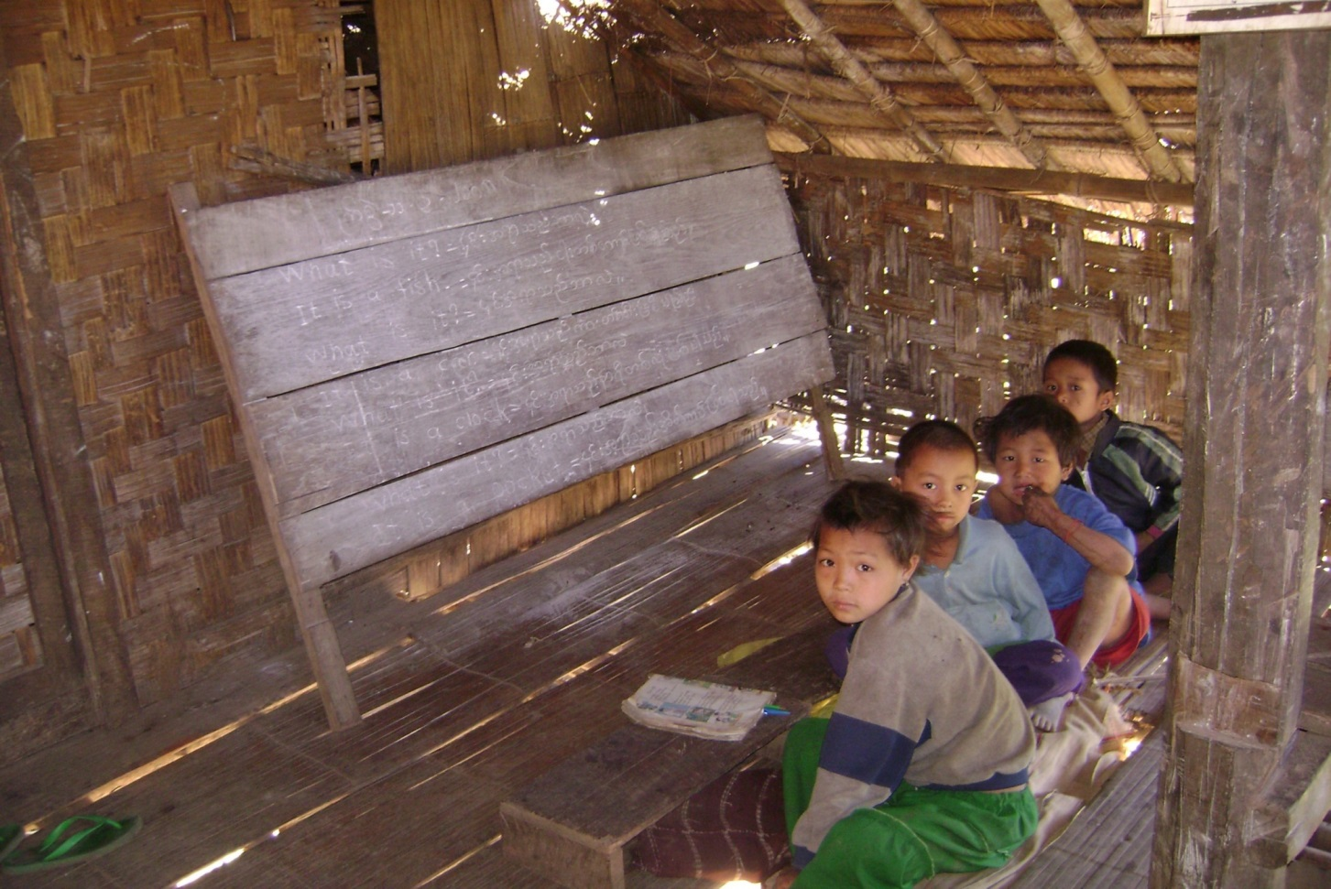
Questions & Discussion

