Slide 1
ICT4D @ Pact in Myanmar
Hein Htet Aung
Notes:
Pact is a capacity development organization that builds the capacity of NGOs, CBOs and government entities around the world to have greater and wider impact in the areas of health, livelihoods and natural resource management.
Pact is based in the United States. It has the country offices in 26 countries in Asia, Africa, Europe and South America.

Slide 2
Swan Yi Project
SHINE Project
CAP 3D
PGMF
Notes:
Pact has started in Myanmar since 1997. Originally, Pact began as the microfinance institution but now Pact expands its program in other sectors such as community based health care, livelihoods and food security and community institutional strengthening.
Currently we have four community development projects while our PGMF colleagues are implementing several different microfinance projects.
Among them, Shae Thot project is our largest program as well as the largest USAID program in Myanmar.
Other projects are the Cocoa Cola funded women empowerment project, Swan Yi, Chevron funded SHINE project and USAID funded CAP 3D project.

Slide 3
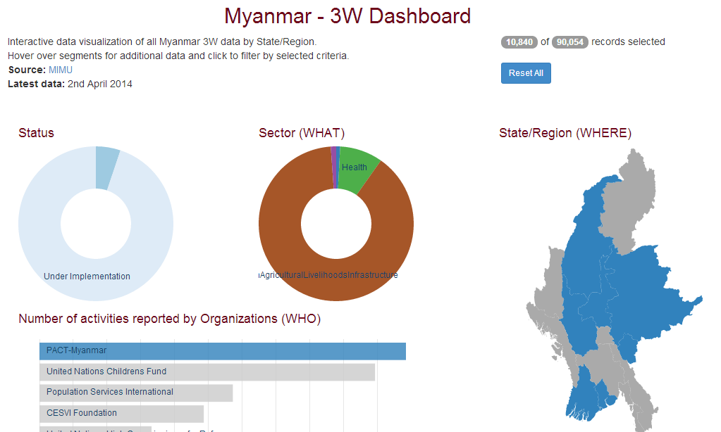
That’s us!
Notes:
This is the screenshot from 3W Dashboard of MIMU. As you all know, MIMU put together all 3W information that each organization submits to MIMU. Here we are proud to say that Pact Myanmar is the most reporting organization for 3 W information. According to the last update, Pact Myanmar stands at the top of the list with 10,840 villages reach. Livelihood sector is the largest one which is due to our microfinance component. Heath sector stands next. We also have a small portion of governance sector which is under USAID funded Shae Thot program.

Slide 4
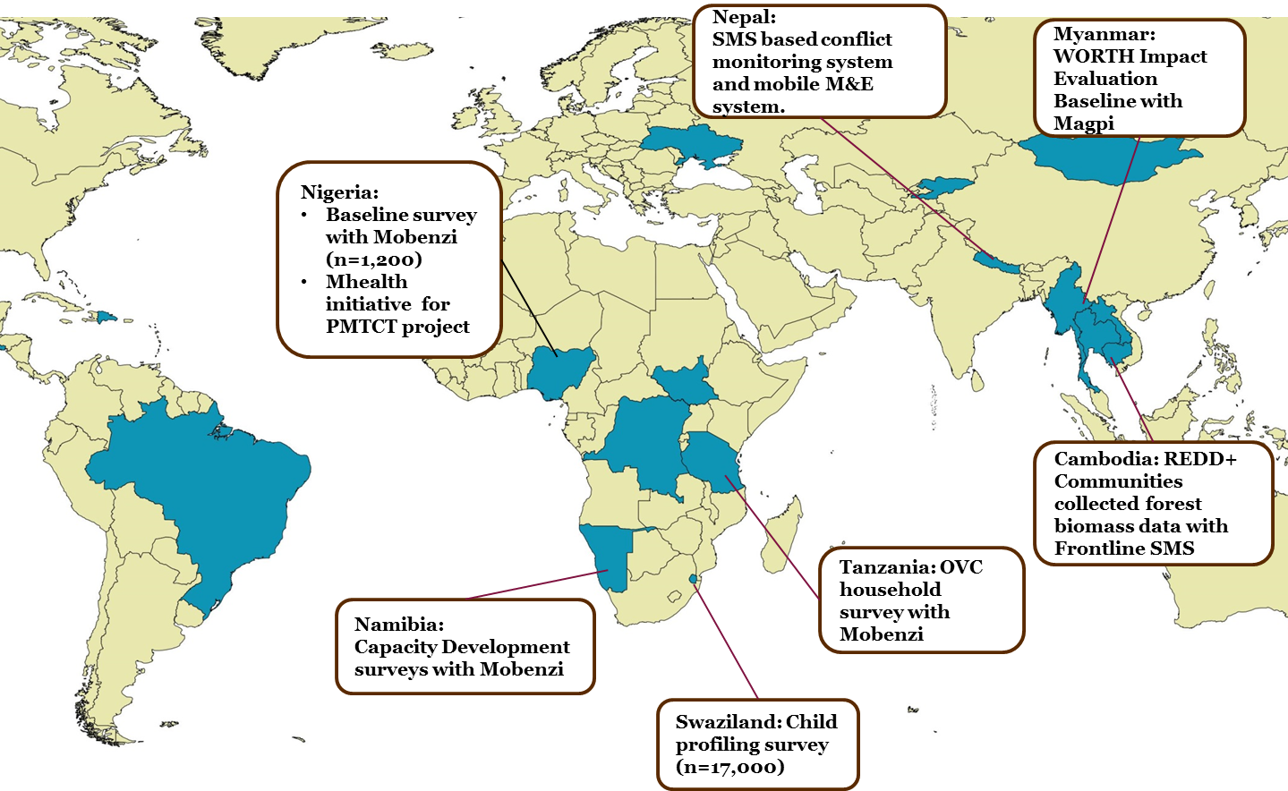
Notes:
Globally, Pact has been using mobile technology in a lot of different countries in different ways. We are using mobile technology in collecting data for different surveys as well as in program implementation, monitoring and evaluation. For example, in Nepal, the communities are trained to send SMS to report any conflicts when happened. Nigeria team used mobile SMS system to tract their clients in PMTCT project. Also, Swaziland team has successfully collected the child profile data from 17,000 respondents.

Slide 5
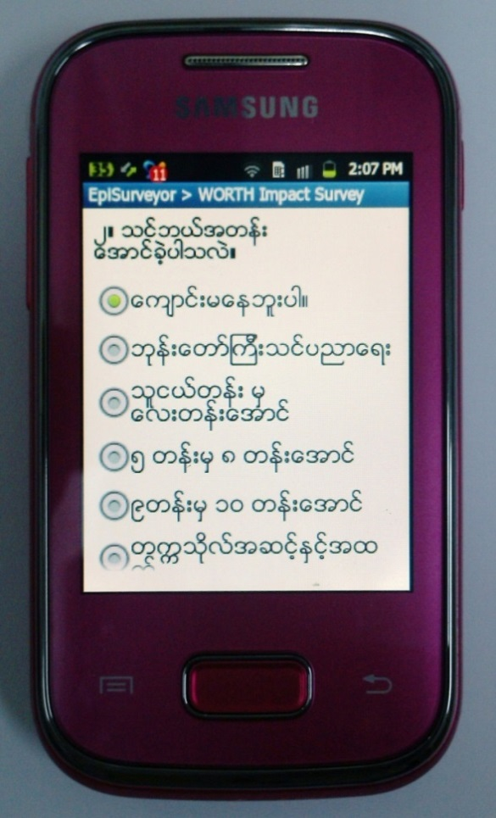
Pact Myanmar Goes Mobile
11% mobile cellular subscription
1% internet users penetration
2012 World Bank data
Notes:
When mobile technology had been rolled out in other parts of the world, we, Pact Myanmar, also wanted to participate. But, as you know, Myanmar does not have the same context as other countries. We had very low penetration of telecommunications infrastructure. At first, we thought it is not possible to apply mobile technology here. However, after having examined the different mobile platforms, we found a suitable one which fits with our country settings. That is Mapi mobile platform. We chose Magpi for a number of reasons. No SIM card is required. Web portal entry is possible. We can see Myanmar fonts. Then we started piloting in one township to collect the savings and loans data of our women empowerment project survey. The pilot was successful and we gained momentum from that point.

Slide 6
Available online at:
http://www.pactworld.org/blog/pact%E2%80%99s-mobile-technology-handbook-debuts
Notes:
Based on our world wide work, experiences and lessons learned, we have published a mobile technology handbook as a guideline for training our own team members as well as our partners. The hand book is available at the online at the link mentioned here. I also bring some copies and you can take them if you have an interest in it.

Slide 7
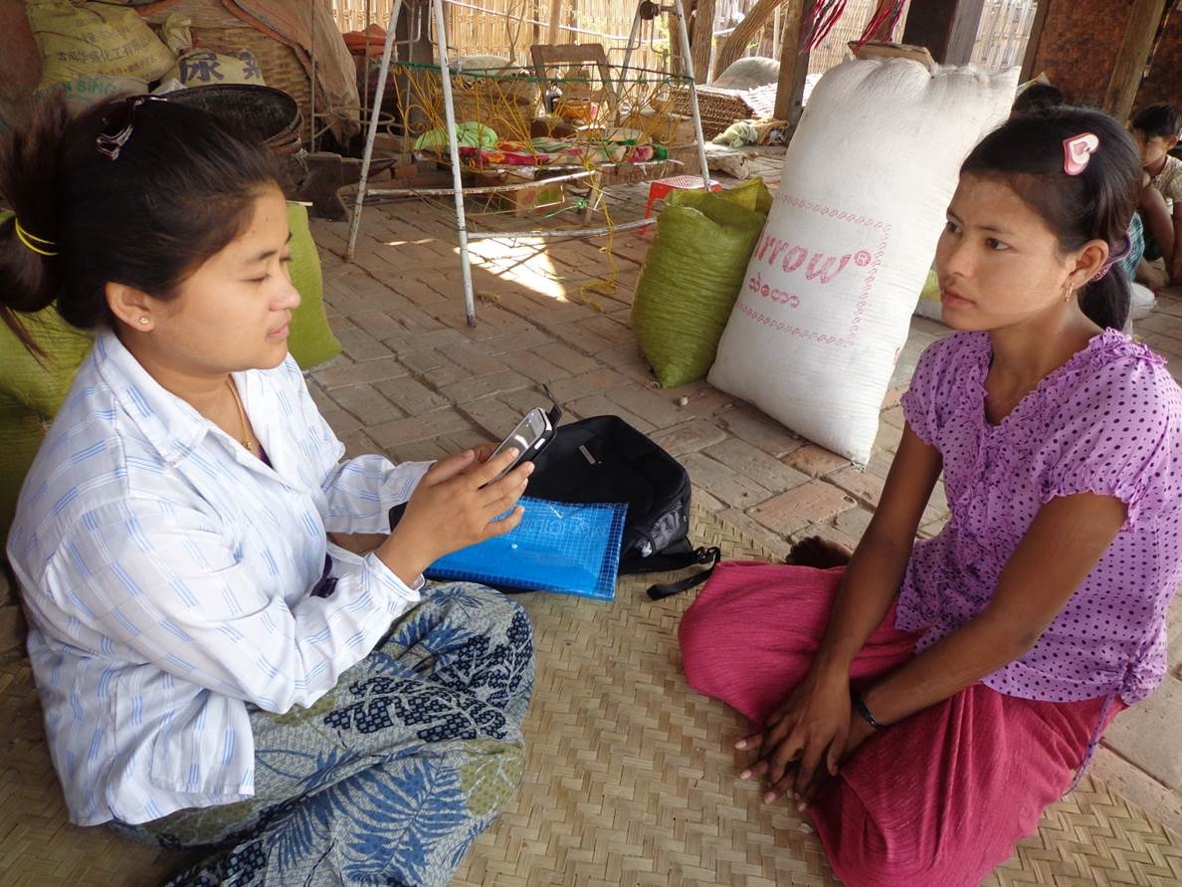
33,000+ women and 1,200+ savings groups
Notes:
We are applying mobile technology to collect survey data of all of our projects. To date, about 400 mobile phones are used to survey more than 33,000 women and 1,200 savings groups in livelihoods and maternal and child health outcomes in Myanmar. By using phones, we are collecting saving and loans data of WORTH groups across 3 projects in 12 townships. For the maternal and child health component of USAID funded Shae Thot Program, we collect data on pre and post knowledge test, and maternal and child health behaviors and practices.

Slide 8
Scaling up
Notes:
Beside collecting survey data, we are also scaling up of applying this technology in other different program components. Under Shae Thot program, we are now working with 7 local partners. We use mobile phones to record the mentoring visits that we conducted, such as M&E mentoring visits, financial mentoring visits. It is an easy way to systematically record that data to help us to analyze which partners needs which kinds of mentoring sessions most. We are also spreading this technology to out local partners. We have trained 2 of them and they are going to collect their baseline surveys at the end of this month.
Similarly, we are also planning to apply mobile phones to track the mentoring sessions that our community facilitators conducted with the community governance groups which we call Village Development Committees in pilot villages.

Slide 9
Advantages…
Cleaner data
Environmentally friendly
Saves time and manpower in data entry
Faster results help project implementation
Easier to share data between projects
Notes:
By using mobile technology in survey data collection, we get more cleaner and faster data. Especially, skips and logic functions help us a lot to get the cleaner data.
It is also environmentally friendly as it reduces the use of paper. Skipping the data entry step saves time and manpower.
It also enables us to perform the quicker analysis which in turns helps us to inform our projects in a timely manner.
With paper collection, it took about a month to start the data analysis but we can start the analysis within a week with mobile data collection.

Slide 10
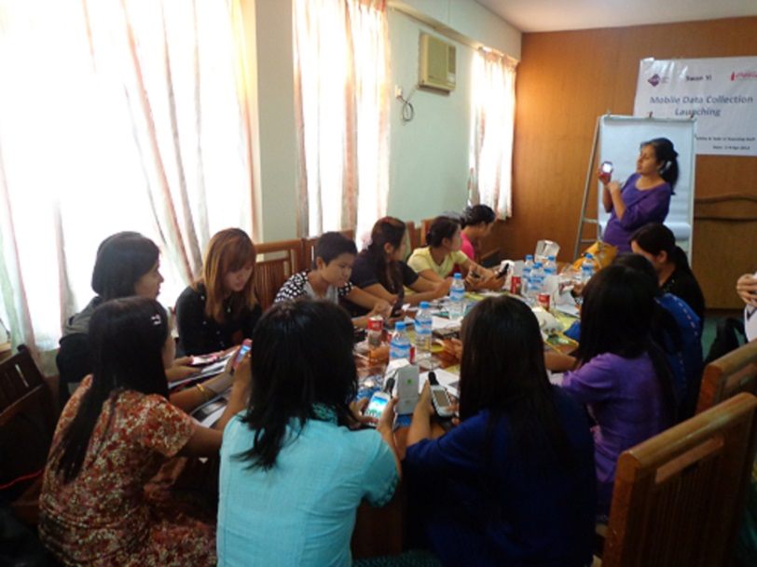
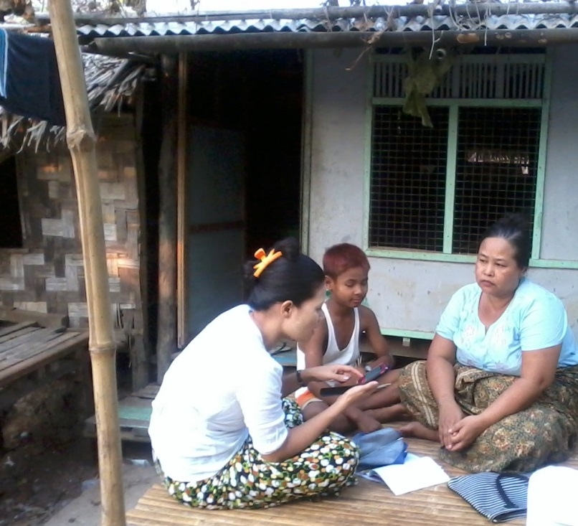
Challenges…
Procurement of smartphones
Intensive orientation
Lack of electricity
Notes:
Besides advantages, there are some challenges we faced.
It was difficult for us to procure required numbers of smartphones in time as there were limited authorized dealers.
We needed to intensively orient the data collectors in how to use touch screens. We included more practice sessions to make sure that they are confident enough to use mobile phones in the field. We also developed a User Guide in Burmese Language for their reference.
As villages don’t have electricity, we instructed the data collectors to charge the batteries before they go to the villages. And also we asked them to go in pairs, so that one person can be a back up if the battery of the other person runs out.

Slide 11
Community Reaction
Stunned and Amazed
Concerned about technology’s security
Curious
Women excited to participate
Hope for future technology
Notes:
It is also interesting to note the community reaction when we began mobile technology in the field.
When staff came to the villages with the mobile phone in their hand, community showed both interest and insecurity. It took us some time to build trust in order to overcome participants’ fears about the security of their answers.
Thus , when staff came to the villages with the mobile phone in their hand, women felt both fear and curiosity. At the same time, the experience of participating in the mobile phone data collection also made communities excited and amazed about the new technology. So the introduction of mobile data collection from Pact helped make communities more friendly toward technology and also gave them hope for future development of technology in the country.

Slide 12
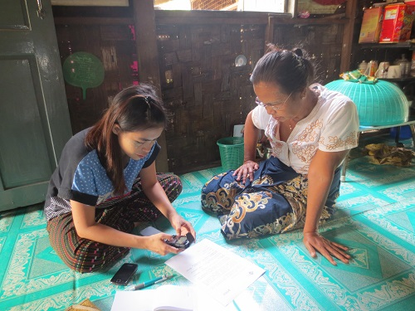
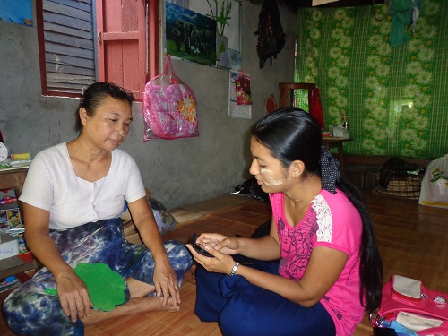
Moving forward…
Regular monthly monitoring
Integration with GIS
Sharing market information
Sharing health knowledge
Networking among beneficiaries
Notes:
Moving forward, we intend to use the mobile technology for regular monthly monitoring. As Magpi platform is not suitable for capturing longitudinal tracking of our beneficiaries, we are looking at the other alternative platforms such as Commcare.
We will also use the mobile phones to capture the geographic coordinates which are currently missing in the latest p-code release.
As mobile coverage in Myanmar improves, we intend to start linking beneficiaries directly with mobile services in sharing market information, sharing health knowledge and networking among beneficiaries for having prompt and better resilience to the problem they face.

Slide 13
GIS…
Notes:
Besides mobile technology, we have started applying the GIS tool in planning and program management. In terms of GIS, we are still in the infancy stage. We completed the first mapping project last month to help our capacity development team to develop a realistic work plan. We provided the township level map like this so that the capacity development team can take into consideration the spread and reachability of target villages.

Slide 14
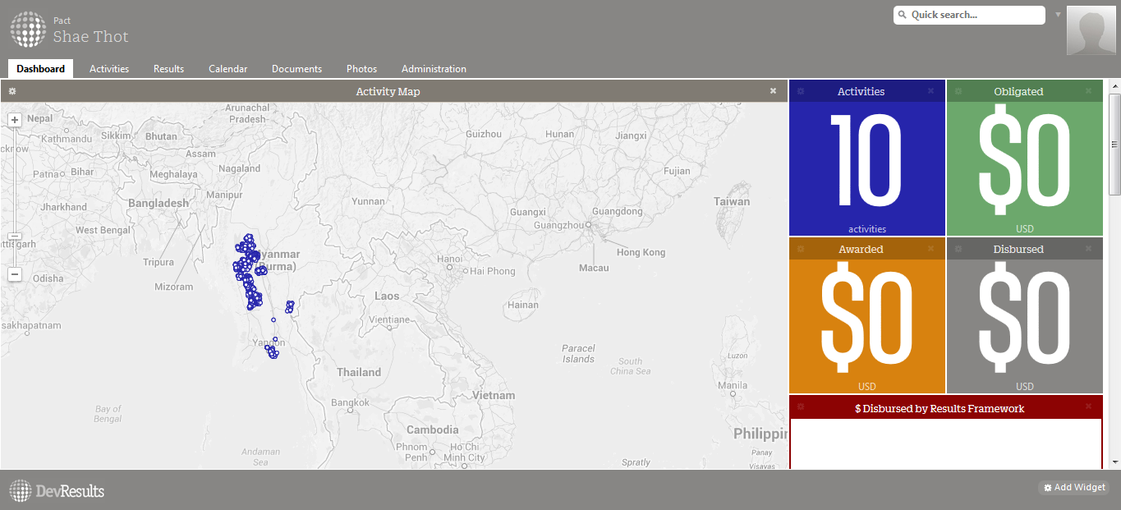
Cloud-based database
Notes:
We are also setting up the cloud-based database which will allow better data access by program personnel and by our partners.

Slide 15
ICT4D Working Group or Taskforce
Proposed first meeting date: May 26, 2014 (Monday)
3pm to 4 pm
Venue: Pact Office
No. 608, Penthouse, Bo Son Pat Condominium
Corner of Merchant Road and Bo Son Pat Street Pabedan Township, Yangon
@ Contact: hhaung@pactworld.org
jlamb@pactworld.org

