Slide 1
FORECAST INTERPRETATION AND INTEGRATION OF INFORMATION OF VARIOUS TIMESCALES
16th Monsoon Forum
Myanmar

Slide 2
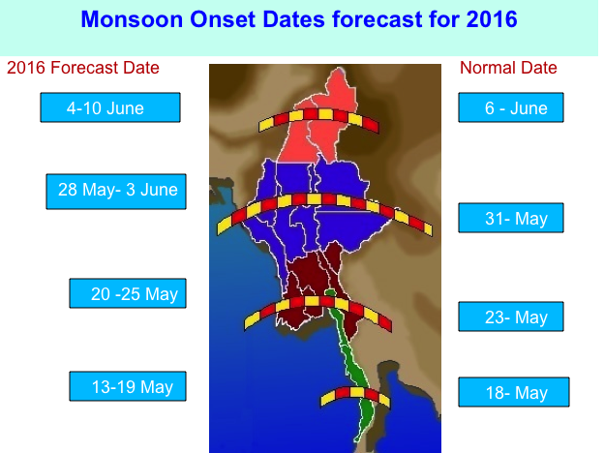

Slide 3
Monsoon Intensity Forecast for 2016
Early-Monsoon | Moderate
Mid-Monsoon | Moderate to Strong
Late-Monsoon | Weak to Moderate

Slide 4
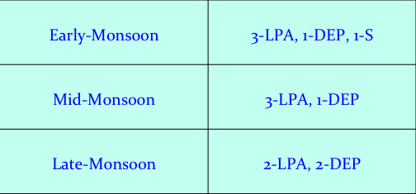
L.P.A, Depression and Storm Forecast for 2016 Monsoon Season

Slide 5
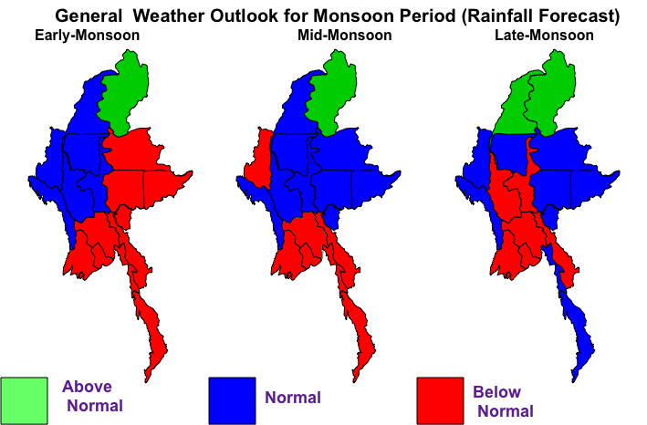

Slide 6
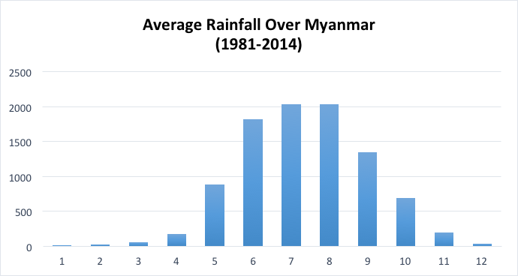

Slide 7
HAZARD CALENDAR
Hazards | J | F | M | A | M | J | J | A | S | O | N | D
Cyclone
High Temperature
Low Temperature
Drought
Squalls
Thunderstorms
Heavy Rain
Monsoon Depression
Hail
Source: DMH

Slide 8
CYCLONIC STORMS WHICH CROSSED MYANMAR COAST, 1877-2012 (Source: DMH)

