Slide 1
Recent Development in the CESR Sector Reform Process
Tin Tin SHU
Task Manager
CESR
18 December 2013

Slide 2
Committee for Implementation of Education Promotion – Diamond Jubilee
Education Promotion Implementation Committee - Background
On 7 October, HE Union President U Thein Sein addressed an Pragmatic Education Reform Seminar, Nay Pyi Taw, emphasising that:
Implementation of education reforms must be accelerated
Education reforms must be pragmatic
Education Promotion Implementation Committee(EPIC) established Oct 2013
Led by H.E. Union Minister in President’s Office (5), U Tin Naing Thein
Co-chaired by Acting Union Minister of Education and Minister of Science and Technology
Task Force of Deputy Ministers from 13 Ministries involved in Education, supported by relevant DGs
Advisory Group of academics, retired faculty members, local experts
18 Working Groups, with over 600 people involved
A key focus for EPIC is to develop Policy, Plan and Budget Link, National Education Law, as an overarching framework for all sub-sectors
CESR findings and recommendations are important for EPIC and EPIC develops Policy, Plan, Budgeting Link and Laws
Notes:
(MoE to add headlines on key areas of consensus on the Rapid Assessment recommendations, especially quick wins; perhaps also mention some areas where consensus is not yet reached?

Slide 3
EPIC – Purpose and Membership
ToRs for the EPIC note that the Committee has been formed ‘In order to effectively and successfully implement education promotion activities in the Republic of the Union of Myanmar’ based on the recommendations of CESR report.
ToRs note that EPIC welcomes and accepts the CESR recommendations”
Membership includes:
Union Minster of President’s Office (5) Chair
Union Minister, Ministry of Education Vice-Chair
Union Minister, MOST Vice Chair
U Nyi Hla Nge (former Dy Minister of Science & Tech) Member
U Aung Myo Min (Former Dy Minister of Education) Member
U Than Oo (chairman of Pyinnya Tazaung – NGO) Member
Dr Myint Kyi (former Chair of Myanmar Language Commission) Member
U Saing Aung Htun (former Professor of History) Member
Dr Thein Myint Member
U Tin Nyo, (Member of Myanmar Human Rights Commission) Member
Dr Tha Lha Shwe, (Chair, Myanmar Red Cross Society) Member
U Lu Ni Member
U Soe Nyunt, Member

Slide 4
PERC –Membership (continued)
Dr. Myint Thein Member
Dr. Khin Mar Htun Member
U Htun Aung Chein (retired University Professor) Member
Dr. Daw Than New (Law Professor) Member
Dr. Thein Lwin (retired Professor) Member
U Tin Htut Ooo Member
Dr. Aung Htun Thet Member
Dr Yin Yin New Member
Dr. Zaw Oo, (formerly Lecturer at Chiang Mai University) Member
Dr Kyaw Yin Hlaing (National University of Singapore) Member
Dr Tin Maung Than Member
Dy. Minister, Ministry of Education Secretary (1)
Dy Minister, Ministry of Education Secretary (2)
Director General, DMERB Secretary (3)

Slide 5
EPIC - Terms of Reference (1)
To implement short (immediate) term and long term activities to develop Myanmar national education as an education system which can facilitate continuing development, meeting international standards
To implement education to become a quality education system which strengthens the traditions and culture of national groups and Myanmar values and to meet needs of Regions and States Development
To manage and implement education to train and produce new generations who are creative and all round developed, and behave as good citizens, and Myanmar youth society appropriate to future democracy
Implement step by step prioritizing activities in consultation with experts, organizations relevant to education, relevant ministries, National Education Committee and Ministry of Education so that the education sector could be reformed in accordance with the current reform processes of the State’s new era and system
Expand and implement human resource development trainings, which will contribute to the labour market needs, in coordination and collaboration with private sector and government in the subsectors of technical and vocational education, non-formal education and private education
.

Slide 6
EPIC - Terms of Reference (2)
Advise and implement amendment of laws, legislation and procedures which are not in line with the current situation as well as those that should be priority from the recommendations of the Comprehensive Education Sector Review – CESR
Implement activities through forming necessary Working Groups for the activities such as education policy, national education law and related legislations, basic education, teacher education, technical and vocational education, higher education system structure and education opportunities, curriculum, education quality assurance, and quality management, which are the recommendations of the Comprehensive Education Sector Review – CESR
To reform education in consultation with State/Region Governments, relevant departments and organizations, and things to be changed despite some strengths in the education sector
To strengthen coordination in order for speedier implementation of current activities and long term plans by existing organizations and committees and Union Ministries as this committee is specially formed to report to the President’s Office and the Union Government directly for the reform and progress of education sector

Slide 7
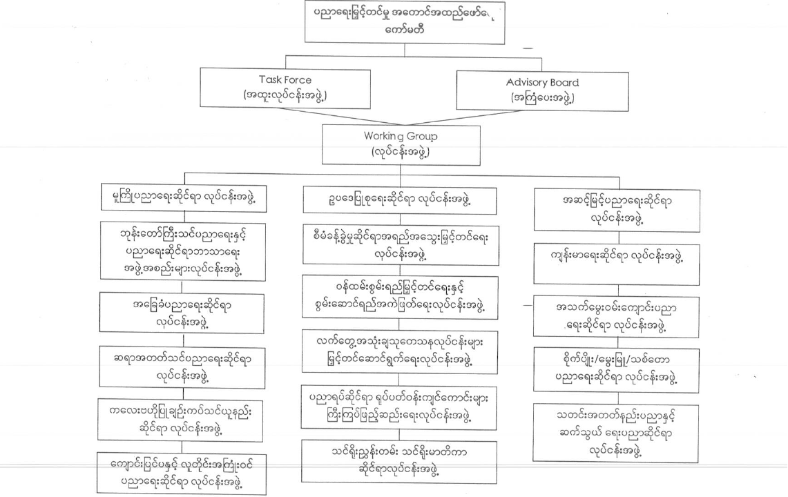
EPIC - Structure
Education Promotion Implementation Committee
Task Force
Advisory Board

Slide 9
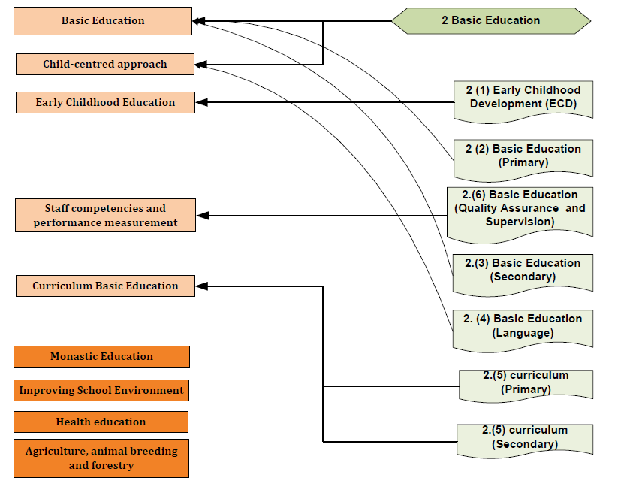

Slide 10
EPIC - Key Tasks and Progress to Date
EPIC is responsible for improving Quality and Equity of Education based on recommendations of CESR to meet Regional Development
EPIC will be conducted in three phases;
i) Phase 1, October 2013 - March 2014 (aligned with end of academic year)
ii) Phase 2, April 2014 - March 2015
iii) Phase 3, April 2015 - December 2015
Each Working Group is required to produce a template by 18 Dec 2013 outlining:
Vision for the thematic area/sub-sector
Policy statement
Activities to be implemented: 2014-16; longer term plans
Vision and policy statements will be consolidated by the Working Group on Law, and incorporated into a National Education Law based on Recommendations of CESR
Drafting of the ‘mother law’ is quite far advanced
Linkages have been made to ensure consistency with the revised Child Law, which is currently being updated

Slide 11
EPIC - Links with CESR
Most EPIC Working Groups are closely relevant to the work of CESR; Working Groups are now starting to be familiar with CESR’s work
Informal meetings and collaboration between key people involved in Working Groups and CESR Sub-Teams have taken place
EPIC members have indicated that they have found CESR outputs to date of great assistance; CESR Team have indicated their willingness to make all materials available to EPIC members
DPs have also provided support on an ad hoc basis, and helped share approved documentation
DP support has been appreciated; further technical and financial assistance are welcome to support planning and costing
Discussions between EPIC and CESR Team have highlighted that close collaboration strengthen implementation for Quality and Equity of Education in every Regions and States.

Slide 12
Next steps
As it is clearly important that the work of EPIC and CESR are aligned, CESR and different Working Groups are planning a series of meetings to share information and ideas
An initial meeting was held at CESR Office on Thursday 5 December, convened by UNICEF, with key members of the groups from both EPIC and CESR.
It is important that CESR/EPIC planning takes account of and builds on successful activities that that are already being implemented, as well as on new evidence produced by CESR
DPs should also take account of GoM priorities, as identified by CESR in their own planning
Strategic prioritisation and costing will be critical to ensure that the Sector Plan is based on a realistic budget, and activities targeted to results and improved learning
DPs supporting CESR will receive a full briefing on EPIC and linkages with CESR from H.E. U Tin Naing Thein on Mon 16 December 2013 in Nay Pyi Taw

Slide 13
Thank you for your kind attention
Any questions? Comments?

