Slide 1

KEY HIGHLIGHTS OF CENSUS RESULTS
KAYAH, KAYIN AND MON STATES

Slide 2
Possible uses of Census Data (Examples)
    Economic and social planning
    Education planning
    Health care planning
    Infrastructure (roads, railway) development
    Improving housing conditions
    Providing amenities (water, electricity, communication, etc.)
    Assessment/Evaluation of programs
    Emergency planning and disaster response
    Business decisions by private sector and individuals
    Administrative purposes (elections, creation of new units, etc.)
    Projection of future populations and their social-economic needs (schools, elderly, immunizations, etc..)
Note: No census in Myanmar since 1983 (over 30 years)
Notes:
Encourage the participants to list other potential uses they can think of

Slide 3
Map of Myanmar
Area in Sq. miles/Km sq.
  Myanmar -261,970/676,578
  Mon State – 4,748/12,297
  Kayin State – 11,731/30,383
  Kayah State – 4,530/11,731
Area constitutes 8.02% of Myanmar land

Slide 4
Number of Administrative Units
STATE/REGION | DISTRICT | SUB/TOWNSHIP | WARD VT
Kachin | 4 | 29 | 760
Kayah | 2 | 8 | 105
Kayin | 4 | 16 | 460
Chin | 3 | 13 | 510
Sagaing | 9 | 45 | 1,995
Tanintharyi | 3 | 16 | 350
Bago | 4 | 28 | 1,697
Magway | 5 | 26 | 1,705
Mandalay | 7 | 30 | 1,685
Mon | 2 | 12 | 463
Rakhine | 5 | 20 | 1,177
Yangon | 4 | 46 | 1,366
Shan | 14 | 80 | 1,904
Ayeyawady | 6 | 33 | 2,172
Nay Pyi Taw | 2 | 8 | 243
 | 74 | 410 | 16,592

Slide 5
A. DEMOGRAPHIC CHARACTERISTICS
HIGHLIGHTS OF 2014 CENSUS

Slide 6
Population of Myanmar, 2014
Total | 51,486,253
Male | 24,824,586
Female | 26,661,667
Sex ratio | 93 males per 100 females
Urban | 30%
Rural | 70%
Population Density | 76.1 persons/Square Km
Notes:
The Total Population includes 1.2 million people that were not enumerated in Kachin State, Kayin State and Rakhine State.
For the missed population, estimates were made based on information previously collected through the mapping and household listing exercises

Slide 7
Population by State/Region
State/Region | Both sexes | Male | Female
Union | 51,486,253 | 24,824,586 | 26,661,667
Kachin | 1,689,441 | 878,384 | 811,057
Kayah | 286,627 | 143,213 | 143,414
Kayin | 1,574,079 | 775,268 | 798,811
Chin | 478,801 | 229,604 | 249,197
Sagaing | 5,325,347 | 2,516,949 | 2,808,398
Tanintharyi | 1,408,401 | 700,619 | 707,782
Bago | 4,867,373 | 2,322,338 | 2,545,035
Magway | 3,917,055 | 1,813,974 | 2,103,081
Mandalay | 6,165,723 | 2,928,367 | 3,237,356
Mon | 2,054,393 | 987,392 | 1,067,001
Rakhine | 3,188,807 | 1,526,402 | 1,662,405
Yangon | 7,360,703 | 3,516,403 | 3,844,300
Shan | 5,824,432 | 2,910,710 | 2,913,722
Ayeyawady | 6,184,829 | 3,009,808 | 3,175,021
Nay Pyi Taw | 1,160,242 | 565,155 | 595,087
Notes:
The difference between the total numbers of males and females in Kayah State is very small (almost equal), Mon State (female more by 79,600) in Kayin State (female more by 23,500). However, at the Union level, there are more females than males by 1,837,081

Slide 8
Proportion of total population and area by State/Region
Notes:
Yangon, Mandalay and Ayeyawady have the highest proportion of the population in the country, together contributing 36% of the total population.
The areas of Kayah, Kayin and Mon accounts for 7.7 of the population
Smallest area is NPT (1%) while smallest population Kayah (0.6%)

Slide 9
Population Density by State/Region
Notes:
Population density is important for understanding the spacial distribution of the population, so that development programmes can be targeted to areas commensurate with the population that live there.
Many sectors such as health, education, private sector, infrastructure development, etc., need information on population development in order to effectively provide social services

Slide 10
Sex Ratio (Union)
Notes:
Sex ratio is the number of males per 100 females.
Sex ratios can be used to observe migration (especially among working age cohorts) and mortality among the different sexes.

Slide 11
Population by Rural/Urban (Union)
Notes:
Urban and Rural are based on the GAD classification:
Urban: Cities, State/Region capitals and Wards
Rural: Village Tracts.

Slide 12
Kayah State Population by District and Township
 | Total Population
 | Both sexes | Male | Female
KAYAH | 286,627 | 143,213 | 143,414
Urban | 72,418 | 35,679 | 36,739
Rural | 214,209 | 107,534 | 106,675
LOIKAW | 243,718 | 119,833 | 123,885
Loikaw | 128,401 | 63,109 | 65,292
Dimawso | 79,201 | 38,936 | 40,265
Phruso | 29,374 | 14,437 | 14,937
Shardaw | 6,742 | 3,351 | 3,391
BAWLAKHE | 42,909 | 23,380 | 19,529
Bawlakhe | 8,480 | 4,651 | 3,829
Parsaung | 25,594 | 13,906 | 11,688
Meisi | 6,319 | 3,402 | 2,917
Ywathit (Sub-Tsp) | 2,516 | 1,421 | 1,095
More males than females in Bawlakhe District and TSPs, why?
Notes:
More males than females in Bawlakhe District and the townships, what could be the issue?

Slide 13
Kayin State Population by District and Township
 | Total Population
 | Both Sexes | Male | Female
KAYIN | 1,504,326 | 739,127 | 765,199
- KAYIN Urban | 329,166 | 163,280 | 165,886
- KAYIN Rural | 1,175,160 | 575,847 | 599,313
HPA-AN | 783,510 | 382,327 | 401,183
Hpa-An | 421,575 | 203,910 | 217,665
Hlaingbwe | 155,544 | 75,960 | 79,584
Thandaunggyi | 30,209 | 15,297 | 14,912
Paingkyon(Sub-Tsp) | 88,604 | 42,977 | 45,627
Shan Ywathit(Sub-Tsp) | 21,735 | 10,963 | 10,772
Leiktho(Sub-Tsp) | 48,606 | 24,703 | 23,903
Bawgali(Sub-Tsp) | 17,237 | 8,517 | 8,720
PHARPON | 35,085 | 17,983 | 17,102
Pharpon | 14,190 | 7,599 | 6,591
Kamamaung(Sub-Tsp) | 20,895 | 10,384 | 10,511
MYAWADY | 210,540 | 107,607 | 102,933
Myawady | 195,624 | 99,771 | 95,853
Sugali(Sub-Tsp) | 5,703 | 2,987 | 2,716
Wawlaymyaing(Sub-Tsp) | 9,213 | 4,849 | 4,364
KAWKAREIK | 475,191 | 231,210 | 243,981
Kawkareik | 220,342 | 105,524 | 114,818
Kyarinseikkyi | 106,427 | 51,806 | 54,621
Payarthonezu(Sub-Tsp) | 90,484 | 44,600 | 45,884
Kyaidon(Sub-Tsp) | 57,938 | 29,280 | 28,658

Slide 14
Mon State Population by District and Township
 | Total Population
 | Both Sexes | Male | Female
MON | 2,054,393 | 987,392 | 1,067,001
Urban | 572,189 | 273,561 | 298,628
Urban | 1,482,204 | 713,831 | 768,373
MAWLAMYINE | 1,232,221 | 587,676 | 644,545
Mawlamyine | 289,388 | 139,026 | 150,362
Kyaikemaraw | 195,810 | 92,746 | 103,064
Chaungzon | 122,126 | 55,596 | 66,530
Thanbyuzayat | 170,536 | 81,449 | 89,087
Mudon | 190,737 | 89,976 | 100,761
Ye | 152,485 | 76,089 | 76,396
Lamine(Sub-Tsp) | 88,476 | 41,634 | 46,842
Khawzar(Sub-Tsp) | 22,663 | 11,160 | 11,503
THATON | 822,172 | 399,716 | 422,456
Thaton | 238,106 | 116,394 | 121,712
Paung | 218,459 | 105,371 | 113,088
Kyaikto | 184,532 | 90,031 | 94,501
Bilin | 181,075 | 87,920 | 93,155

Slide 15
Population Pyramid (Union)
Notes:
The Union population pyramid shows a declining proportion of children in the population, reflecting lower birthrates at the Union level.
The pyramid shows a large proportion of the population in the younger age groups, which presents an opportunity to the country to develop if the young people are well invested in (Good education, good employment, skills development, participation in decision making and democratic processes, etc..)

Slide 16
Changing population structure (Union)
Notes:
The 1973 and 1983 pyramids were broad-based, showing larger proportions of children under the age of 10 years
The 2014 pyramid shows declining proportions of children, but increasing proportions of young people who are graduating into the working-age population. As discussed in the previous slide, these young people present an opportunity for the development of the country, if well invested in.

Slide 17
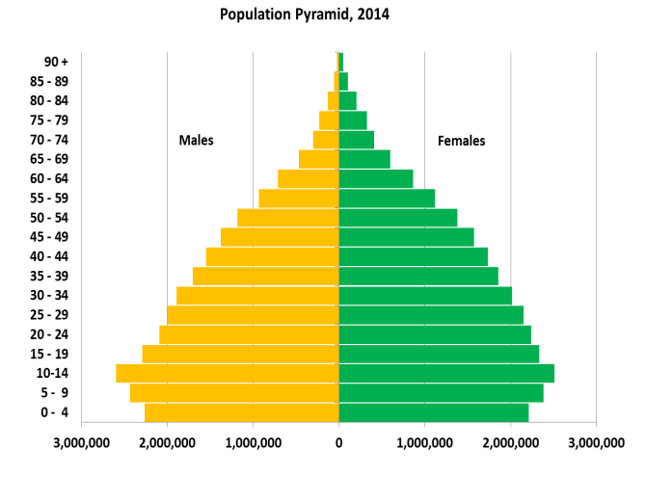
Population Pyramid for Kayah State
Notes:
The population pyramid for Kayah State has a different shape from the Union pyramid.
The Kayah pyramid shows a higher proportion of children in the population, which has contributed to the broad base of the pyramid
This means birthrates are higher and these children will exert pressure on education needs, health services and employment services in the next few years.

Slide 18
Population pyramid – Bawlakhe District
Notes:
Encourage participants to explain this shape, its possible source and the implications for Bawlakhe district and for Kayah State.
Is the shape due to large migration of males into Kayah? Is it because of institutional population (e.g. army barracks, etc.)?

Slide 19
Population Pyramid, Kayin State, 2014
The population pyramid for Kayin State in 2014 has a broad base, illustrating increasing birthrates.
This show that the population suddenly declines in the working age groups from age 15 to 64.

Slide 20
Population pyramid –Hpa-An District
The population pyramid for Hpa-An takes the same shape as the one for Kayin State
A broad base, illustrating increasing birthrates
This shows that the population suddenly declines in the working age groups from age 15 to 64.
Male
Female
What are the implications of this population structure ?
Any implication on economic, immigration, etc..?

Slide 21
Population Pyramid of Mon State
Mon’s population pyramid is pot shape. This means declining birthrates and illustrates that there is a larger proportion of population aged 10 – 14 years.
Notes:
The population pyramid for Mon State in 2014 displays an almost similar shape to the population pyramid of the Union,
but with a dome-shape after the ages 20 – 24.
The shape of the pyramid illustrates that there is a larger proportion of young people in the population and a potential for a larger elderly population in the future.

Slide 22
Kayah State by special age groups
Total Population | 0 – 14 Years | 15 – 64 Years | 65 Years +
286,627 | 99,003 | 176,934 | 10,690
Notes:
The proportion of the working age population is about 62%. At the Union level, it is about 66%. The proportion of children in Kayah is 35%, while at the Union level, the proportion of children is 29%

Slide 23
Mon State by special age groups
Total Population | 0 – 14 Years | 15 – 64 Years | 65 Years +
2,054,393 | 641,960 | 1,278,995 | 133,438

Slide 24
Kayin State by special age groups
Total Population | 0-14 years | 15-64 years | 65 years +
1,504,326 | 538,596 | 888,642 | 77,088

Slide 25
Households by size of household
Notes:
Information on household size is vital in understanding the living arrangements of a society, the quality of life, and the housing needs of the population. During disasters, it is also important to understand the average household size in order to respond effectively to the needs of the affected population

Slide 26
Mean Household Size

Slide 27
Mean Household Size – Kayah State
The average number of persons per household is highest in Dimawso Township

Slide 28
Mean Household Size – District and Township
The average number of persons per household is highest in Shan Ywathit Sub township

Slide 29
Mean Household Size - Township
The average number of persons per household is highest in Ye and Paung Townships

Slide 30
Female-headed households
Tanintharyi and Mon have the highest female headed households, migration???
Notes:
This is important for determining safety nets for potential vulnerable populations in society.
For example, households headed by females are more likely to be poorer (labour force participation of females is very low in Myanmar); are less likely to send children to school; less likely to afford good nutrition, etc..
Development agencies may therefore design programmes aimed at ensuring that the vulnerabilities associated with female headed households are addressed.

Slide 31
B. SOCIAL CHARACTERISTICS

Slide 32
Marital Status for Males and Females at Union Level
(age 15 years+)

Slide 33
Marital Status of Male by different age groups at Union Level

Slide 34
Marital Status of Female by different age groups at Union Level

Slide 35
Marital Status for Males and Females in Kayah State (age 15 years+)
Males
Females
Proportion of married males and females is the same
More females are widowed (10%) than males (2%)
Notes:
Marital status is one of the most important factors affecting population dynamics, particularly fertility (and more importantly in the case of Myanmar).
Marital status also affects other social and economic characteristics of the population, such as education/school attendance, labour force participation, etc., especially in late adolescence and young adulthood.
At the Union level, a higher proportion of males (61%) than females (58%) are married, while the proportion of those who reported single is also slightly higher for males (32%) than females (30%).
However, many more females (10%) than males (3%) are widowed at the Union level.
How can these differences in singlehood and widowhood between males and females be explained in Kayah?

Slide 36
Marital Status for Males and Females in Kayin State
(age 15 years+)
Male
Female
Divorced/ Separated
Renounced
Widowed
Single
Married
Proportion of married males and females is the same
More females are widowed (11.3%) than males (3.5%)

Slide 37
Marital Status for Males and Females in Mon State
(age 15 years+)
Male
Female
Proportion of married males is higher than females
More females are widowed (11.4 %) than males (3.6%)

Slide 38
C. MIGRATION

Slide 39
People born in Kayah State, but residing outside Kayah
Born in Kayah | 254,125
Living in Kayah | 232,126
Living outside Kayah | 21,999
Notes:
Most of the people born in Kayah but living outside Kayah are in Shan State, Yangon Region and Mandalay Region.
Understanding volumes of migration is important because it is a basic factor for population change (along with births and deaths) and the labour force in an area.

Slide 40
People born outside Kayah, residing in Kayah
Notes:
Most of the people born outside Kayah, but living in Kayah, are from Shan State and from Mandalay Region.
It is important to understand this information, so that the flow of in-migrants is included in the development plans of Kayah State

Slide 41
Persons born in and outside of Kayah by residence
Notes:
There are more people that have moved to Kayah, compared to the number that has moved out of Kayah.
Development planners need to take into account the positive net migration in their planning, as it has implications on service delivery (education, health, housing, etc.)

Slide 42
Reason for Moving
Notes:
This is important in order to understand the “Push” and the “Pull” factors affecting migration.
In Kayah, More females have migrated than males
The most common reason for moving for males is employment, while females mostly move to follow family.

Slide 43
People reported in Kayah as living abroad, by country of residence
Total | Thailand | Malaysia | Singapore | USA | Other
8,385 | 5,601 | 1,134 | 716 | 414 | 520
Notes:
Most of the people from Kayah that were reported to be abroad were in Thailand (67%).

Slide 44
Persons born in and outside of Kayin by residence

Slide 45
Reasons for Moving
The most common reason for moving for males is employment. For females, following family.

Slide 46
Persons born in and outside of Mon by residence

Slide 47
Reasons for Moving
The most common reason for moving for males is employment. For females, following family.

Slide 48
People reported in Mon as living abroad, by country of residence
Total | Thailand | Malaysia | Singapore | USA | Other
426,586 | 385,487 | 32,620 | 4,342 | 957 | 3,180

Slide 49
International Migration
Notes:
The numbers are based on what was reported by households during the Census (the numbers could be higher).
In absolute numbers, Kayah has the lowest number of people that were reported to be abroad.

Slide 50
D: EDUCATION CHARACTERISTICS

Slide 51
Literacy by State/Region
Notes:
Kayah needs to change to the green side of the Union Average.
What needs to be done to achieve this?
Who needs to do what? Who are the stakeholders?
How long would it take?

Slide 52
Literacy Rates by State/Region
Notes:
Literacy rate among the population aged 15 and over is 89.5 percent
Kayah has one of the lowest literacy rates in the country (Highest is Yangon with 97%, while Kayah is only 82%). What could be the reason for this (ask the education people that are present at the workshop)
The difference between males and females is very wide (about 10%). What could be the reason and what are the implications on development in Kayah?

Slide 53
Myanmar’s literacy rate is equal to the average literacy rates for ASEAN countries

Slide 54
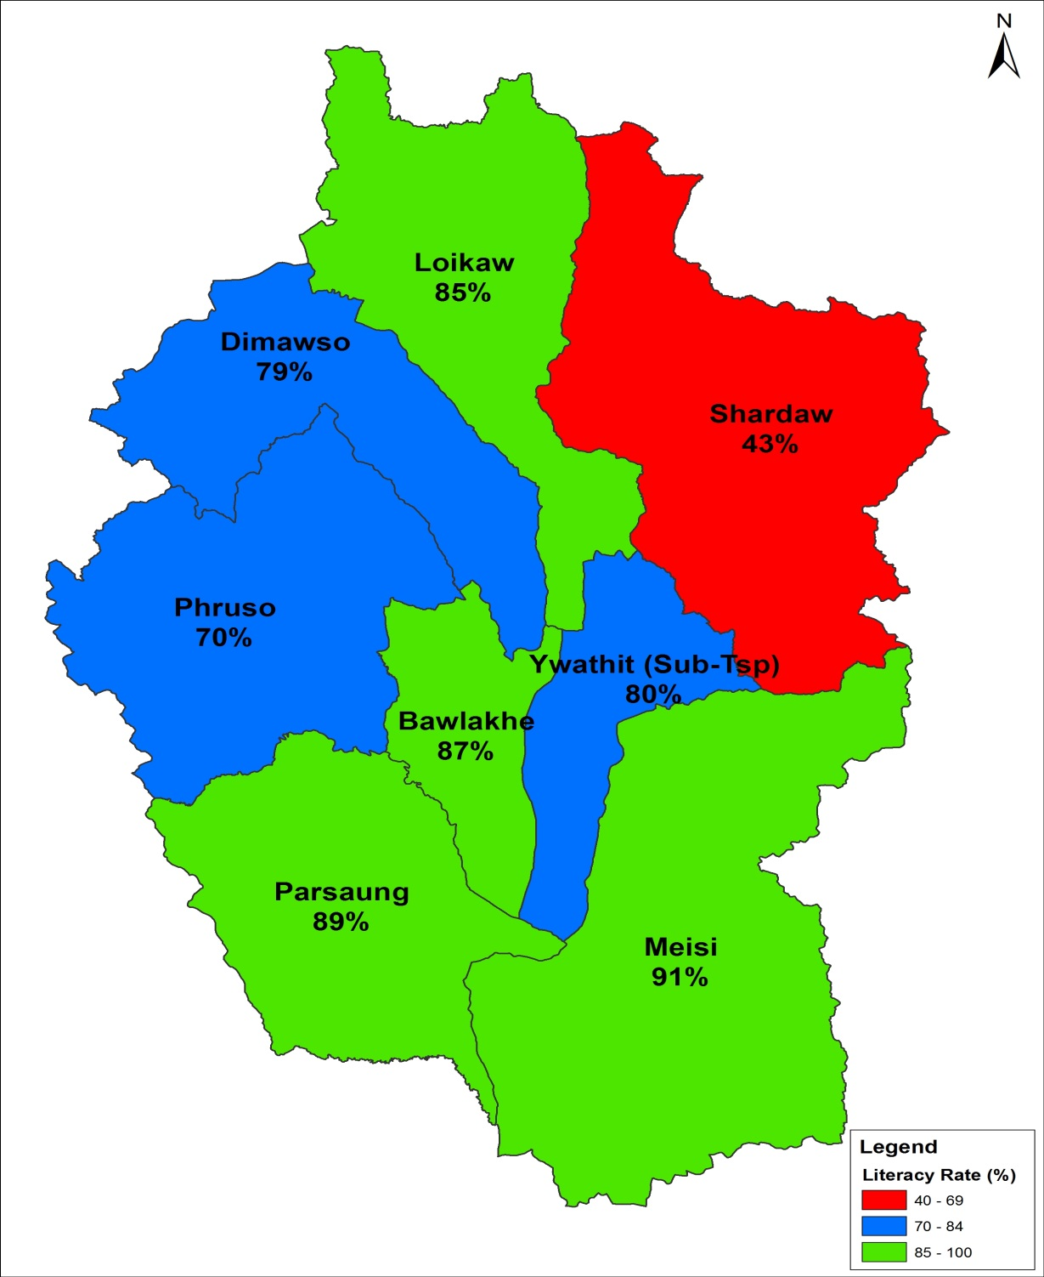
Literacy rates are much lower in Shardaw Township compared to other Townships. What could be the reasons?
Literacy Rates by Township
Union Average: 89.5%
Kayah Average: 82.1%
How do the Townships compare?

Slide 55
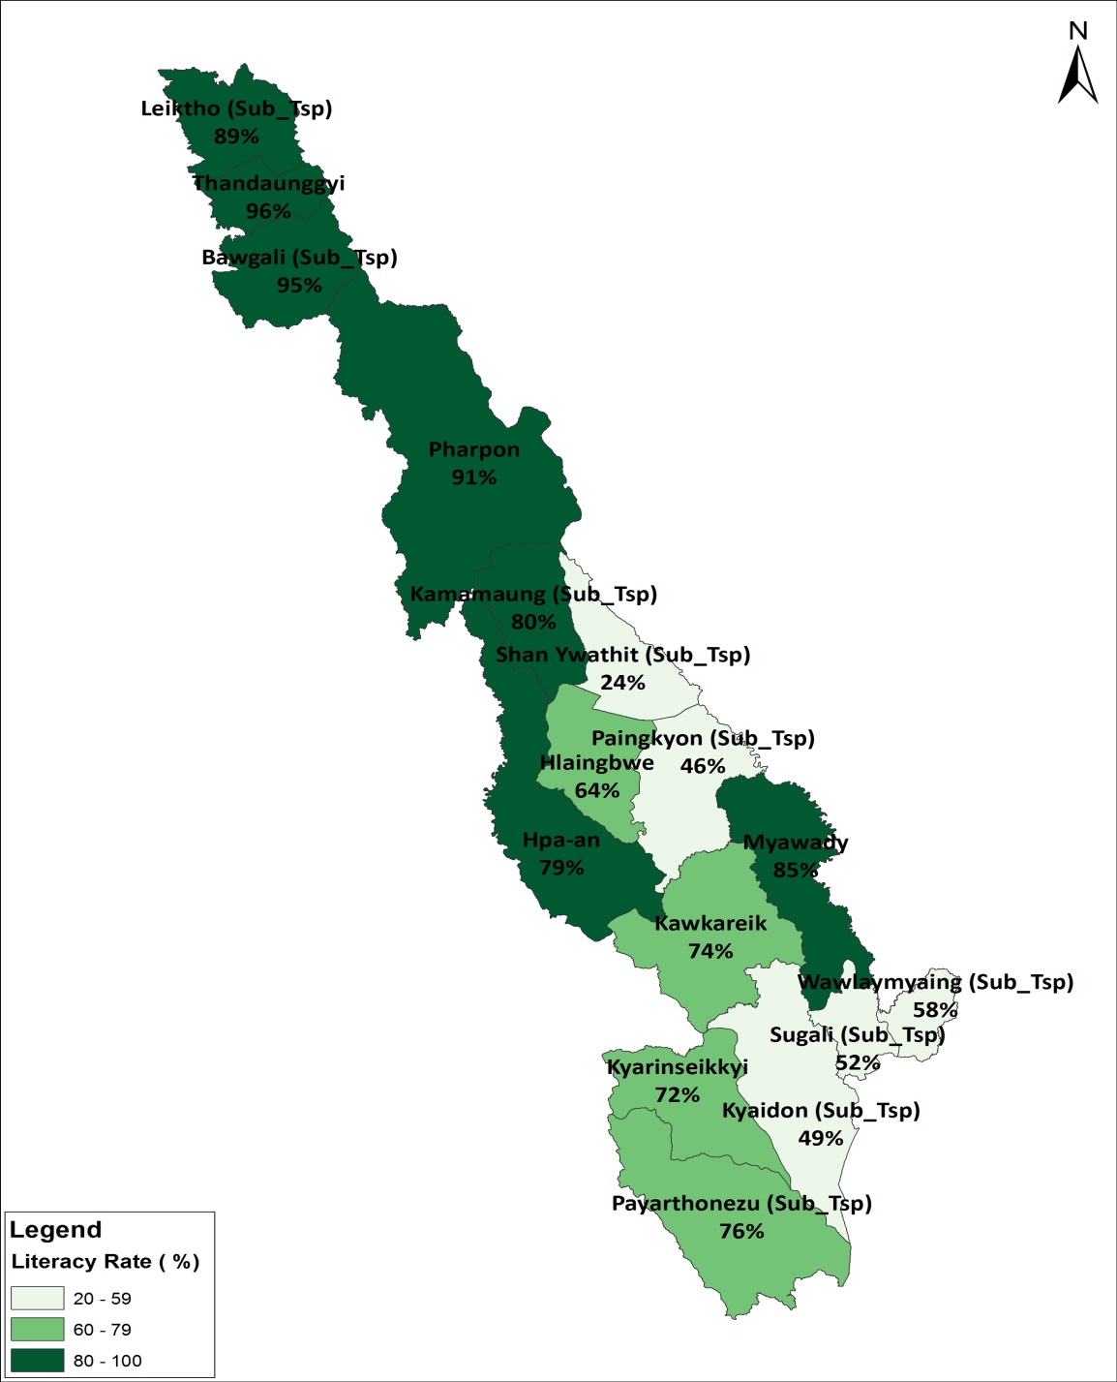
Literacy rates are much lower in Shan Ywarthit sub township.
Compare among Townships.
What could be the reasons?
Literacy Rates by Township
Union (Average) : 89.5%
Kayin (Average) : 74.4%

Slide 56
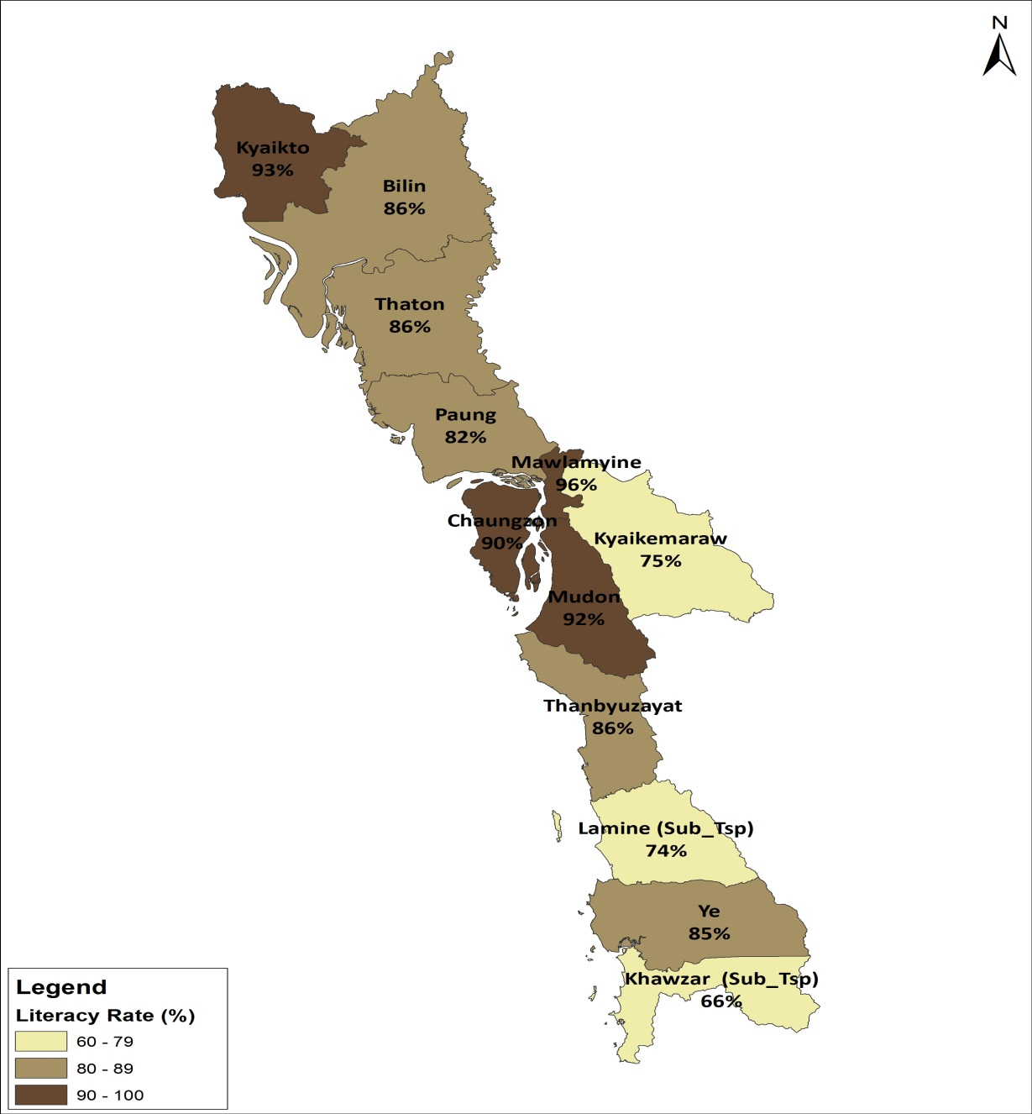
Literacy rates are much lower in Khawzar (Sub) Township compared to other Townships.
What could be the reasons?
Literacy Rates by Township
Union (Average) 89.5%
Mon(Average): 86.6%

Slide 57
School attendance by Age and Sex - Kayah State
Notes:
Do children drop out of school to join the labour-force at a younger age?
Is Child labour a problem in Kayah?
Why are boys dropping out more than girls?
What needs to be done to address this problem?

Slide 58
School attendance by Age and Sex -
Kayin State
Notes:
Do boys drop out of school to join the labour-force at a younger age?
Is Child labour a problem in Kayin?

Slide 59
School attendance by Age and Sex -
Mon State
Notes:
Do boys drop out of school to join the labour-force at a younger age?
Is Child labour a problem in Mon?

Slide 60
Highest Education level Completed 25yrs +
44.2% of population have completed primary education
16.2% have No Education
Notes:
Does the information reflect reality, that 16.2 % have no education and that only 9% hold Diploma and above?
What can be done in such situation?
There is small gender differential

Slide 61
Highest Education Level, 25yrs +
Proportion of population with no education is high in Shan, Kayin and Chin

Slide 62
Highest Education Level 25+, Kayah State
Within Kayah State, in all townships 15% of their population have not completed any education level, worst is Shardaw Tsp with 67.3%
Notes:
Why is the level of education completed so bad?

Slide 63
E: ECONOMIC CHARACTERISTICS

Slide 64
Unemployment rate by State/Region
Notes:
Information on economic activities collected from 10 yrs +
Unemployment Rate refers to the share of the labor force that is without work but available for and seeking employment.
The Unemployment Rate reported here relates to those aged 15-64 years old
Kayah has one of the lowest unemployment rates in the country.

Slide 65
Labour Force Participation Rate by State/Region
Notes:
Labor force participation rate is the proportion of the population ages 15-64 years that is economically active (i.e. people who supply labour for the production of goods and services)
Labour force participation of Kayah is relatively higher than most States/Regions.
However, labour force participation of females remains low. What can be done to improve the labour force participation of women?

Slide 66
F: BIRTHS AND DEATHS

Slide 67
Total Fertility Rate by State/Region
Notes:
Total fertility rate represents the average number of children that would be born to a woman if she were to live to the end of her childbearing years (ages 15-49 years)
Total fertility rate is an important determinant of population change and for planning of social-economic development of a country

Slide 68
IMR and U-5MR by State/Region
Notes:
Infant Mortality means death of children before they reach their first birthday
Under-5 Mortality means death of children before they reach their fifth birthday
Infant mortality of 62 and Under-5 mortality of 72 for Kayah State are still unacceptably high. The causes of such deaths should be examined and addressed as a matter of urgency.
What can be done about it? Who are the main players to reduce these rates?

Slide 69
Life Expectancy at Birth by State/Region
Notes:
Life expectancy at birth indicates the number of years a newborn infant would live, assuming mortality patterns at the time of its birth remain the same throughout its life.

Slide 70
H: Disability

Slide 71
Disability prevalence by State/Region
Notes:
The categories of disability that were collected during the census are: Seeing, Hearing, Walking and Remembering.
The options available as responses were: 1. No – No difficulty; 2. Yes – Some difficulty; 3. Yes – a lot of difficulty; and 4. Cannot do at all
Disability prevalence was based on people that gave options 2, 3 and 4 as their responses.

Slide 72
Disabled Population by Type of Disability – Kayah State
 | Persons | Males | Females
Total | 286,627 | 143,213 | 143,414
Not Disabled | 270,010 | 135,324 | 134,686
Disabled | 16,617 | 7,889 | 8,728
Type of Disability:
In Seeing | 9,026 | 3,987 | 5,039
In Hearing | 5,790 | 2,746 | 3,044
Walking | 6,589 | 3,054 | 3,535
Remembering | 6,940 | 3,187 | 3,753
Disability prevalence rate in Kayah State is 5.5% for Males and 6.1% percent for Females
Notes:
It is important for people working in the areas of disability to know the actual numbers of disability, by type of disability. With such information, they can estimate the resources required to support people with disability, e.g. how many wheelchairs, how many hearing aides, etc..

Slide 73
Disabled Population by Type of Disability – Mon State
 | Persons | Male | Female
Total | 2,054,393 | 987,392 | 1,067,001
Not Disabled | 1,945,095 | 937,613 | 1,007,482
Disabled | 109,298 | 49,779 | 59,519
Type of Disability:
In Seeing | 60,858 | 25,640 | 35,218
In Hearing | 29,876 | 13,269 | 16,607
Walking | 43,656 | 19,988 | 23,668
Remembering | 35,753 | 16,386 | 19,367
Disability prevalence rate in Mon State is 5% for Males and
5.6% percent for Females

Slide 74
Disabled Population by Type of Disability – Kayin State
 | Both Sexes | Male | Female
Total | 1,504,326 | 739,127 | 765,199
Disabled | 99,389 | 45,996 | 53,393
Not Disabled | 1,404,937 | 693,131 | 711,806
Type of Disabled
In Seeing | 60,539 | 25,956 | 34,583
In Hearing | 28,603 | 12,886 | 15,717
Walking | 39,030 | 18,175 | 20,855
Remembering | 38,598 | 17,396 | 21,202
Disability prevalence rate in Kayin State is 6.2 % for Males and
7 % percent for Females

Slide 75
Disability by Age and Sex
Notes:
Disability increases as people get older, as expected. For Kayah, the disability rate rises after age 35 years.

Slide 76
I: HOUSING CONDITIONS

Slide 77
OWNERSHIP OF HOUSING UNIT - UNION
86 percent of households own their housing unit
Owner = (86 %)
Renting = (7 %)
Government quarters = (3 %)

Slide 78
Type of Housing Unit UNION
 | Apart/ Cond | Bglw/ Brick | Semi-pacca | Wooden | Bamboo | Hut 2 - 3 years | Hut 1 year | Other
UNION | 4.5 | 6.8 | 6.5 | 41.2 | 37.4 | 1.9 | 0.9 | 0.8
- Urban | 12.4 | 13.3 | 11.0 | 37.4 | 23.6 | 0.8 | 0.5 | 1.0
- Rural | 1.4 | 4.2 | 4.8 | 42.7 | 42.7 | 2.3 | 1.0 | 0.8

Slide 79
74.3% of households have improved toilet facilities in Myanmar
Households with improved facilities – Rural (67.3%) and Urban (92.3%)
Most households have water seal,
But 14% of households have no toilet facilities

Slide 80
Access to Improved Sanitation by State/Region
Notes:
Improved sanitation includes Flush Toilet and Water Seal Toilet (Improved pit latrine) only.
Poor sanitation may lead to the spread of communicable diseases, particularly food and water-borne diseases
Although the proportion of households that use improved sanitation in Kayah is high, it can still be improved

Slide 81
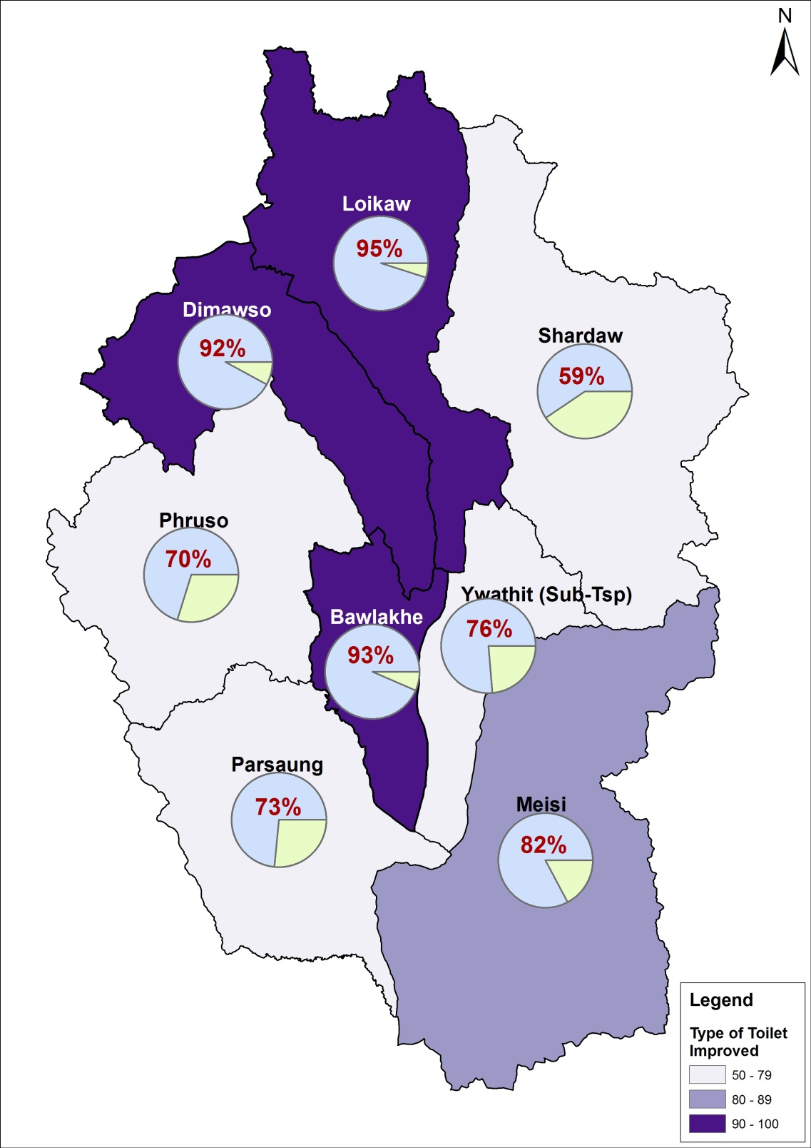
Access to Improved Sanitation by Township
Union Average: 74.3%
Kayah Average: 88.6%
How do the Townships compare?
Notes:
Improved sanitation includes Flush Toilet and Water Seal Toilet (Improved pit latrine) only
What can be done to improve sanitation in Townships such as Shardaw, Pruso, Parsaung, etc.?

Slide 82
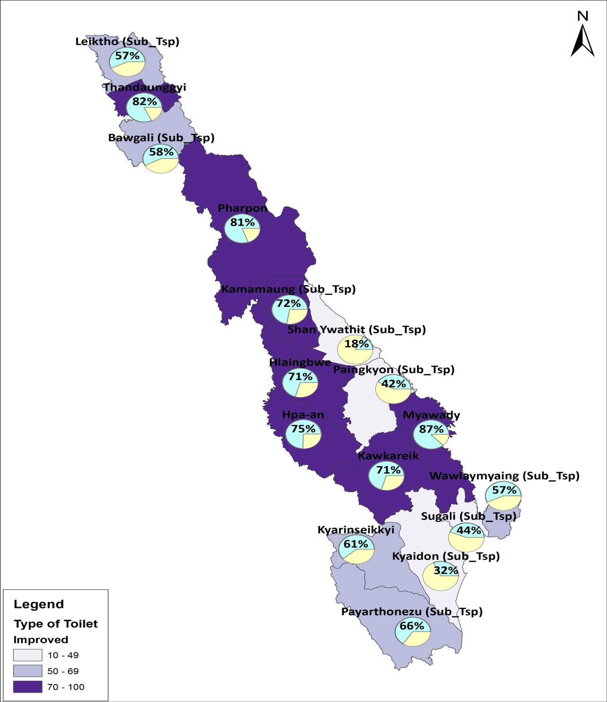
Access to Improved Sanitation by Township (Kayin)
Union Average: 74.3%
Kayin Average: 68.9%
How do the Townships compare?

Slide 83
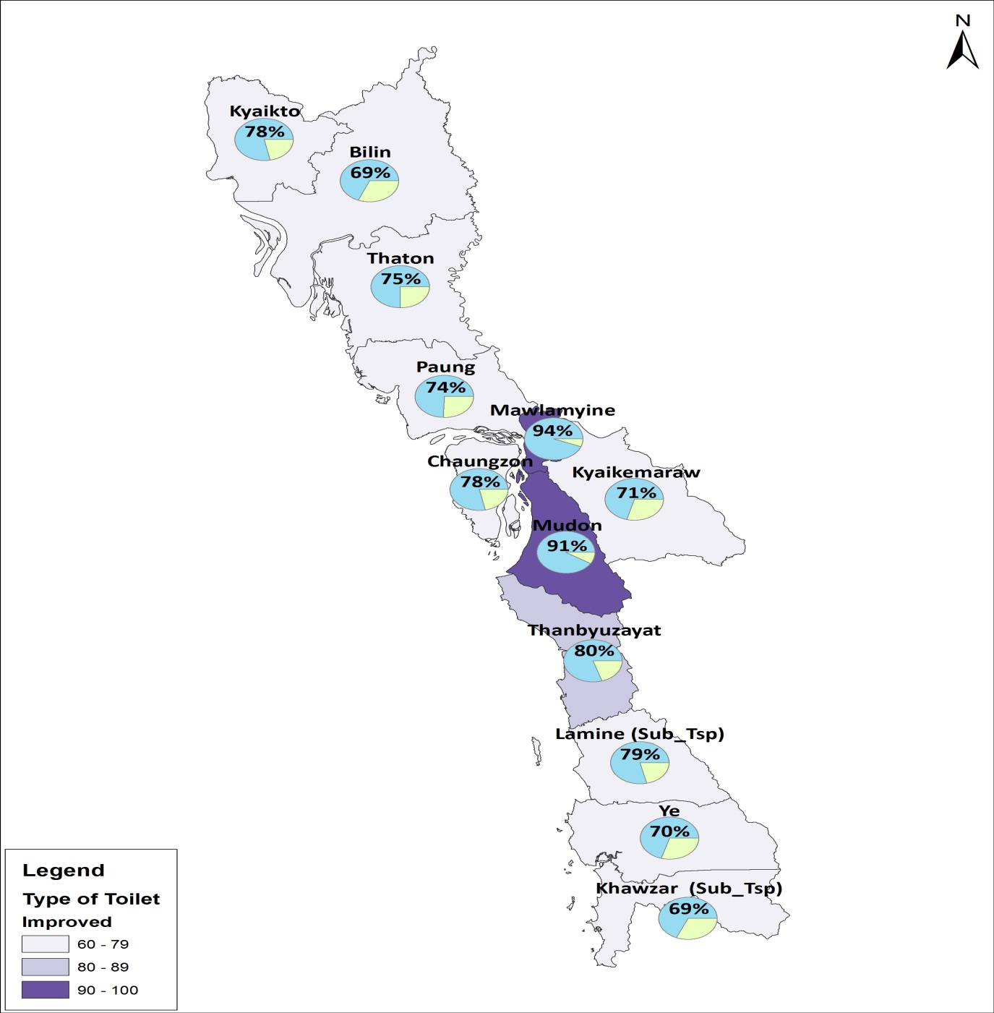
Access to Improved Sanitation by Township (Mon)
Union Average: 74.3%
Mon Average: 78.7%
How do the Townships compare?

Slide 84
SOURCE OF WATER FOR DRINKING
About 31 percent of households use a tube well or borehole as a main source of drinking water
Tube well or borehole = (31 %)
Tap water/ piped = (9 %)
Protected well/ Spring = (19 %)
Water Purifier = (10%)
About 69% of households use safe water

Slide 85
About 31 percent of households in urban areas use water purifiers or bottled water

Slide 86
Access to Improved Source of Water by State/Region
Notes:
Improved water source includes: Tap water, Tube-well, Protected spring, Water purifier and Bottled water
Kayah has one of the lowest proportions of households with access to improved water sources
What can be done to increase access to improved sources of water?
Who are the main players in the area of water supply? What is the way forward on this issue?

Slide 87
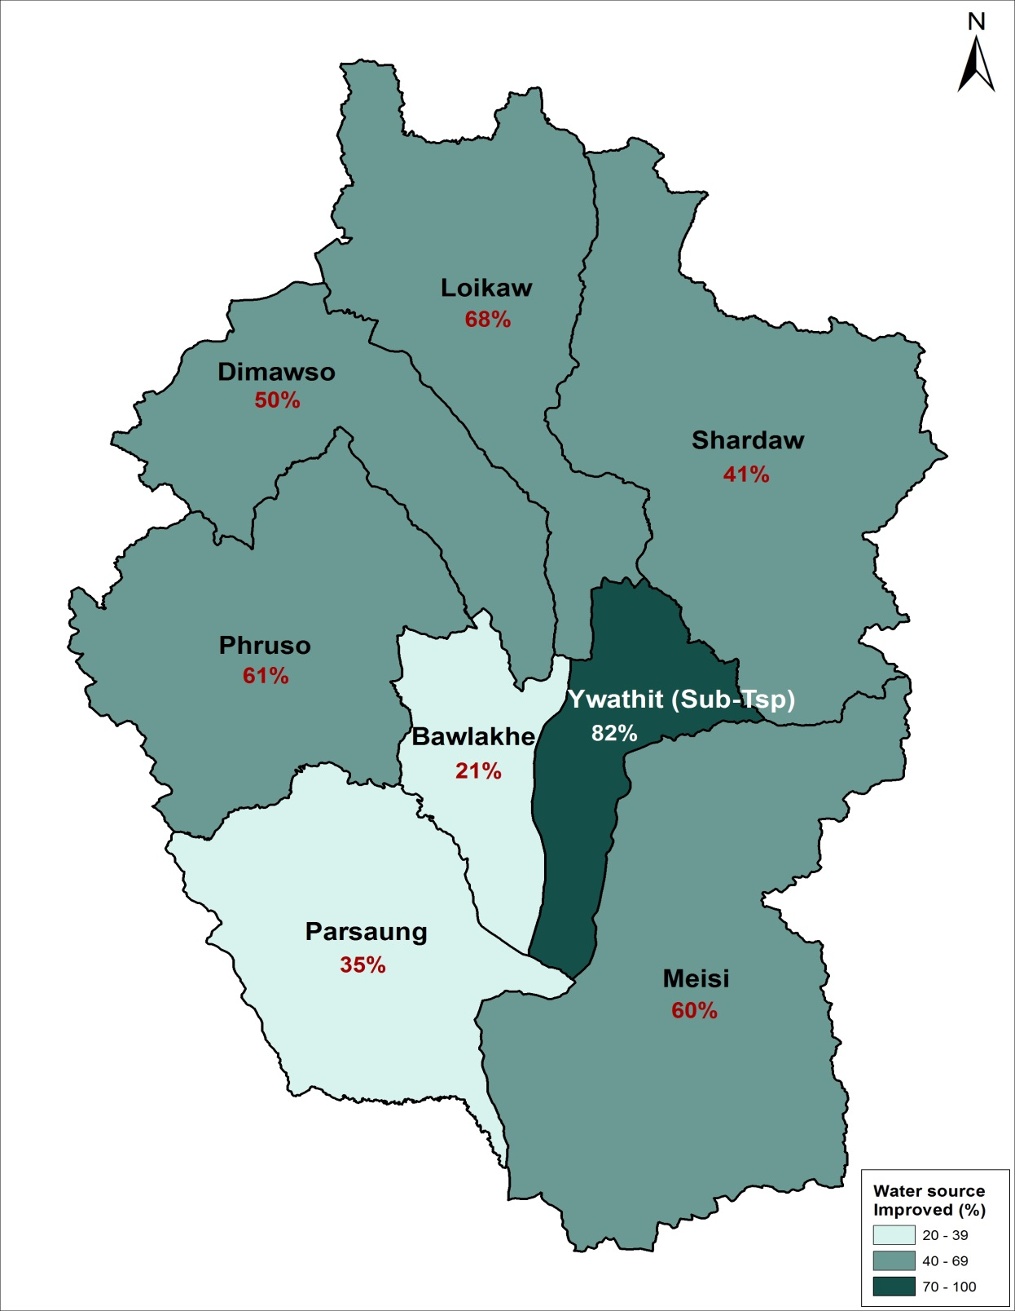
Proportion of HHolds with improved source of drinking water by Township
Kayah Average: 58%
Lowest
Bawlakhe: 21%
Parsaung: 35%
Highest:
Ywathit (ST): 82%
Loikaw: 68%
Notes:
Bawlakhe and Parsaung Townships have particularly low access to improved sources of water.
Why is this the case? What can be done about it?
Who are the main players and what should be the way forward?

Slide 88
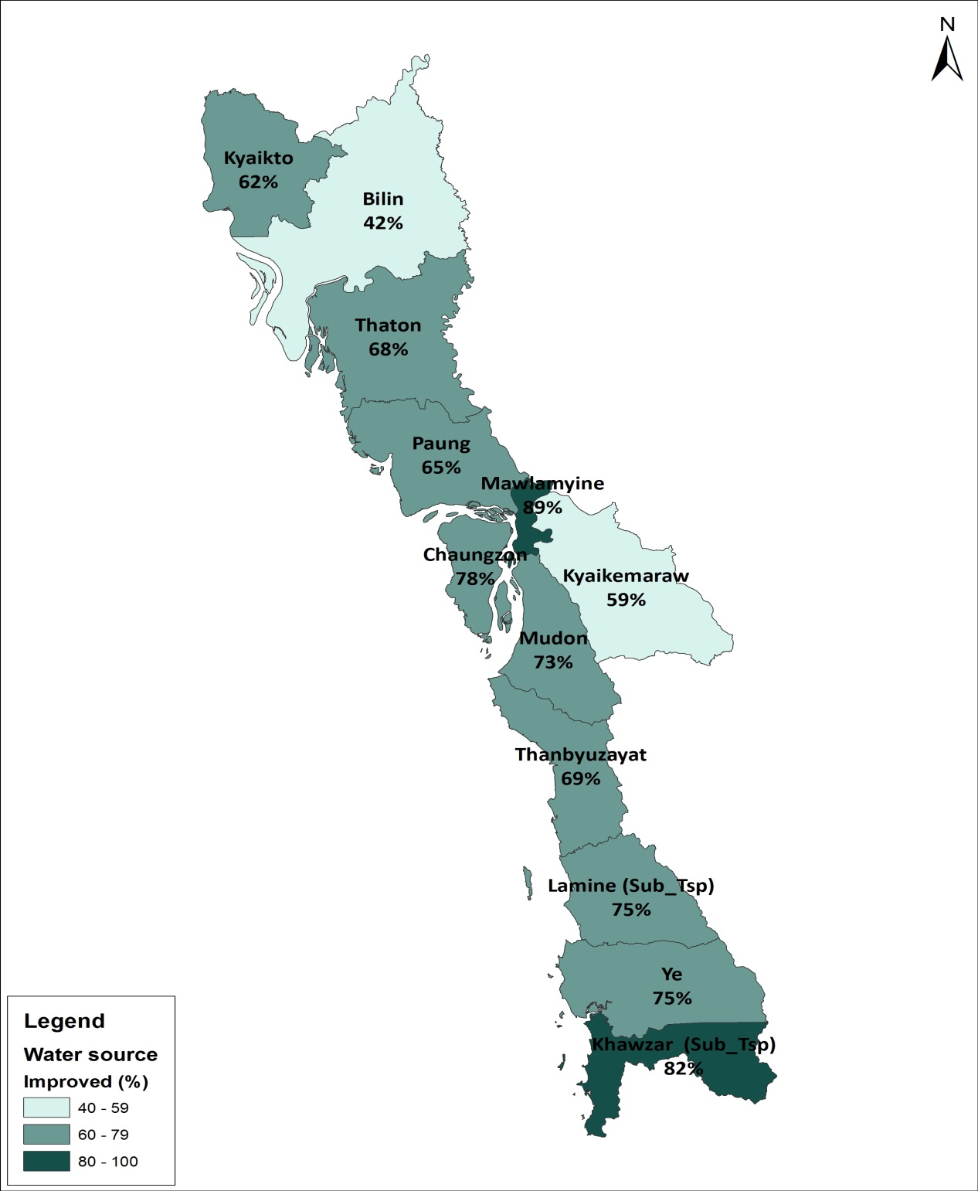
Proportion of Households with improved source of drinking water by Township (MON)
Mon State 69 %
Lowest
Billin 42.5 %
Kyaikemaraw 58.6 %
Highest
Mawlamyine 88.7 %
Khawzar (ST) 82. 4 %

Slide 89
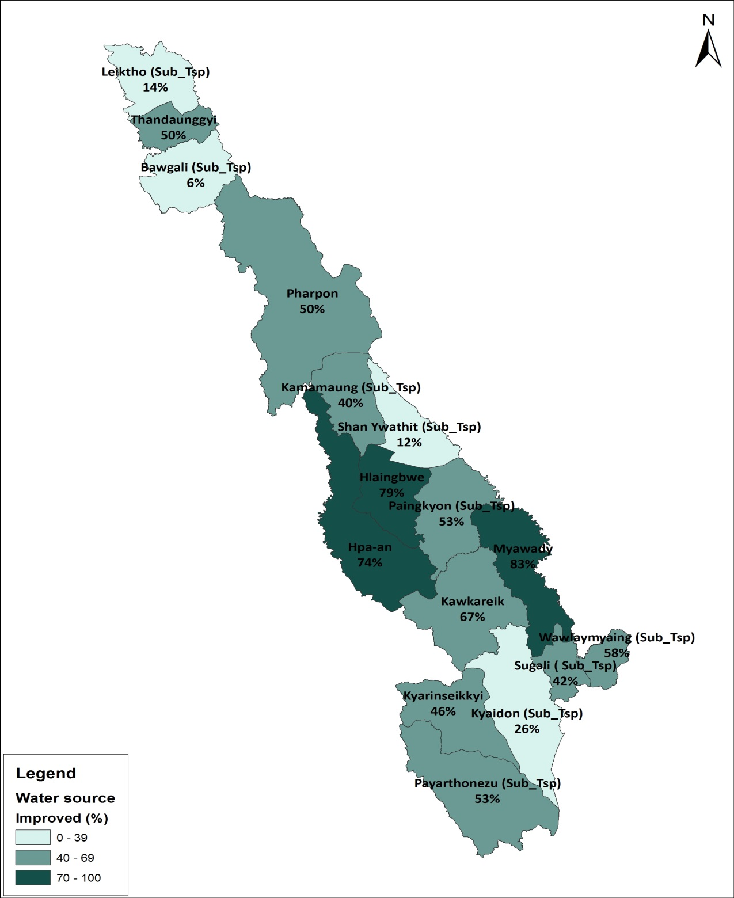
Proportion of Households with improved source of drinking water by Township (Kayin)
Kayin State 64%
Lowest
Shan Ywarthis (Sub) 12%
Bawgali (Sub) 6%
Highest
Myawady 83%
Hlaingbwe 79%

Slide 90
J. HOUSEHOLD AMENITIES

Slide 91
SOURCES OF ENERGY
32 percent of households use electricity for lighting
The proportion of households that use electricity for lighting - Urban (78 %) , Rural (15 %)

Slide 92
Use of Electricity for Lighting - Union
Notes:
Access to electricity as a source of lighting is relatively high in Kayah, compared to other States/Regions. However, the rate is still low, as only 49% of households have electricity. Some countries in the region (e.g. Malaysia and Singapore) have 100% access to electricity.
Kayah can improve from 48% to even higher rates.
What can be done to achieve this? Who should lead on this? What is the way forward?

Slide 93
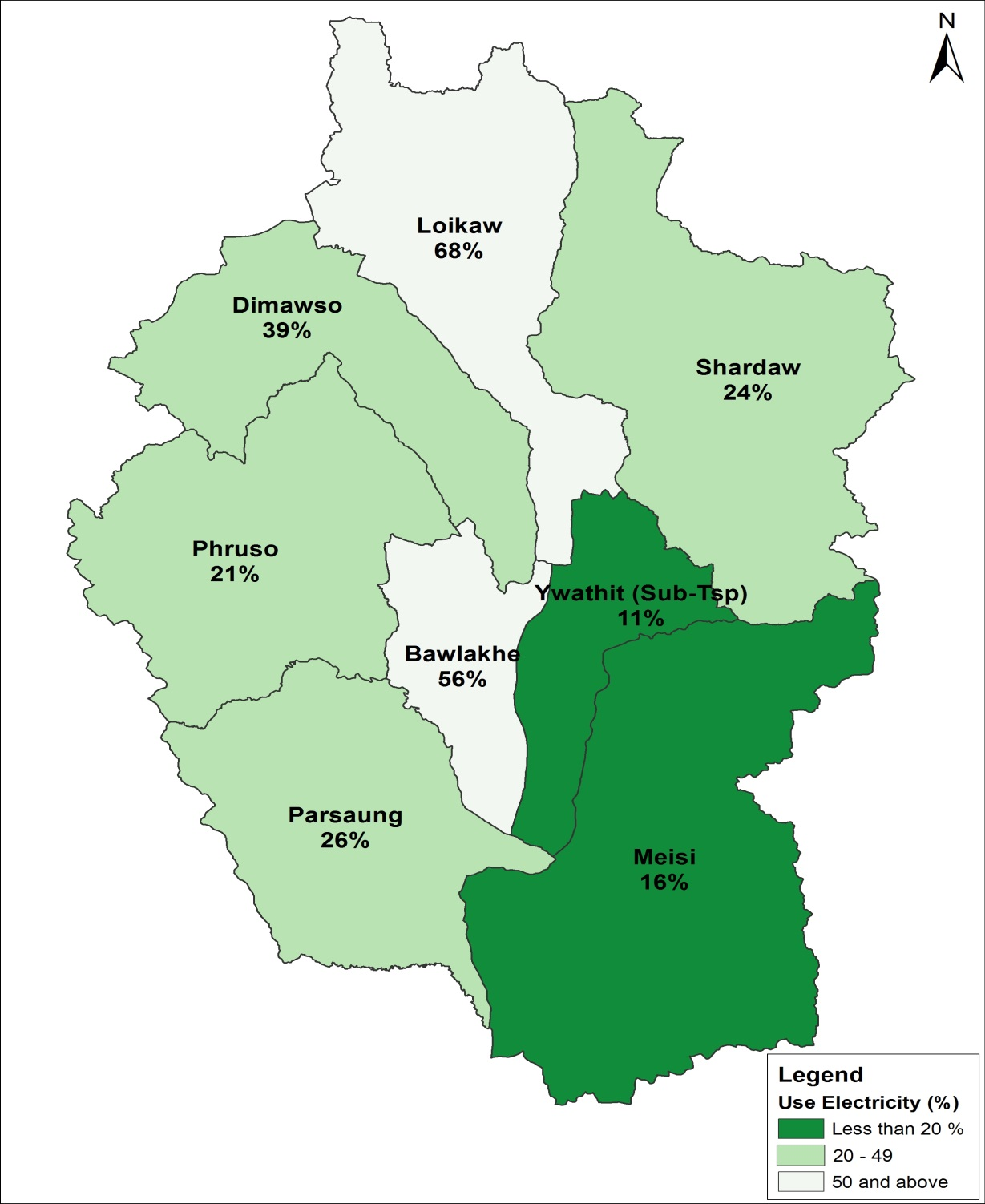
Use of electricity for lighting, by Township
Although Kayah is second highest in Myanmar, most township have very low access to electricity, e.g.:
Ywathit (ST): 11%
Meisi: 16%
Phruso: 21%
Notes:
What can be done to improve the situation in Ywathit, Meisi and Phruso?
What should be the way forward on this?

Slide 94
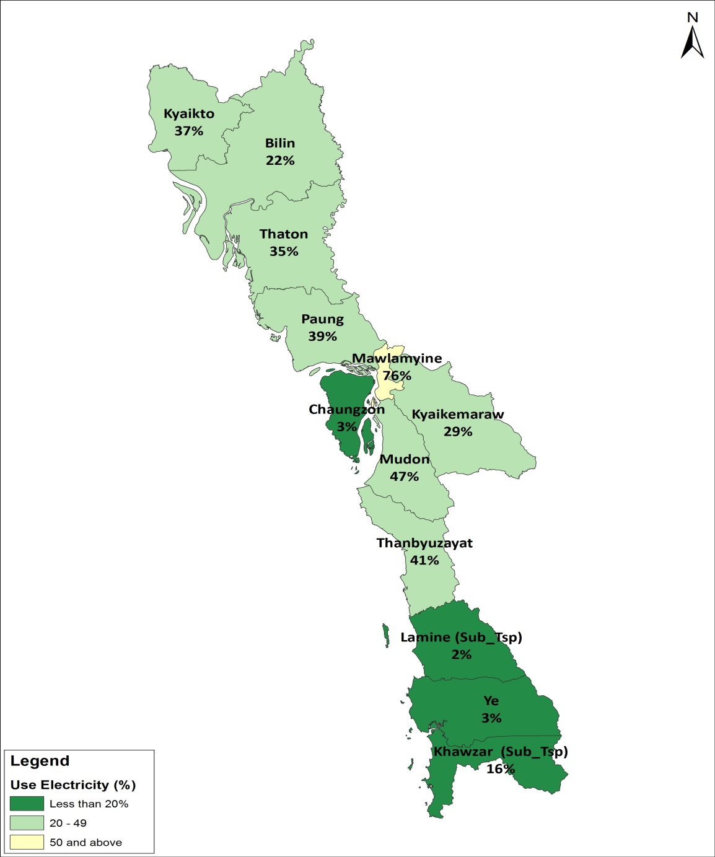
Use of electricity for lighting, by Township
Although Mon is fifth highest use of electricity in Myanmar, most townships have very low access to electricity, e.g.:
Lamine (Sub-T) 2.4% Chaungzon 2.7%
Ye 3.0%

Slide 95
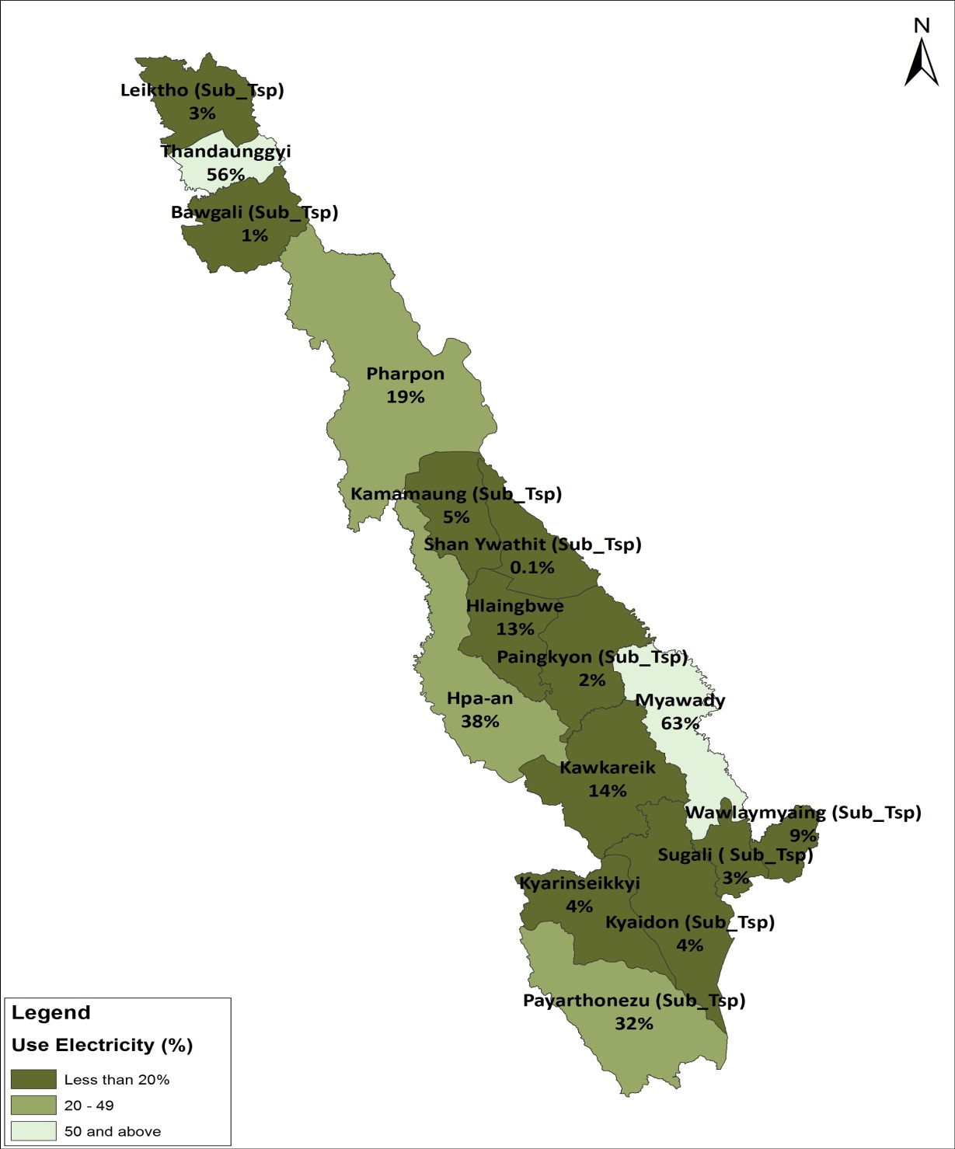
Use of electricity for lighting, by Township
Kayin State is the seventh lowest in use of electricity in Myanmar, most townships have very low access to electricity, e.g.:
ShanYwarthit(Sub) 0.1%
Bawgali (Sub) 1%
Paingkyon (Sub) 2%

Slide 96
Source of fuel for cooking (Union)
Notes:
81% of households in Myanmar use wood-based fuels for cooking. This is very high, and it leads to cutting down of trees and deforestation.
Low access to electricity and gas are some of the major factors for this problem.

Slide 97
Use of Firewood or Charcoal
Notes:
In Kayah, 77% of households use wood-based fuels. This is high.
What are some of the possible solution for reducing the proportion?
Who are the players, and what should be the way forward on this?

Slide 98
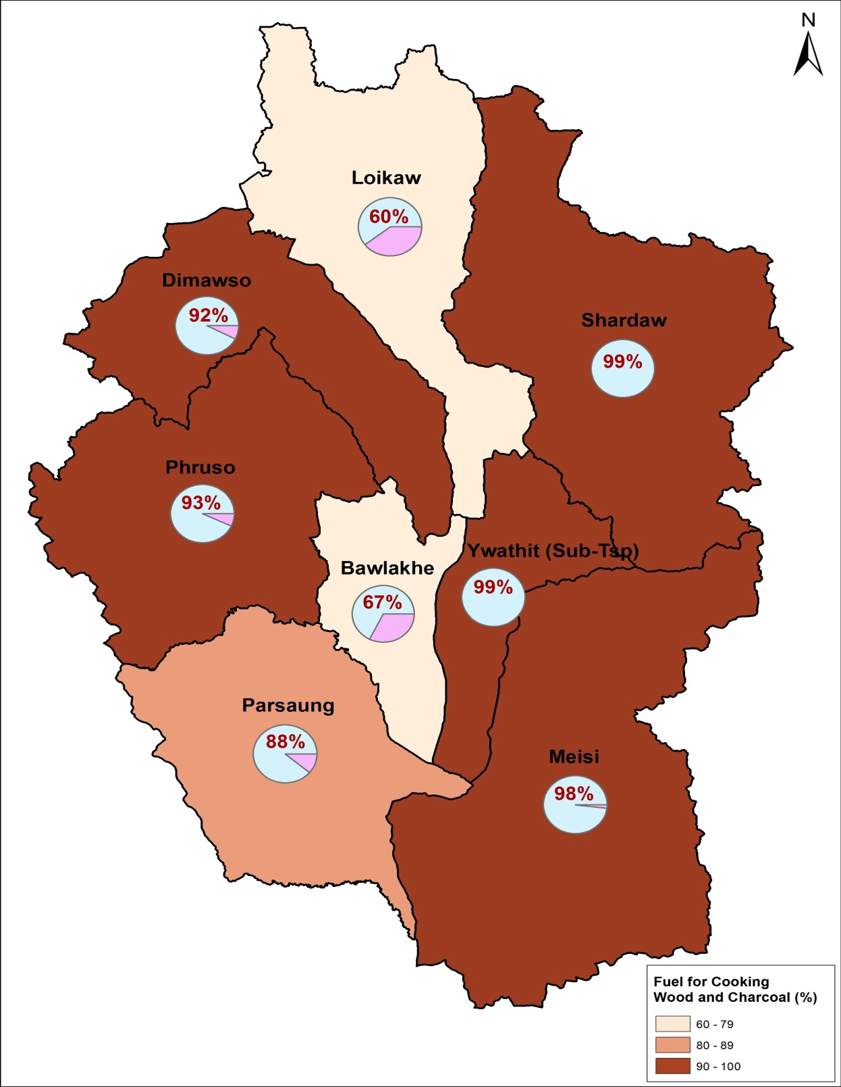
Use of Wood-based fuels for cooking
Close to 100% of Hholds in Ywathit, Shardaw and Meisi use either firewood or charcoal for cooking
Notes:
All townships in Kayah have high proportions of households that use wood-based fuels.
What can be done at the township level to address this?

Slide 99
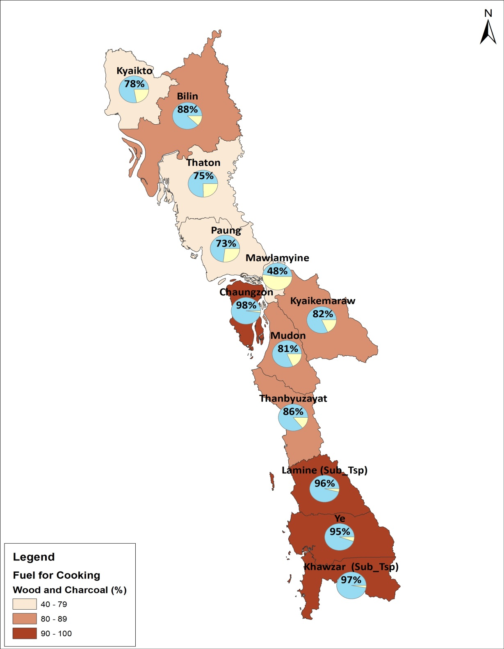
Use of Wood-based fuels for cooking
Households in Chaungzon township, Chawzar (Sub) and Lamine (Sub) mostly use either firewood or charcoal for cooking

Slide 100
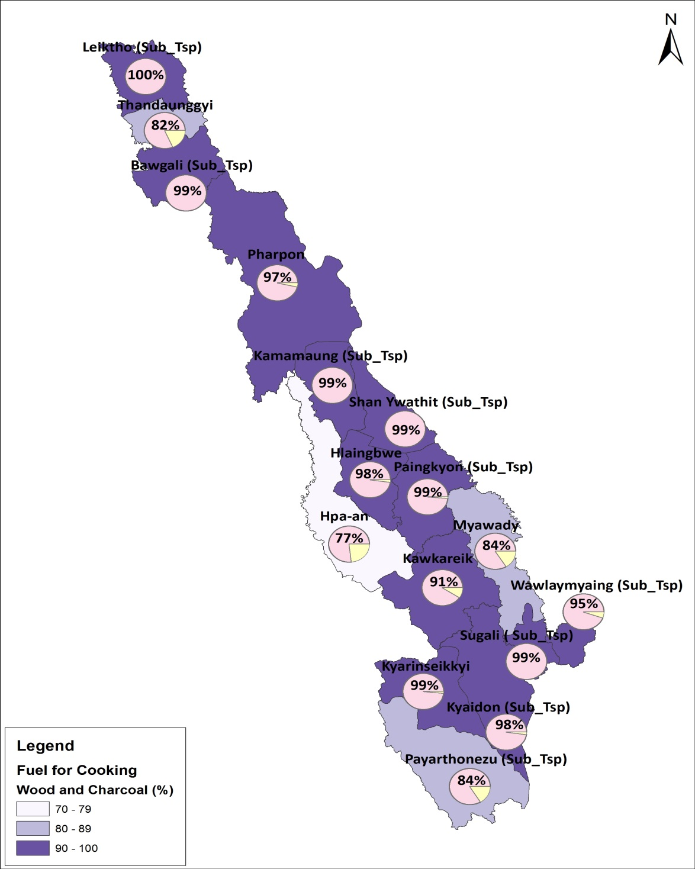
Use of Wood-based fuels for cooking
100% of Households in sub-township of Leiktho, Bawgali, Kamamaung, Sugali mostly use either firewood or charcoal for cooking

Slide 101
COMMUNICATION FACILITIES
50 percent of households have a television and 33 percent have a mobile phone
Television –
  Urban – (76%)
  Rural – (40%)
Mobile phone –
Urban – (63.5%) Rural – (21%)

Slide 102
Access to Radio
Notes:
Access to radio is useful for transmitting important messages on health, HIV/AIDS, disaster preparedness and response, democratisation, agricultural practices, etc.
Knowledge of availability of communication amenities would enable stakeholders to determine the most effective mode for transmitting important messages to the people.

Slide 103
Access to Television
Notes:
Same as for radio

Slide 104
Access to Mobile Phone
Notes:
Same as for Radio

Slide 105
F. TRANSPORTATION EQUIPMENT
About 39% of all households have a motorcycle
72 percent of households with cars, trucks and vans are in urban areas, while 28 percent are in rural areas.
Among households with motorcycles and mopeds, 70.2 percent are in rural areas while only 29.8 percent are in urban areas.

Slide 106
How to access census results
Online www.dop.gov.mm and http://myanmar.unfpa.org/census (all publications and tables in Microsoft excel)
Printed copies to be distributed to all Townships, Districts, State/Regions
DVDs with all publications and tables in Microsoft Excel
Additional data to be requested by letter, email to Director General, Department of Population

Slide 107
DISCUSSIONS

