Slide 1


SILENT FEATURES OF 2014 MYANMAR CENSUS
Presentation at MIMU meeting with IM Group
Yangon, 2nd September 2013
Fredrick Okwayo, UNFPA Country Technical Adviser
Notes:
1

Slide 2
Outline
Background
Key considerations
Methodology
Maps
Questions
Results from Pilot Census
Data Release calendar
Challenges
Your role in the census
Notes:
This is the outline if my presentation, it is short and devoid of technical staff as I know most participants here are not census experts but we would rather discuss what census can contribute in such a society as Myanmar.
This is the presentation as seen by UNFPA and we do not speak for Government
The

Slide 3
Background
Previous censuses in Burma
The 2014 Myanmar Census is historic
First real time statistical information
One time snap shot on the 29th March 2014
Supports transition process
Provide sampling frame for credible research
3
Notes:
During the British rule 1872 to 1941, census were done routinely, after independence in 1948, was done only in 1973 and 1983. Since then there has been no statistical information, I would say for the last 30 years.
As a result the 2014 Census can be termed as historic - in many ways; - it’s the first real opportunity after 30 years to have credible data in this country, it will make all of us know how many people there are in Myanmar and who they really are.
3. This is going to be the first up to-date information showing the living condition of the people, diversity of the Myanmar population which is very important from the Human Rights perspective, it will show the vulnerability with the population and the various indicators.
4. The census information will help move the current transition forward; the major factors are (Participation, Inclusiveness, Good governance, Peace and democracy)
5. It will provide a sampling frame for credible research to upcoming household based surveys, these will be representative and hence generate credible data. So the census will ensure that future survey results reflects the truth.
So to me the main reason why 2014 census is being conducted is that it is the First real time statistical exercise to be conducted in last 30 years and hence will enhance research – how different people live, how each area is unique, … it will be useful in peace, election and in effective decision making process.

Slide 4
Key Considerations for Implementation
  Full coverage of the population, targets all people and areas
  Legal Mandate
    Mandates DOP to conduct the census
    Protects data confidentiality and how to release data
    Outlines obligation and rights of the public
  Structures all the way to Ward and Village tract level
  Not regulated, conducted and checked by ITAB
Notes:
1. Targets to cover all people in every part of this country….. includes self govt controlled areas, self-administered areas, all religious groups, remote areas, IDP camps and islands in swampy places
2. Legal Mandate: The 2013 Census Law was enacted in July 2013 and the law is unique from the previous one (1972) in three main points, 1) it legitimizes the Ministry of Immigration and Population – (DOP) to undertake the census and it creates structures, 2) it ensures confidentiality of individual data, spells out how data will be released and that it is for only statistical purposes, 3) it outlines the obligation of the public and their rights. The Law is a major step in conforming with international practice.
3. There are Census Offices and Committees at every administrative level – down to ward and village tract – this is to ensure full coverage in every part of the country – if every area has a committee they will create ownership and participation
4. The census processes is not regulated like previously believed; now development partners, INGO walks into the Census Office to witness progress. There is also the ITAB which is internationally constituted and scrutinizes all aspects to ensure that international guidelines are followed and met.
Robust census which embraces participation.

Slide 5
Key Consideration for Implementation
  Subjected to strict monitoring and consultation
  Risk mitigation measures identified during assessment and pilot census (political, logistical, administrative and technical)
  Conducted a pilot census in 20 township and testing the census in Rakhine IDP camps
  Large team of experts (political, communication, mapping, data processing, overall management, etc.)
Notes:
There are continuous reviews and engagement with various state actors leaders of political parties, religious leaders, community leaders, development partners, NGOs, INGOs, media, Youth Groups, Women Groups, etc. There are also field monitoring to ensure transparency and participation in the exercise.
A risk assessment was conducted and grouped them into four types political, logistical, administrative and technical); A risk mitigation measures have been prepared and is being utilized to minimize them (grouped into for example mistrust in the government executed activities; to mitigate this the census committees are being expanded to include NGO, religious leaders, etc. people not in government; when representation in these groups are broad they will have discussions and feed back from the public. Also the Census team and UNFPA is having consultations with youth groups, women groups, NGOs and addressing their concerns, re-looked at the entire communication strategy, on the technical side, introducing adult learning participatory training, etc.
3. Lessons learnt from the pilot census conducted in 20 townships across the country are being used to improve the census process, training, publicity, engagement with the public. Consultation also going on in Rakhine. Generally people are aware of the census – but the issue is strong trust, all they want is to do a good census.
4. Proper technical support in all census areas (political ….. risks, communication strategy, mapping/GIS, data processing, overall management, etc.) all these have ensured that quality of the outputs is to the highest standards.

Slide 6
2014 Census Methodology
The census will be done on “de facto” basis
  Everybody within the borders of Myanmar on Census Night will be counted
Census Night is Saturday 29th March 2014
  The Reference time is 00.00 hrs 30th March 2014
Data collection will continue for 12 days until 10th April
Method of enumeration is face-to-face interview (canvasser method)

Slide 7
Who will be counted?
Everyone who spends the Census Night (the night of 29/30th March 2014) within Myanmar’s borders
Both Myanmar citizens and foreigners (exception are Foreign embassy staff based in Myanmar)
All persons who spend the Census Night in a household, whether members or visitors will be counted in that household
Any person who died after the Census Night (but who was alive on the Census Night);
7
Notes:
7

Slide 8
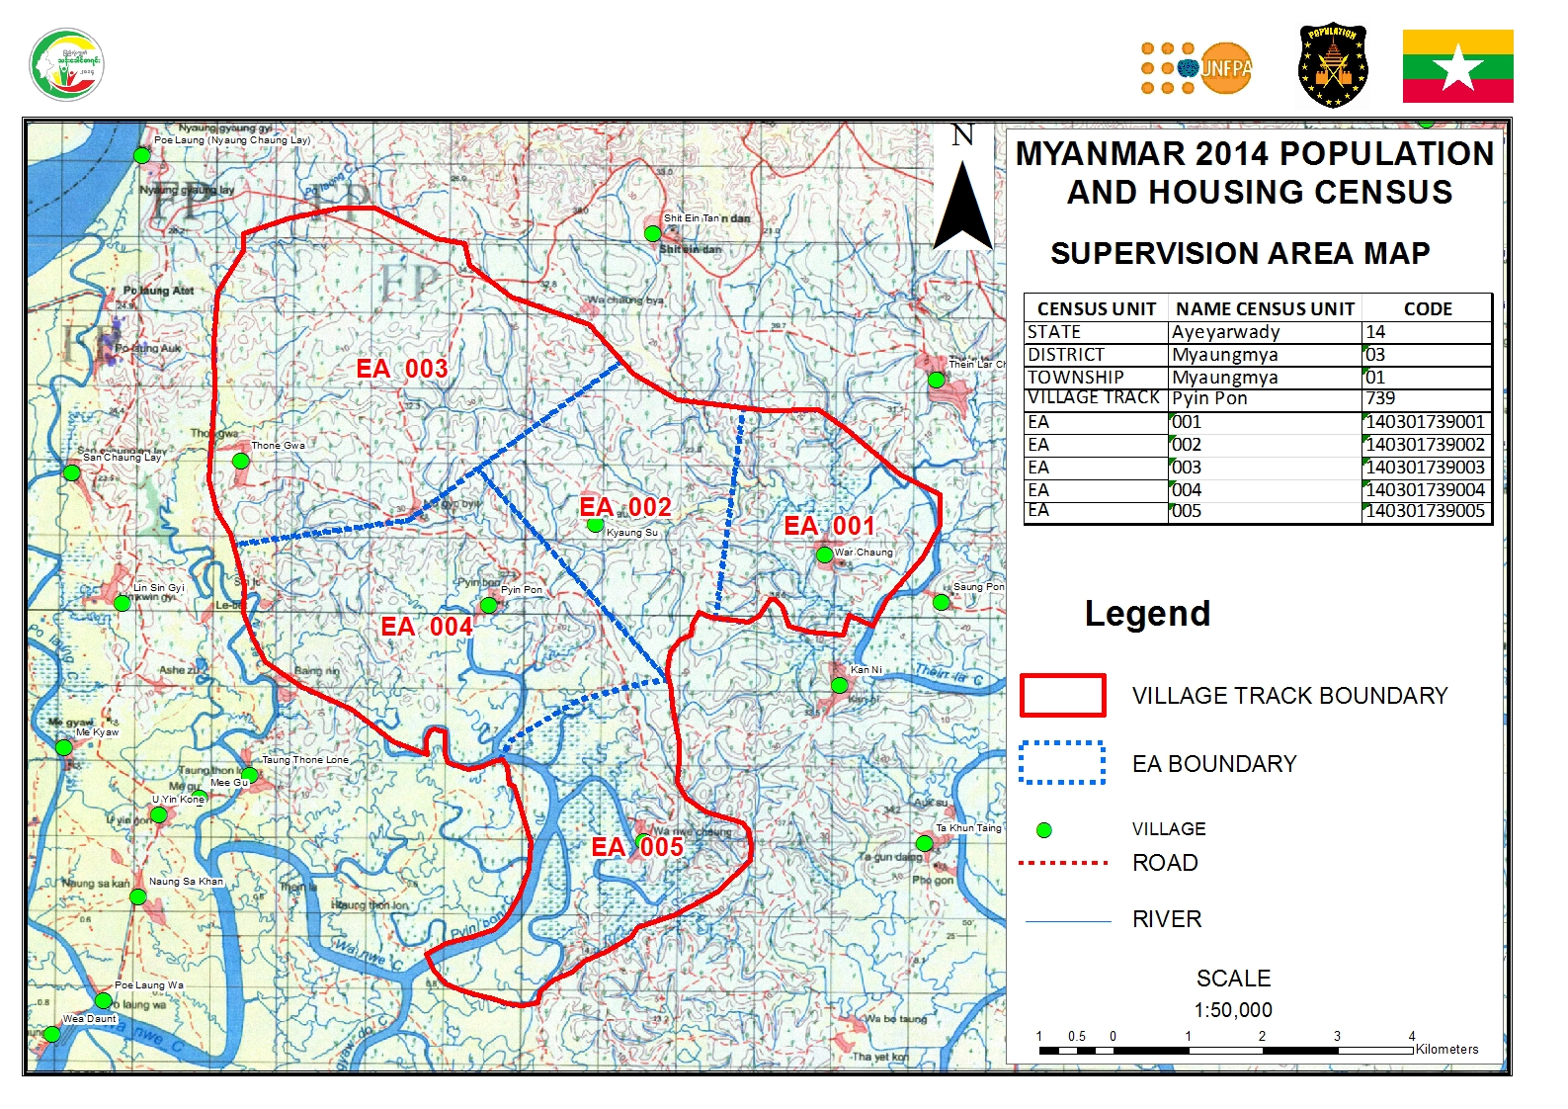
PREPARATION OF FINAL CENSUS MAPS
AREAS WITHOUT FIELD MAPS
Sample EA Map using MIMU Data and 1:50,000

Slide 10
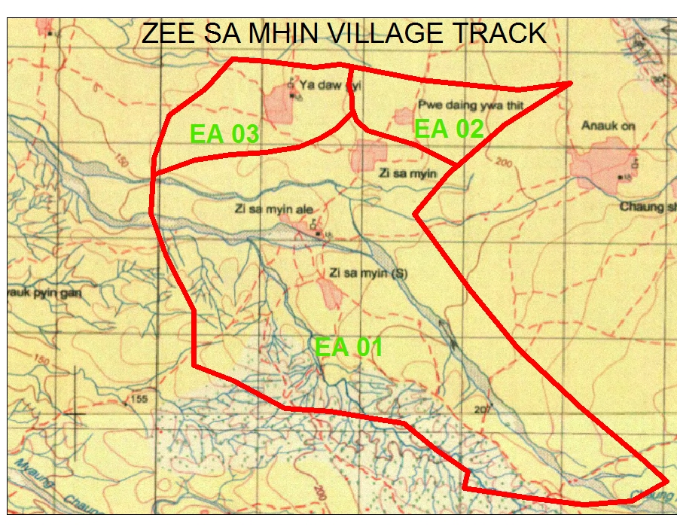
PREPARATION OF FINAL CENSUS MAPS
AREAS WITHOUT FIELD MAPS
EA Demarcation using 1:50,000

Slide 11
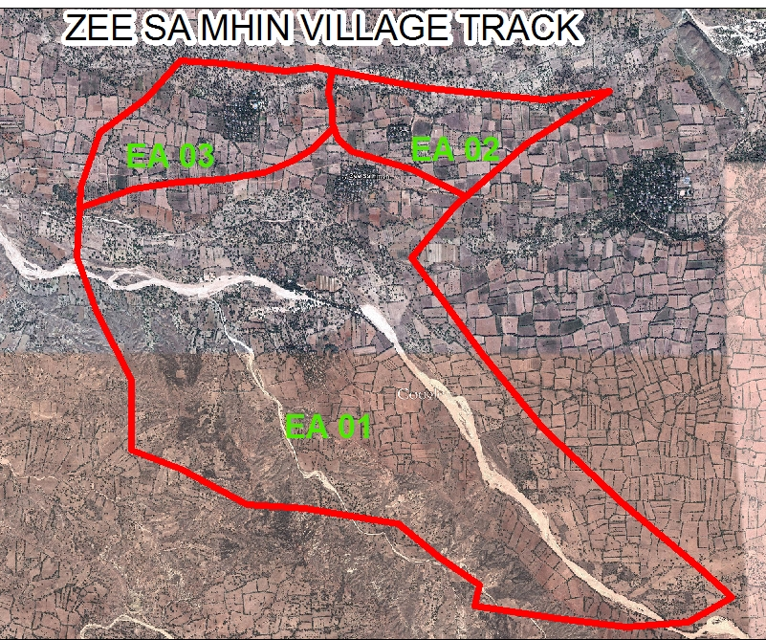
PREPARATION OF FINAL CENSUS MAPS
AREAS WITHOUT FIELD MAPS
EA Demarcation using Satellite Imagery

Slide 12
Contents (41 questions)
Demographic characteristics (Age, sex, religion, marital status, ethnic groups)
Disability, type of Identity Cards
Migration
Education
Labour Force
Fertility/Mortality
Type and conditions of housing unit
Household amenities, water, toilet, energy
Ownership of specific items by household
Household members abroad
Recent deaths in the households
Notes:
12

Slide 13

Census Questionnaire (Eng)

Slide 14
Census Questionnaire (Myan)

Slide 15
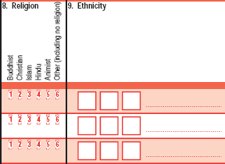
Religion
Ethnicity
Questions for all members (Demographic Characteristics)
Indicators:-
Religion
Ethnicity
Note: Code list of 135 ethnic groups provided . If the answer is not in the list, enumerator fill the “others” code and write the name of ethnicity/nationality as given.

Slide 17
Relationship to Head of Household
Table 2. Relationship by Sex
Relationship | Sex
 | Total | Percent | Percent | Percent
Total | 49,575 | 100 | 100 | 100
Head | 11,296 | 22.8 | 36.9 | 10.9
Spouse | 7,443 | 15 | 0.5 | 27.3
Child | 18,463 | 37.2 | 39.6 | 35.2
Son/Daughter-in-law | 1,596 | 3.2 | 3.3 | 3.1
SonDaughter-in-law | 4,095 | 8.3 | 8.8 | 7.8
Parent/Parent-in-law | 1,016 | 2 | 1.1 | 2.9
Sibling | 1,233 | 2.5 | 1.9 | 3
Grandparent | 70 | 0.1 | 0.1 | 0.2
Other relative | 2,262 | 4.6 | 4.4 | 4.7
Adopted child | 87 | 0.2 | 0.2 | 0.2
Not relative | 2,014 | 4.1 | 3.2 | 4.8

Slide 18
Literacy
Sex by Read/write(Population age between 15 and 24 years
Sex | Read/write
 | Total | Yes | Percent | No | Percent
Total | 9,046 | 8,515 | 94.1 | 531 | 5.9
Male | 3,921 | 3,706 | 94.5 | 215 | 5.5
Female | 5,125 | 4,809 | 93.8 | 316 | 6.2
Sex by Read/write ( Population 5 years and above)
Sex | Read/write
 | Total | Yes | Percent | No | Percent
Total | 45,549 | 39,063 | 85.8 | 6,486 | 14.2
Male | 20,629 | 17,941 | 87 | 2,688 | 13
Female | 24,920 | 21,122 | 84.8 | 3,798 | 15.2

Slide 19
Religion
Table 4. Religion by Sex
Religion | Sex
 | Total | Percent | Percent | Percent
Total | 49,451 | 100 | 100 | 100
Buddhist | 41,188 | 83.3 | 83.5 | 83.1
Christian | 7,805 | 15.8 | 15.5 | 16.1
Islam | 364 | 0.7 | 0.8 | 0.6
Hindu | 82 | 0.2 | 0.2 | 0.2
Animist | 9 | * | * | *
Other | 3 | * | * | *

Slide 20
Type of Identity Card -10 years and above
Table 5. Identity card by Batch - Urban/Rural
Identity card | Total | Total | Urban | Rural
Citizenship Scrutiny Card | 33616 | 81.6 | 83.9 | 80.4
Associate Scrutiny Citizenship Card | 203 | 0.5 | 1.5 | *
Naturalized Scrutiny Citizenship Card | 198 | 0.5 | 1 | 0.2
National Registration Card | 541 | 1.3 | 1.6 | 1.2
Temporary Registration Card | 153 | 0.4 | 0.9 | 0.1
Foreign Registration Card | 27 | 0.1 | 0.2 | *
Foreign Passport | 10 | * | 0.1 | 0
None of the above | 6469 | 15.7 | 10.9 | 18.1

Slide 21
Type of cards owned by State

Slide 22
When are data planned to be released
Preliminary Results: Population by sex and related indicators at administrative level. 3 months after data collection (July 2014);
Main Results: 11 months after data collection (Feb/March 2015)
Frame for household based surveys – August 2014
Thematic Reports: Fertility, Mortality, Migration, Population Projections, Education, gender, etc. from November 2015 to Dec 2016
Dissemination of the results and further research

Slide 23
Challenges
Technical and Institutional capacity
Building strong public confidence in the process through outreach and advocacy
Ensuring census remains a strong statistical exercise
Accessibility to some parts of the country
Full participation of all people in the country (political, administrative, logistical and technical risks)
Notes:
Due to the long time and a closed society, there is both individual and institutional capacity gap not only for census but for most of the issues, the last census was taken 30 years ago, everybody who participated have retired. But we are taking steps to not only do the census but also build capacity. We all have to build capacity in all the areas.
As much as people may be aware of the census, they have no confidence in government led processes, hence there is every need to build a strong public confidence through outreach, advocacy and feedback. This has to be done slowly, it may take a long time to build trust and confidence.
Linking correctly the census to other activities like registration, elections, etc. It is important that census is treated as a statistical activity and not a political one. Census should not be linked too much with political activities that people in the country do not have trust in. It should be an activity for everyone regardless of political belief, ethnicity, age, etc.
Getting finances at the right time is critical as specific activities must be implemented as planned otherwise census may not succeed. Contribution and pledges
Access to all parts of the country remains a challenge as areas which are self administered poses a challenge but there are on-going peace negotiations. The Minister of MOIP is meeting with leaders of self administered areas, religious groups to discuss the need to participate in census, We as UNFPA see this as a very important activity in the peace process as leaders from opposite political divide are sitting down to work together for its success. Last week the Speaker of the Parliament met with leader of Wah Group and they are almost in agreement regarding census preparations.
The risks which were threatening the conducted of the census were identified and they are being mitigated, examples the showing of Household Listing Form

Slide 24
The critical role of INGOs, NGOs, civil society and DPs
We need your support! Become a 2014 Census Partner!
By supporting the 2014 Census of Myanmar, your organization will help your constituencies get the services they deserve:
    The Census determines the distribution of government funding to critical community services such as the provision of doctors, health centers, schools, teachers, roads, electricity, services for disabled people, political representation, etc…
    An incomplete count means that some segments of society, often the ones that need it most, will not receive the services and funding they deserve.
Notes:
24

Slide 25
Your contribution to the census
Know census facts and share them
Create awareness among the staff, communities, families and friends
Demystify misconceptions or myths about the census, including journalists
Reassure the population of the confidentiality/ secrecy of the census process and results

Slide 26
Possible Actions
  Include information about the 2014 Census in your newsletters, bulletins, and Web sites
  Help recruit community leaders from the constituencies you work with to advocate for the census in their communities
  Offer information sharing sessions, focal group discussions, meetings with your constituencies to spark conversations and informed discussion on the importance of the 2014 Census.
  Detailed information on the census is being printed and will be shared soon.
Notes:
26

Slide 27
Thank you and any questions….
Notes:
27

