Slide 1
ETWG Newsletter
ETWG

Slide 2
Objectives : Why the newsletter?
To boost coordination among the agencies working in Education and with other sectors.
To enrich transparency.
To be on track with updated information about the education sector as a whole.
To be used as a lead up for ETWG website.

Slide 3
Character : What it will do
Provide detailed and brief articles
Bring a different contexts to compliment the minutes
Demonstrate education programme data in various formats (e.g. map, charts, tables)
Provide news and updates from across the sector
ANY FEEDBACK?

Slide 4
Contents : What should be in it
ETWG Updates
Sub Sectors Updates
Emergency Updates
Geographical Coverage Map
Agencies vs. Sub Sectors Table
Summarized case studies/articles from agencies
ANY FEEDBACK?

Slide 5
Frequency : How frequent ?
Quarterly
Two months
After/Before ETWG meetings
Parallel to ETWG meetings
ANY FEEDBACK?

Slide 6
Data collection
Sub Sectors | Agencies | # of Townships | # of Villages

Slide 7
Data Collection map
Sub sectors indication
Color indication by sub sectors
Duplicates can be indicated with a bar chart / pie chart
ANY FEEDBACK?

Slide 8
Preliminary protocol
Data Collection
Sent off to all the members of ETWG
Sent off to OCHA
ETWG Meeting
ETWG Meeting Minutes
News collection

Slide 9
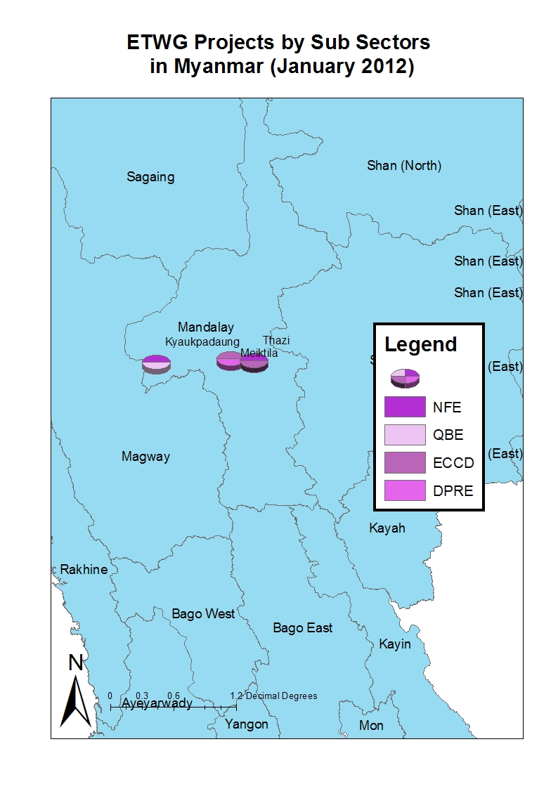
The map

Slide 10
Constraints
Translations from Myanmar to English are preferred to be done from the agencies themselves

Slide 11
Summary

Slide 12
THANK YOU!!

