Slide 1
Brief Presentation on Basic Education Sector Development

Slide 2
Basic Education Sector Development
Current Situation
Key Challenging Areas
Required support from ETWG
Possible Collaboration with MOE

Slide 3
Current Situation
Improving access to and quality of basic education
The number of pre-school classes in basic education schools increased from 1416 in 2005 to 2353 in 2010.
The number of basic education schools increased from 39,444 in 2005 to 40,876 in 2011 with an increase of 1,432 schools. The average distance of a student to travel from home to school is 1.43 miles. The 89 % basic education schools are in rural areas, most of the school buildings in remote and rural areas will be needed to improve.
Opening of schools in border areas increased to 1074 schools.
Opening of private schools has been initiated, 21 schools are already allowed to setup in 2011-2012 AY.

Slide 4
Current Situation
Improving access to and quality of basic education
The total enrolment increased from 7.5 million in 2005-06 to 7.9 million in 2009-10, 8 million in 2010-11, Among them the girls enrolment in basic education slightly increased from 49.5 % in 2005-06 to 50.1% in 2009-10.
The primary school enrolment rate increased from 82.5% in 2005-06 to 84.6% in 2010.
The primary school completion rate increased from 69.9% in 2005-06 to 73.5% in 2010.
The transition rate from primary to lower-secondary increase from 73.3% in 2005-06 to 77.61% in 2010.

Slide 5
No. of Basic Education Students by Level (2005-06 to 2010-11)
Grade | 05-06 | 06-07 | 07-08 | 08-09 | 09-10 | 2010-11 | % Increase
Primary | 4918951 | 5013581 | 5109630 | 5094618 | 5125945 | 5210011 | 5.9%
Middle | 1966653 | 2047796 | 2135353 | 2131010 | 2178728 | 2265563 | 15.2%
High | 632841 | 638402 | 693515 | 681856 | 673719 | 683402 | 8.0%
Union | 7518445 | 7699779 | 7938498 | 7907484 | 7978392 | 8158976 | 8.5%

Slide 6
Girls Enrolment by Level (2005-06 to 2010-11)
Grade | E/Female | 05-06 | 06-07 | 07-08 | 08-09 | 09-10 | 2010-11 | % Increase
Primary | Enrollment | 4918951 | 5013581 | 5109630 | 5094618 | 5125945 | 5210011 | 5.92%
 | Female | 2438448 | 2479128 | 2535863 | 2514087 | 2538044 | 2579668 | 5.79%
Middle | Enrollment | 1966653 | 2047796 | 2135353 | 2131010 | 2178728 | 2265563 | 15.20%
 | Female | 963898 | 1006851 | 1058545 | 1061953 | 1103936 | 1147934 | 19.09%
High | Enrollment | 632841 | 638402 | 693515 | 681856 | 673719 | 683402 | 7.99%
 | Female | 318338 | 329269 | 363407 | 353889 | 354323 | 359415 | 12.90%
Union | Enrollment | 7518445 | 7699779 | 7938498 | 7907484 | 7978392 | 8158976 | 8.52%
 | Female | 3720684 | 3815248 | 3957815 | 3929929 | 3996303 | 4087017 | 9.85%
 | % of Girls | 49.49% | 49.55% | 49.86% | 49.70% | 50.09% | 50.09%

Slide 7
Grade Enrolment Structure by Gender (2005-06 and 2009-10)
AY Grade | 05-06 |  |  | 09-10
 | Total | Male | Female | Total | Male | Female
G-1 | 1169172 | 599969 | 569203 | 1188757 | 602031 | 586726
G-2 | 1027063 | 518696 | 508367 | 1080818 | 551741 | 529077
G-3 | 966226 | 487365 | 478861 | 998007 | 506235 | 491772
G-4 | 919602 | 461204 | 458398 | 937721 | 473043 | 464678
G-5 | 836888 | 413269 | 423619 | 869292 | 428928 | 440364
G-6 | 587085 | 299234 | 287851 | 648933 | 323338 | 325595
G-7 | 513134 | 262161 | 250973 | 560471 | 275674 | 284797
G-8 | 475094 | 243793 | 231301 | 489903 | 241737 | 248166
G-9 | 391340 | 197567 | 193773 | 425458 | 207423 | 218035
G-10 | 336491 | 170417 | 166074 | 344880 | 167839 | 177041
G-11 | 296350 | 144086 | 152264 | 306763 | 141093 | 165670
Union | 7518445 | 3797761 | 3720684 | 7851003 | 3919082 | 3931921

Slide 8
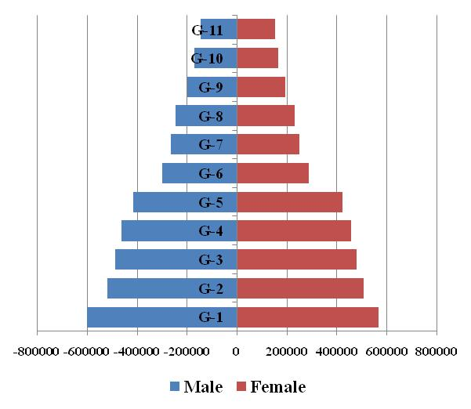
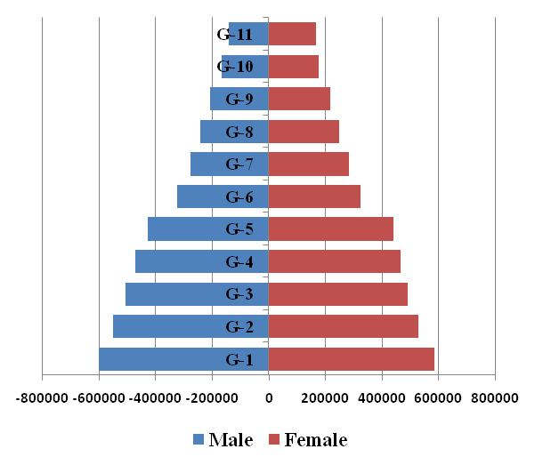
Grade Enrolment Structure by Gender
2005-06 AY
2009-10 AY

Slide 9
Grade Enrolment Gender Structure by Urban/Rural (2009-10)
 | Urban |  |  | Rural
Grade | Total | Male | Female | Total | Male | Female
G-1 | 242585 | 116532 | 126053 | 964172 | 503499 | 460673
G-2 | 231773 | 120743 | 111030 | 849045 | 430998 | 418047
G-3 | 222689 | 116047 | 106642 | 775323 | 390193 | 385130
G-4 | 214357 | 111745 | 102612 | 723364 | 361298 | 362066
G-5 | 208803 | 107145 | 101658 | 660489 | 321783 | 338706
G-6 | 223516 | 110352 | 113164 | 425417 | 212986 | 212431
G-7 | 206090 | 98080 | 108010 | 354381 | 177594 | 176787
G-8 | 193221 | 94188 | 99033 | 296682 | 147549 | 149133
G-9 | 205547 | 100786 | 104761 | 219911 | 106637 | 113274
G-10 | 217473 | 106263 | 111210 | 127407 | 61576 | 65831
G-11 | 198210 | 91635 | 106575 | 108533 | 49438 | 59095
Union | 2364264 | 1173516 | 1190748 | 5504724 | 2763551 | 2741173

Slide 10
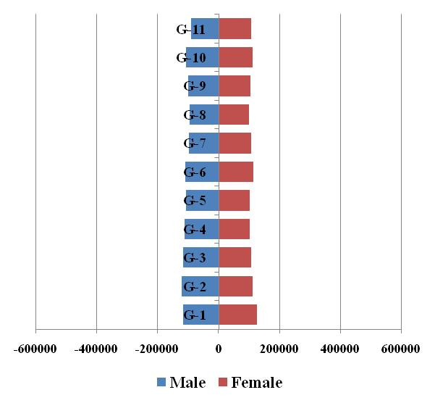
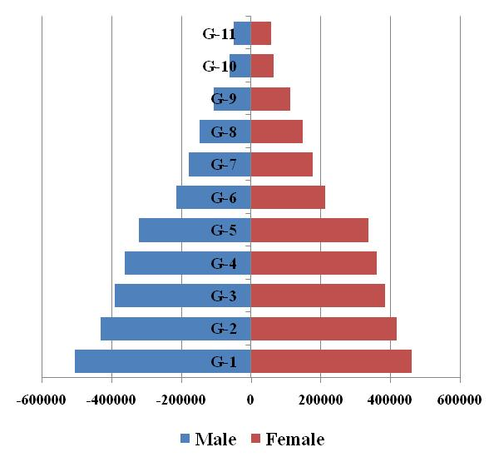
Grade Enrolment Gender Structure by Urban/Rural (2009-10)
Urban Students
Rural Students

Slide 11
Current Situation
Improving access to and quality of basic education
The basic education expenditure increased from 37579.34 million kyats in 2005-06 to 231883.8 million kyats in 2010-11 by about 6 times.
Arrangement has been made to award scholarships and stipend to outstanding students, poor and intellectual students at all Grade/ levels.

Slide 12
Allocation of Basic Education Expenditure during the years from 2005 to 2011
Academic Year | Current | Capital | Total
2005-06 | 35490.5 | 2088.9 | 37579.4
2006-07 | 125321.8 | 3020.8 | 128342.6
2007-08 | 132890.1 | 5160.2 | 138050.3
2008-09 | 135933.3 | 9910.3 | 145843.6
2009-10 | 157923.2 | 25833.1 | 183756.3
2010-11 | 222324.4 | 9559.4 | 231883.8
Increase % | 626.43 | 457.63 | 617.05

Slide 15
Current Situation
Improving access to and quality of basic education
The Child Centered Approach has been implemented on pilot basic in 67 townships during the years 2004 to 2010 in collaboration with JICA and the rest of over 260 townships has been planned to expand by MOE for improving teaching learning process in primary schools.
The refresher courses for basic education teachers have been conducted during 2009 and 2010 also trainings, the training for English and Mathematics teachers were conducted.
The primary school Life Skills curriculum has been revised and the secondary school Life Skills curriculums are being revised.

Slide 16
Current Situation
Improving access to and quality of basic education
Pupil-teacher ratio has been improved at all level of basic education.
All primary school teachers are certified and over 90 % of secondary school teachers certified.
The NFPE, TEMIS and SSA/SIP have been implemented and some selected project townships
The TEMIS project will be expanded nation-wide

Slide 17
Gaps for achieving MDG/EFA set targets
Basic Education Indicators 2010 and 2015(Target)
Sr. | Indicators | 2010 | 2015 (Target) | Gaps
1 | Pre-school enrolment | 22.9 | 25.00 | 2.10
 |  | (MICS)
2 | Grade-1 Intake Rate | 98.37 | 99.00 | 0.63
3 | Net Enrolment Ratio (NER)
 | - Primary | 84.60 | 95.00 | 10.40
 | - Lower Secondary | 47.20 | 60.00 | 12.80
 | - Upper Secondary | 30.00 | 40.00 | 10.00
4 | Completion Rates
 | - Primary | 73.50 | 95.00 | 21.50
 | - Lower Secondary | 77.40 | 85.00 | 7.60
 | - Upper Secondary | 34.60 | 65.00 | 30.40
5 | Transition Rates
 | - Primary to Lower Secondary | 77.61 | 85.00 | 7.39
 | - Lower Secondary to Upper Secondary | 93.40 | 95.00 | 1.60
6 | Pupil-Teacher Ratios
 | - Primary | 28:1 | 30:1 | -
 | - Lower Secondary | 34:1 | 27:1 | *
 | - Upper Secondary | 25:1 | 27:1 | -
7 | Adult Literacy Rate | 95.01 | 99.00 | 3.99
 |  | (2011)

Slide 18
Key Challenging Areas
To improve school retention rates
To upgrade the quality of teachers
Capacity building for education personnel at all levels
To expand NFPE, TEMIS and SSA/SIP
Research, monitoring and assessment of education programs

Slide 19
Required support from ETWG
Technical assistance (eg. English teachers proficiency upgrading)
Materials assistance (Computers, Projectors, Exercise Books for UPE)
Financial assistance (School infrastructure improvement, opportunity cost for needy students)

Slide 20
Thank You

