Slide 1

Conflict Early Warning System
MYANMAR PEACE CENTER
January 8, 2014

Slide 2
Contents
MPC Structure
CFNI Structure
Conflict Early Warning System – concept overview
Information management requirements
Challenges
Questions

Slide 3
The Myanmar Peace Center (MPC)
Established to assist the Union Peace-making Central Committee and the Union Peace-making Work Committee for the peace process.
Serving as the focal point for international partners and civil society organizations on issues related to the peace process.
Facilitating dialogues between government and non-state actors.

Slide 4
Union Peace-making Central Committee
Union Peace-making Working Committee
MPC committee
Special Advisors
Donor Support Group
(Govts, IOs, NGOs, Projects, Experts)
Executive Director
Independent International Experts
Program Director(s) / Assoc. Program Director(s)
Asst. Executive Director
Ceasefire Negotiation Program (CFN) | Peace Dialogue Program (PD) | Peace Building Operations Coordination Program (PBOC) | Outreach and Public Diplomacy Program (OPD) | Myanmar Mine Action Centre (MMAC) | Administration and Support Division (ASD)
Negotiations Implementation Regulation Monitoring Training | Meetings Negotiations Dialogues Process Control Research Training | Government Relations IO & NGO Relations Private Sector Relations Operations | Advocacy, Communications and Social Mobilization Networking News Room Media Production Social Media | Mine Risk Education, Demining, Victim Assistance, Advocacy and Stockpile Destruction | Administration Finance Logistics Support Services Security Legal
Seconded International Experts

Slide 5
Ceasefire Negotiation and
Implementation (CFNI)
CFNI
(Program Director)
Program Manager
Consultants
Monitoring
Capacity Building
Early Warning
Coordination and Liaison

Slide 6
Conflict Early Warning System (CEWS)
Early warning is a process that:
  (a) systematically monitors and reports conflict indicators;
  (b) promotes an understanding among decision-makers of the nature and impacts of violent conflict; and
  (c) alerts stakeholders of the potential outbreak, escalation, and resurgence of violent conflict

Slide 7
Conflict Early Warning System (CEWS)
CEWS Objectives:
  Increase government, NGO, EAG and CSO awareness of the occurrence and/or likely occurrence of conflict
  Increase the number and effectiveness of preventative peacebuilding initiatives in conflict-affected communities
  Reduce local tensions through directly supporting community peacebuilding initiatives
  Enhance awareness of the drivers of conflict – particularly amongst government and donor agencies

Slide 8
Conflict Early Warning System (CEWS)
CEWS Objectives:
  Increase accountability amongst the protagonists of conflict through public diplomacy and awareness
  Reduce the spread of rumours and accusations between groups that can be detrimental to the peace process
  Improve the exchange of information between government and ethnic armed groups, in conjunction with joint monitoring mechanisms

Slide 9
CEWS Outputs
  Daily update – a short qualitative snapshot of any key events from the previous 24 hours.
  Ad hoc situation reports – updates published as required in the event of significant challenges to the security environment
  Weekly update – quantitative and qualitative update of reporting across the previous week. Geographic focus on identified ‘hotspots’ with an update of each area’s ‘stability index’.
  Monthly overview – in-depth analytical review focussing on the drivers of conflict, including recommended action for preventative policy solutions.
  Geospatial mapping – conflict data, stability index and key indicators will be updated near-real time via online mapping software. Data to be linked to key nodes via VPN connection.
  Conflict drivers workshops – monthly briefing session based on in-depth analysis with key implementation partners.
  Flexible peacebuilding fund – support to NGOs and local CSOs working on preventative/peacebuilding measures. - to be informed by EWS analysis, in consultation with donor partners.
  External research and assessment – in addition to the routine analysis within the EWS, the MPC will commission specialised research and assessment on issues identified as particular inhibitors to stability. The tailored field-based research will be used to inform policy advocacy strategies, and also to shape priorities for the MPC’s flexible peace fund.

Slide 10
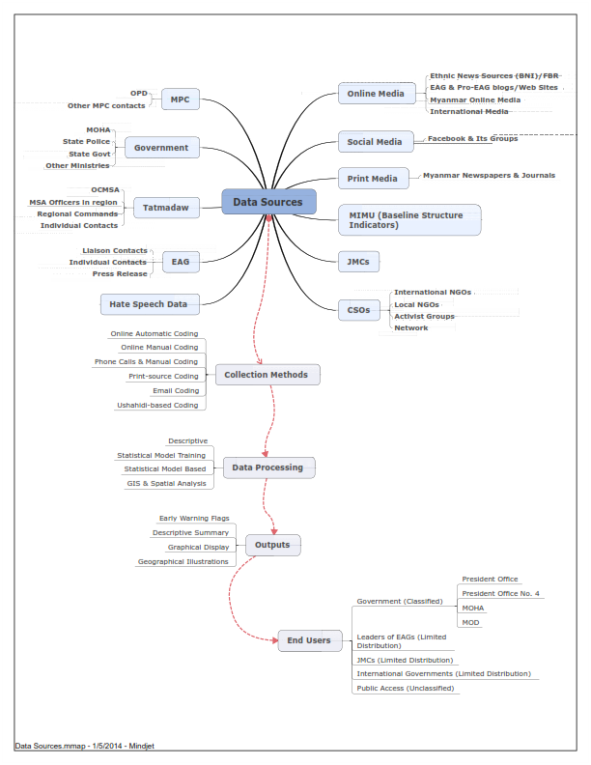




Early warning in context
MYANMAR PEACE CENTER

Slide 11
Information management
Access database – automated algorithms – web-based reporting/GIS
Multiple sources of information
  Verification required/duplication must be minimised
Data ownership/security
Long-term media monitoring automation

Slide 12
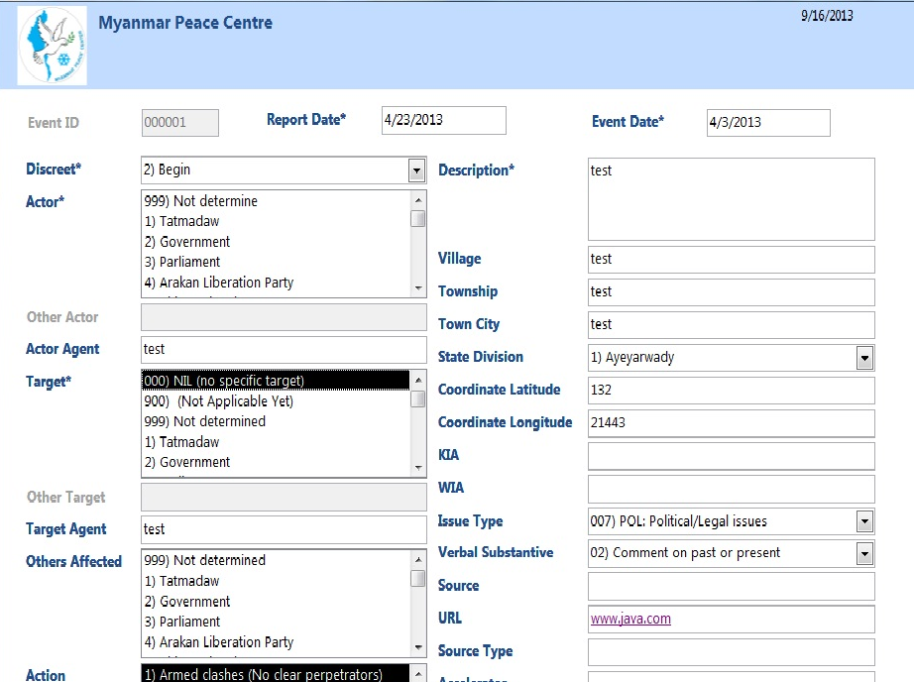
Information management

Slide 13
Challenges
Database/software development
Resource intensive nature of manual data input
Event verification
Accuracy/reliability of source data – particularly to the township level
Linking information to response mechanism

Slide 14
Questions?

