Slide 1

AWD WASH response

Slide 2
Agenda
Collective brainpower
WASH activities in AWD
Targeted response: CATI/CLUSTI approach
Rakhine, intervention plan

Slide 3
Objectives
Quick assessment on knowledge and current WASH interventions
Overview of the WASH interventions in AWD, specific attention to CATI/CLUSTI approach
Identification of collective interventions for Rakhine

Slide 4
WASH response activities should be data-driven, using real-time epidemiological and geographical information
WASH activities in AWD
During an outbreak
Why?
Identify the affected and at-risk populations
Guide the response
Prioritize interventions
Allocate funds

Slide 5
WASH activities in AWD
Household level
Community level
Healthcare level
Public institutions level
Cross-cutting
Notes:
https://www.menti.com/ala918q9xdxp

Slide 6





Household level
WASH activities in AWD
Household disinfection
Household disinfection kit distribution and training
Chlorine spraying
Safe water storage
Water storage container distribution
Water storage container disinfection
Household water treatment
Chlorine-based water treatment methods (PUR® , aquatabs ®, Oasis ®, Watergard ®...)
Non-chlorine-based water treatment methods (Boiling, Filter, Solar)
Water quality monitoring
Improved hygiene practices
Hygiene and health education (AWD awareness, ORS preparation, etc.)
Household AWD kit distribution (soap, bleach, ORS, etc.)
Notes:
https://www.menti.com/ala918q9xdxp

Slide 7

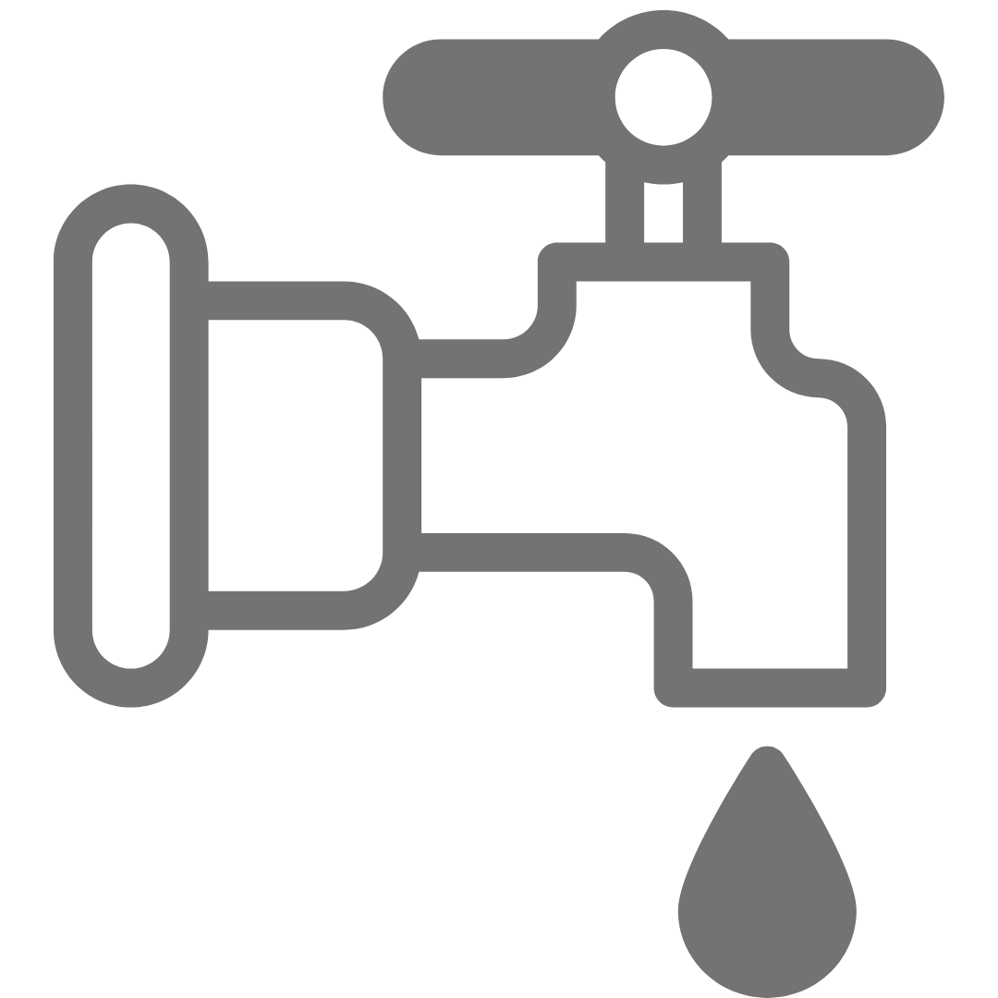
Community level
WASH activities in AWD
Water supply and treatment
Inhibit access to contaminated or high-risk water points
Temporary safe water supply systems
Operation and maintenance of water treatment stations, water points and distribution networks (tank disinfection, light repairs, etc)
Water quality monitoring
Source-based water treatment
  Bucket chlorination
  Chlorine dispensers
  Well disinfection*
  Water vendors training
  Water vendors hygiene supplies
Notes:
https://www.menti.com/ala918q9xdxp

Slide 8


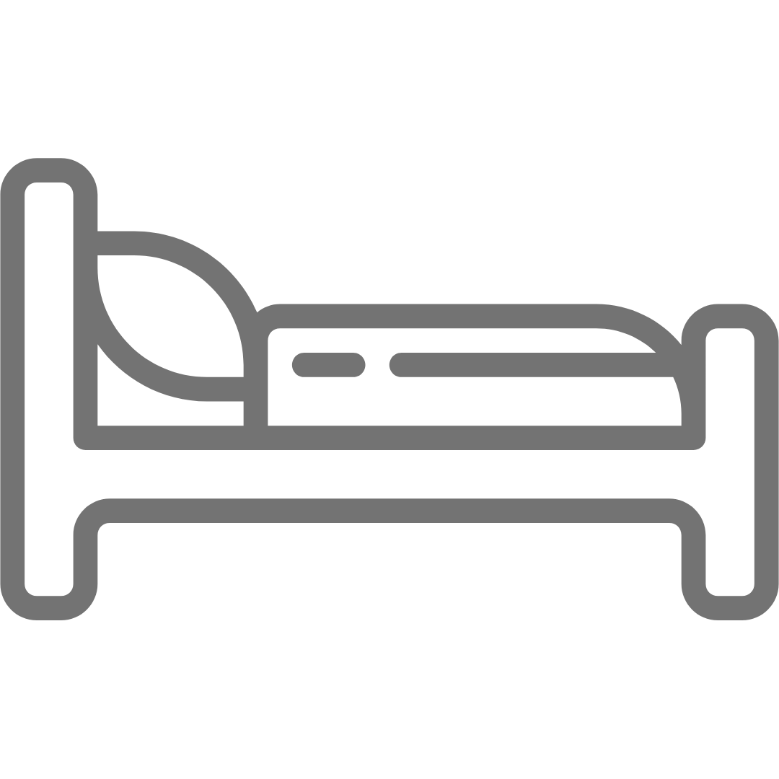
Community level
WASH activities in AWD
Improved sanitation
Safe disposal of excreta (light sanitation and handwashing repairs, except if IDP/refugee camps)
Wastewater disposal
Waste management and flies control
Food safety and hygiene
Food vendors hygiene supplies
Food vendors hygiene training and awareness
Hygiene and health education
Mass media, radio, tv, posters...
Participative methodologies
Burial and funeral hygiene
Safe and dignified burials
Funeral ceremony hygiene
Notes:
https://www.menti.com/ala918q9xdxp

Slide 9





Healthcare level
WASH activities in AWD
WASH in HCF
Infection, Prevention and Control (IPC)
Hospitals
Water quality/quantity
Wastewater and drainage
Latrines
Handwashing
Hygiene promotion
Hand hygiene
PPE
Food hygiene
Laundry
Waste management
Safe dignified burials/corpse management
Vector control
Environmental cleaning
AWD treatment centers
Oral Rehydration Points
ORS preparation
Hygiene promotion
Water treatment and safe storage
AWD awareness
ORT volunteers
Notes:
https://www.menti.com/ala918q9xdxp

Slide 10




Public institutions level
WASH activities in AWD
Specific public institutions and/or public places that may function as a source of infection
Markets
WASH interventions should include:
Community engagement
Hygiene and health education
Food safety and hygiene
Water supply and treatment
Improved sanitation
Hygiene kits
RCCE
Schools
Others
Notes:
social mobilization, hygiene and health education, food safety and hygiene, water supply and treatment, and improved sanitation

Slide 11

Cross-cutting
WASH activities in AWD
Social Inclusion
Conduct disability assessments: Identify the specific needs of people with disabilities in relation to AWD prevention, treatment, and care
Develop accessible communication materials: Provide information on AWD prevention and treatment in accessible formats
Ensure inclusive service delivery: Adapt healthcare facilities and services to meet the needs of people with disabilities
Risk Communication and Community Engagement
Develop culturally appropriate messages
Establish feedback mechanisms

Slide 12
Cross-cutting
WASH activities in AWD
Nutrition
Promote breastfeeding
ORS and SAM: Include the protocol for children with severe acute malnutrition (SAM) for oral rehydration therapy
Strengthen food safety and hygiene: Promote safe food handling and preparation practices to prevent foodborne illnesses.
Education
School personnel trained in AWD treatment and prevention
Messages are reinforced at school

Slide 13

Targeted response
Case/Cluster-Area Targeted Approach – CATI/CLUSTI
What is the objective of CATIs/CLUSTIs?
Deliver a rapid response consisting in a complete package to each case and the immediate neighbors (CATI) or local clusters of cases (CLUSTI), ideally the same day of the case admission at a CTC/HCF to break the transmission of AWD
Notes:
It is a specific package of tailored response activities implemented by a mobile response team targeting AWD case households and neighboring households in a defined perimeter with the objective of breaking the contamination chain in the households and communities during outbreaks
The approach uses epidemic surveillance and contact tracing to target beneficiaries, and it can prove effectiveness in reducing AWD cases when the rapid response team intervention is triggered at an early phase.

Slide 14
Targeted response
Preconditions and programmatic considerations
Interest and willingness among national and
local authorities
Predictable, flexible and timely funding
Incorporating the CORTs into national surveillance and response programmes is key to sustainability (Environmental health unit Zimbabwe; Community Health Workers..)
Strong information management, including a
robust surveillance system and timely sharing
of epidemiological data
Strong coordination between stakeholders
CORTs includes multiple layers of engagement: HH, community, HCF
Materials, supplies, logistics, warehouse
Notes:
Experience and capacity-building among WASH responders is critical to select the appropriate service delivery mechanism(s) depending on the phase of the outbreak, the transmission context and the type of population affected.

Slide 15
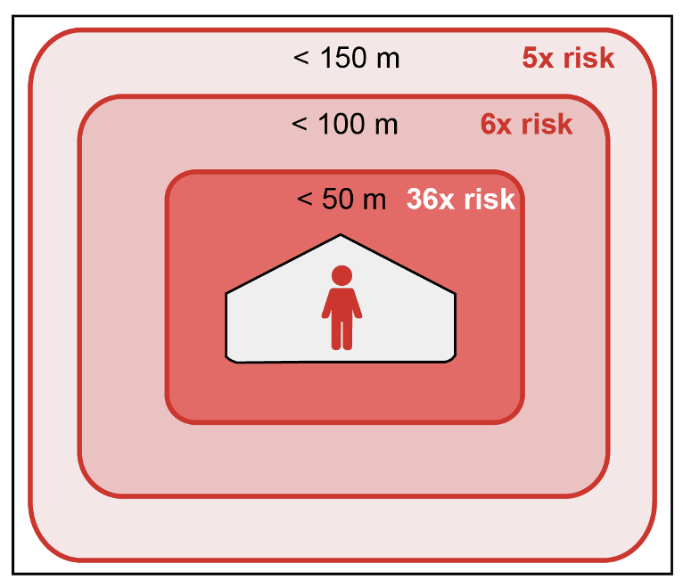
Sensitization on WASH AWD Response Package
Targeted response
Case/Cluster-Area Targeted Approach – CATI/CLUSTI
Specific package of tailored response activities, to limit AWD transmission, implemented by a mobile response team at case residences and neighboring households in a defined perimeter around localized cases.
36 times greater risk within 50m (in the first 3 days)
6 times greater within 51 - 100 m (in the first 3 days)
5 times greater within 101 - 150 m (within the first 3 days)
Notes:
Increased risk of disease transmission for close neighbors of AWD cases.
Source: Modified figure from MSF (2017), Debes et al. (2016) and Azman et al. (2018)

Slide 16
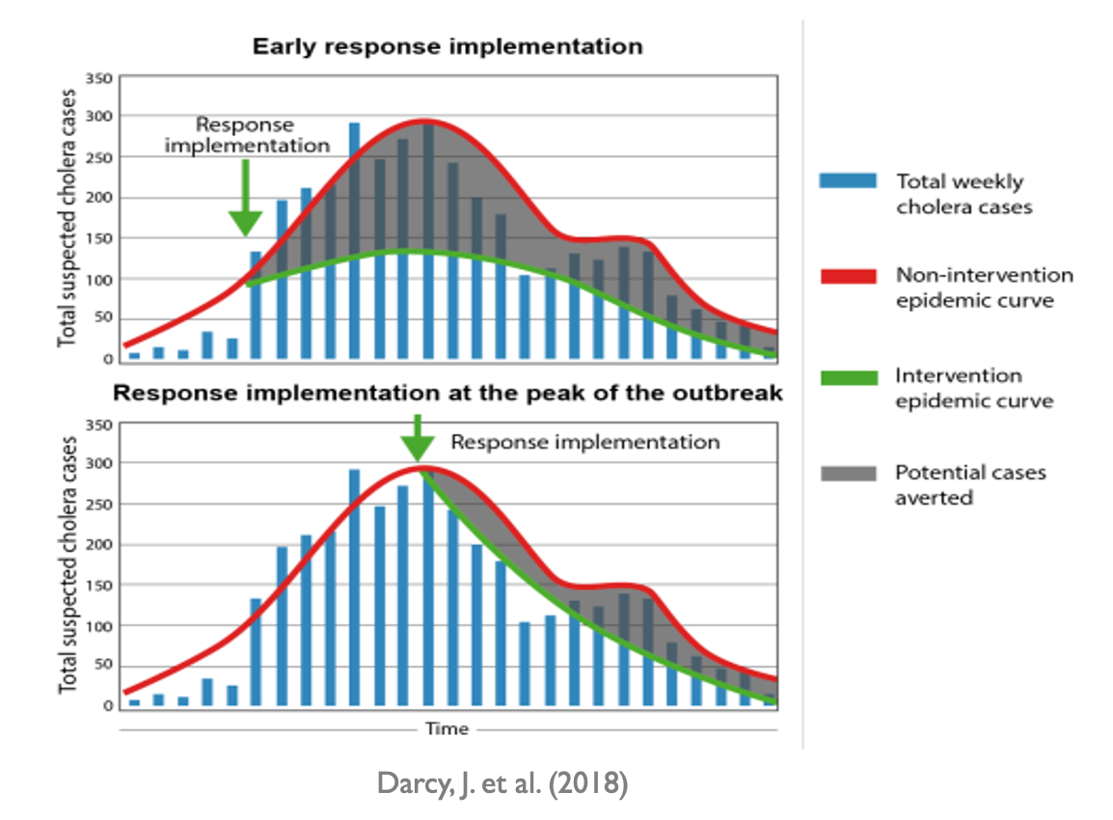
Targeted response
Case/Cluster-Area Targeted Approach – CATI/CLUSTI
To quickly stop disease transmission, rapid response is critical
  Within 24-48 h
  Before the outbreak peak
  Agile teams, close monitoring
  Preparedness is critical for rapid response
Schematic representation of the same outbreak and AWD control measures implemented at different timepoints.
Notes:
To quickly stop disease transmission, rapid response is critical. AWD outbreaks can be contained if an investigation is carried out quickly, optimally within 24 to 48 hours of receiving an alert, and the response is implemented before the outbreak peak, in all affected areas. After the peak of the outbreak, the effect of the response (even if well designed and implemented) will likely be marginal, or at least far more limited than if implemented earlier during the outbreak.
Schematic representation of the same outbreak and AWD control measures implemented at different timepoints. The top epidemic curve demonstrates the impact of emergency WASH interventions implemented early during the outbreak, while the bottom epidemic curve shows the impact of interventions implemented after the peak of the outbreak. The green curve represents the evolution of the outbreak considering the impact of the WASH interventions in early and late response scenarios and the potential cases averted (in gray) (modified version of a figure in ﻿Evaluation of the UNICEF Level 3 response to the AWD epidemic in Yemen 12).
Response teams should be agile to adapt and respond to the evolving epidemiological situation, including an increase or decrease in case numbers as well as changes in the contexts of transmission, which requires close follow-up and monitoring 13,14.
Preparedness is critical for a rapid response, including capacity building and prepositioning of WASH supplies (based on recent epidemiological analyses of AWD hotspots, at-risk populations, risk factors, seasonal characteristics, etc.).

Slide 17
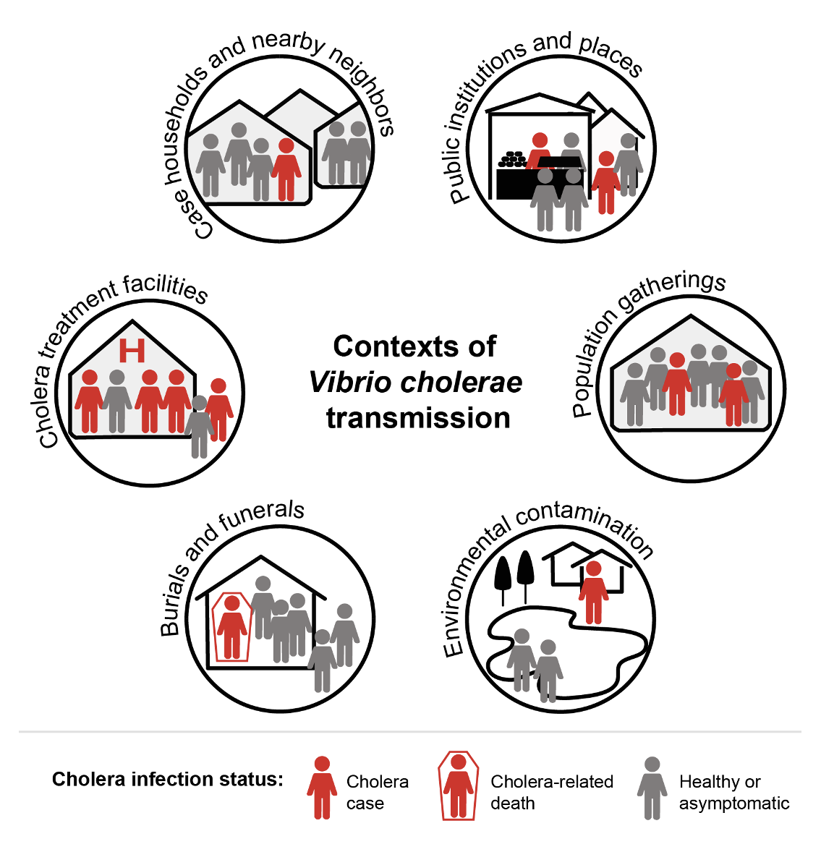
Targeted response
Case/Cluster-Area Targeted Approach – CATI/CLUSTI
Case households and nearby neighbors
Public institutions and places
Population gatherings
Environmental contamination
Burials and funerals of AWD cases
AWD/hospital treatment facilities
Based on the identified transmission context/s, the appropriate service delivery mechanisms and WASH packages may be selected
souce: adapted from ACF AWD handbook (2013)
Notes:
AWD control measures must be tailored according to the local disease transmission context(s) as well as the at-risk populations and practices, which may evolve over the course of an epidemic. The transmission context is defined as the circumstances in which a person will likely contract the disease ¹⁵. In areas where water supply, access to sanitation, and/or food safety and hygiene are lacking, six major AWD transmission contexts include:
within case households and between nearby neighbors
public institutions and places (e.g., railway or bus stations, markets, harbors, public places, and schools)
population gatherings (e.g., large-scale population movements, refugee camps, IDP camps, military bases, ceremonies, mass gatherings)
AWD treatment centers
funeral and burial ceremonies of AWD cases (including preparation, washing and touching of AWD corpses as well as shared funeral feasts)
environmental contamination (e.g., release of AWD patient feces into (1) local lakes or rivers used as a drinking water source or (2) unprotected drinking sources due to flooding)
Based on the identified transmission context(s), the appropriate service delivery mechanisms and WASH packages may be selected

Slide 18
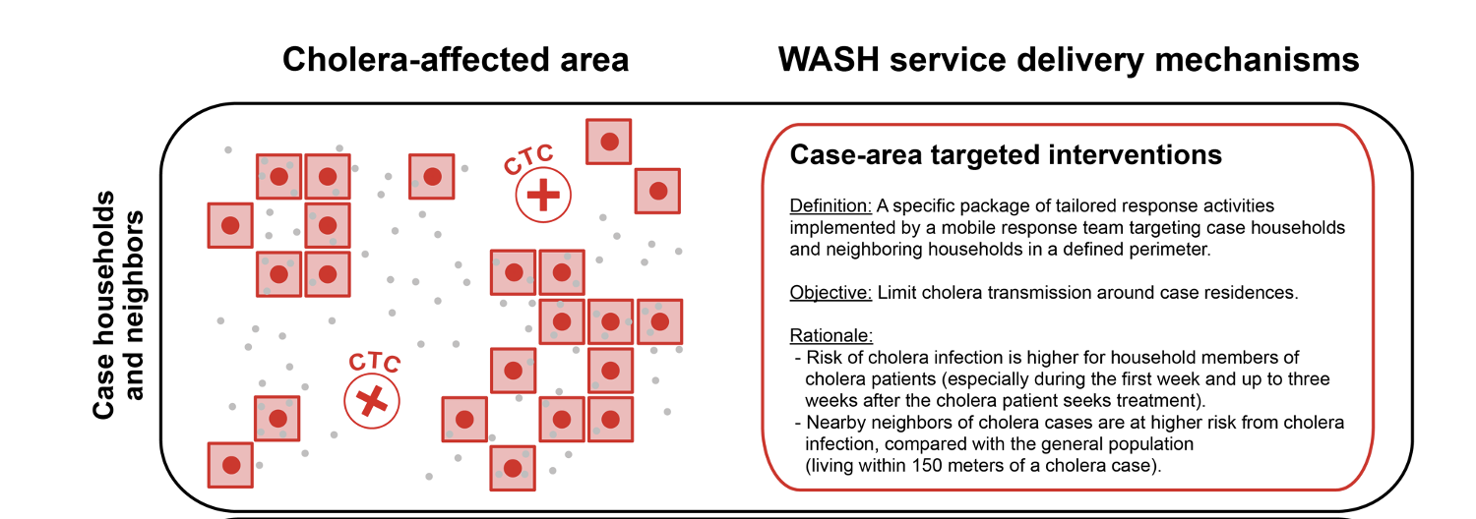
Targeted response
Delivery mechanisms - CATI
Once cases are identified, a team carries out a rapid case investigation, active case search, and WASH interventions at the case resident to limit transmission
Notes:
Service delivery mechanisms for targeted interventions
To rapidly stop AWD transmission, four distinct service delivery mechanisms may be implemented: 1) case-area targeted interventions, 2) case-cluster targeted interventions, 3) healthcare center-based interventions and 4) blanket neighborhood interventions. The decision to select the appropriate delivery mechanism(s) depends on several criteria including the number of cases, the availability and quality of the epidemiological data, the availability of resources, and security issues.
Case-area targeted interventions are specific tailored WASH activities carried out by mobile teams at case residences and neighboring households in a defined perimeter (50- to 150-meter radius) around localized AWD cases. Once cases are identified, a team carries out a rapid case investigation, active case search, and WASH interventions at the case resident to limit transmission: home disinfection, hygiene promotion, household water treatment, water quality monitoring and delivery of a household AWD kit. Meanwhile, preventive WASH activities are conducted at the residences of nearby neighbors (e.g., rapid investigations, active case search, hygiene awareness, household water treatment, water quality monitoring and distribution of neighbor household AWD kits). To effectively interrupt transmission, interventions should be conducted during “windows of opportunity”: during the early and late phases of an outbreak.

Slide 19
Targeted response
Community Outreach Response Teams (CORTs) / Rapid Response Teams (RRT)
CORTs (literature)
Team Leader
Hygiene promoter
Driver
RRT (Example A)
CATI supervisor
CATI Team Leader
Two sprayers
Two Hygiene promoters
RRT (Example B)
CATI supervisor
CATI Team Leader
Technical WASH
Epidemiologist
Nurse
Hygiene promoter
CONSIDERATIONS:
The team members should be selected among the communities in order to facilitate acceptance and give access to the households
Train the team on communication /information sharing when facing a community with different belief systems
Team must speak the local languages and have a strong knowledge of the local culture(mitigating stigmatization)
Notes:
Experience and capacity-building among WASH responders is critical to select the appropriate service delivery mechanism(s) depending on the phase of the outbreak, the transmission context and the type of population affected.

Slide 20
Targeted response
Response strategy
Active search of cases
Quick transmission context assessment
Distribution of household water treatment products or chlorination of water sources at household
Water quality testing (spot-check for chlorination) at households
Direct house disinfection or support to household for promoting disinfection (kitchen, toilets, patient’s bed)
Hygiene awareness, with AWD household kit disinfection with a focus on kitchen, toilets and patient’s bed area.
Reported case: A person arrives at a health facility with AWD symptoms or is diagnosed at home
Collection of information at the health center
Activities at household level
Activities in the perimeter around the case household
Activities scale up in the community- water point chlorination, hygiene promotion, hygiene kit distribution
Post intervention monitoring
Notes:
Experience and capacity-building among WASH responders is critical to select the appropriate service delivery mechanism(s) depending on the phase of the outbreak, the transmission context and the type of population affected.

Slide 21
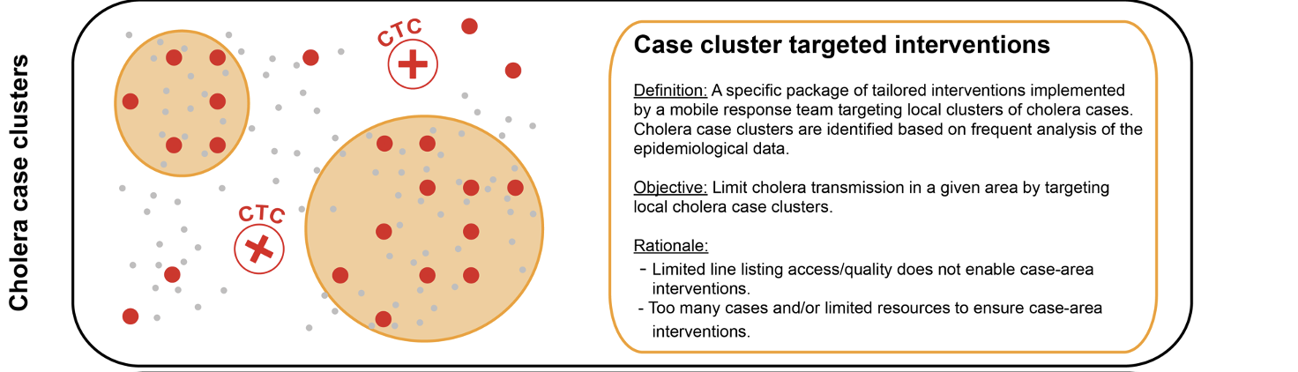
Targeted response
Delivery mechanisms - CLUSTI
Notes:
The case-cluster approach involves a specific package of tailored interventions implemented in the community by a response team(s) with the aim of limiting AWD transmission in a given territory by targeting local clusters of AWD cases. With this approach, epidemiological data are regularly analyzed to identify AWD case clusters, prioritizing persistent clusters. If case localization data is insufficient, community interventions may be implemented in highly-affected areas of a neighborhood (estimated case clusters). Within case clusters, the transmission context(s) is also assessed to target interventions at important sites of potential AWD transmission (e.g., markets, healthcare facilities, common water sources).
Targeting case clusters, interventions carried out in the community may include water quality monitoring and source-based water treatment (e.g., water network chlorination), temporary safe water supply systems, “quick fixes” for water and/or sanitation systems, restriction of access to contaminated or high-risk water points, mass media hygiene promotion, mass media food safety and hygiene, enforcement of public health regulations, and social mobilization.

Slide 22
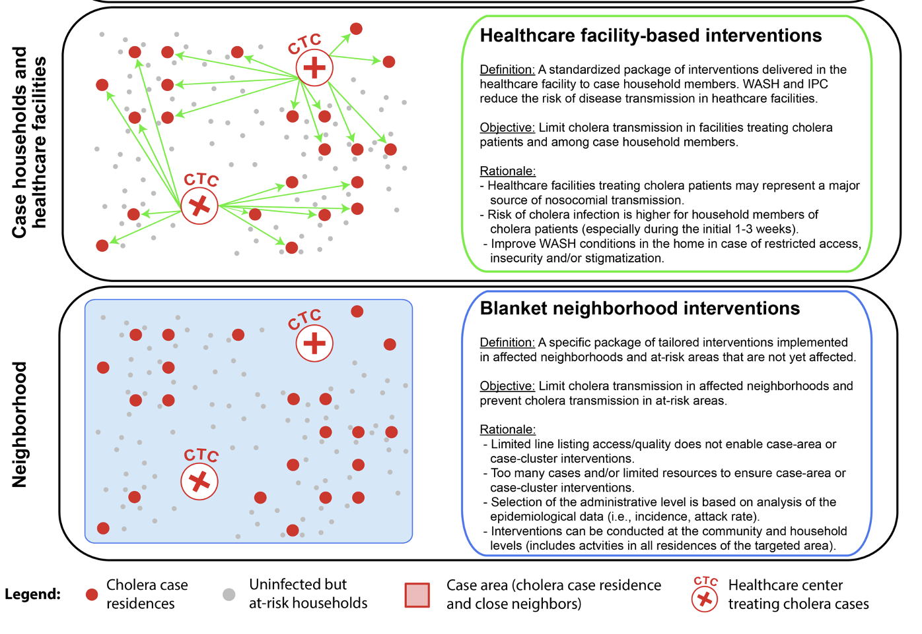
Targeted response
Delivery mechanisms – Other targeted interventions
Notes:
Healthcare center-based approach
Any facility managing suspected AWD cases (or cases with AWD-like disease) should benefit from prevention activities to reduce the risk of disease transmission. Response teams may provide additional support in terms of WASH, treatment of effluent, infection prevention and control (IPC) in healthcare facilities receiving AWD patients as needed, including hygiene promotion for patients and relatives. ORPs may be installed in the communities.
Blanket neighborhood interventions
Blanket interventions are a specific package of tailored interventions implemented in affected neighborhoods and at-risk areas that are not yet affected. Analysis of epidemiological data and transmission context are performed to target interventions in highly affected areas and sites of potential AWD transmission. Blanket interventions may include water quality monitoring and source-based water treatment (e.g., water network chlorination), temporary safe water supply systems, restriction of access to contaminated or high-risk water points, mass media hygiene promotion, mass media food safety promotion, enforcement of public health regulations, social mobilization, and improved sanitation.

Slide 23
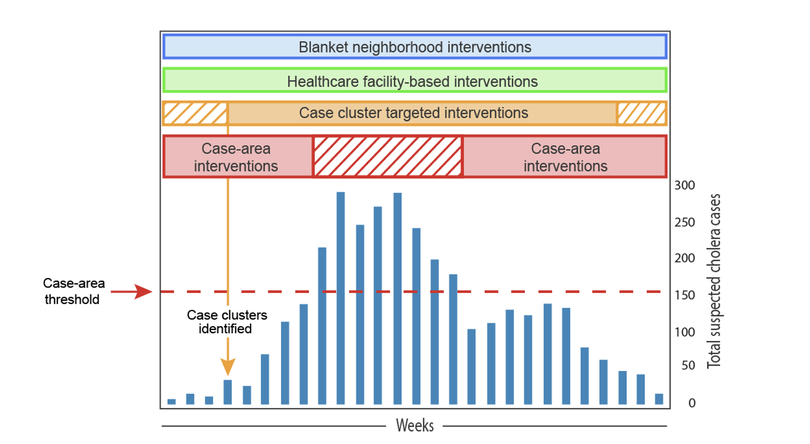
Targeted response
Delivery mechanisms
Windows of opportunity: multiple service delivery mechanisms may be implemented simultaneously or consecutively during an outbreak, depending on the outbreak phase, magnitude and context.
Notes:
Experience and capacity-building among WASH responders is critical to select the appropriate service delivery mechanism(s) depending on the phase of the outbreak, the transmission context and the type of population affected.

Slide 24
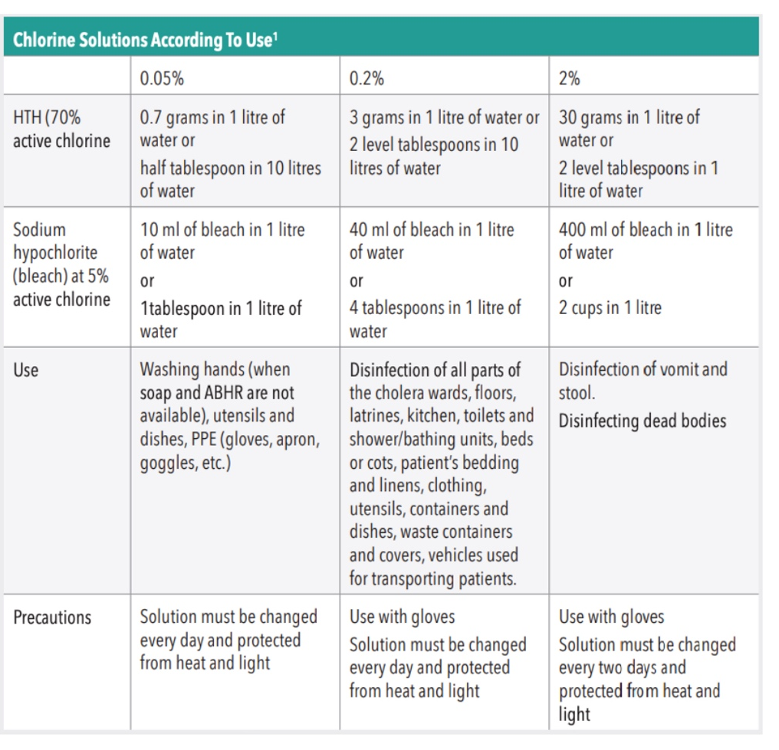

Slide 25

Rakhine, intervention plan

Slide 26
Bibliography
Response to AWD outbreaks. Case Area Targeted Interventions and Community Outbreak Response Teams. UNICEF, 2019
Operational AWD toolkit. ACF, 2023
AWD outbreak response. Field Manual. GTFCC, 2019
IPC in schools during AWD. Guidance note. Global WASH Cluster
Management of a AWD epidemic. MSF, 2022
Lutter contre le choléra! ACF, 2013
Preparedness, prevention and control. OXFAM, 2012
UNICEF AWD toolkit. UNICEF, 2013
Water, Sanitation and Hygiene and Infection Prevention and Control in AWD Treatment Structures. GTFCC, 2019

Slide 27
Thank you for your attention

