Slide 1

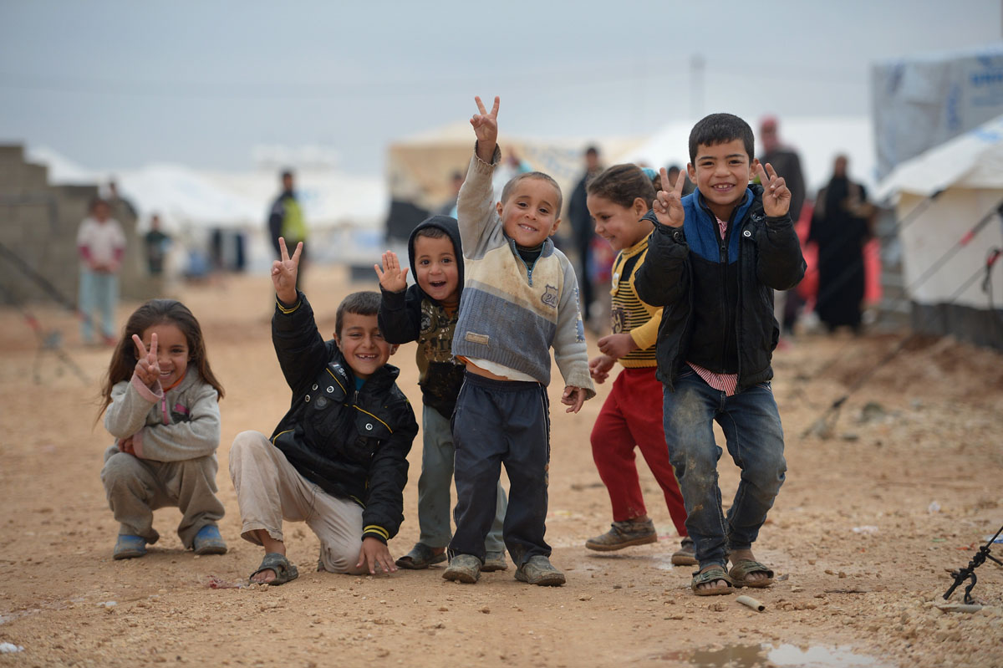
Communication and Community Engagement
Bangladesh Message Library
Notes:
This session has been developed by the CDAC Network – a network of more than 30 humanitarian, media development, social innovation, technology, and telecommunication organisations, dedicated to saving lives and making aid more effective through communication, information exchange and community engagement. The CDAC Network’s starting point is the principle that information and communication are critical forms of aid.
The objective is to provide a brief overview of the issue. Because our time is limited, the depth with which we will explore the subject will also be. At the end of the session we will share materials, including where to find out more information about communication and community engagement.
We hope that you will share your experiences during the session so that we can build on your experience and knowledge. Please feel free to ask question as we go through the session. Unless anyone has any questions now, we’ll get started.

Slide 2
Learning Objectives
At the end of this session you will be able to:
To explain what communication and community engagement is and why it is important
To advocate for how communication and community engagement can be mainstreamed through the humanitarian programme cycle
Notes:
This session will help you understand what communication and community engagement is and why it matters. It will also provide some suggestions for how this could be implemented throughout the humanitarian programme cycle.

Slide 3

Communication and community engagement is about creating and opportunities for two-way dialogue with the affected community.
This enables a better response, empowers the community to give feedback and participate, and ensures the response is based on the needs, capacities and opinions of the people affected.
Notes:
This looks different in different contexts and when implemented by different organisations. However, some typical communication and community engagement activities include: the sharing of life-saving information, establishing feedback mechanisms and creating opportunities for the participation of the affected community in the response.
The approach finds ways to keep affected people at the heart of humanitarian action and to build on their existing capacity to deliver a more efficient and effective response. It is about developing relationships with different groups in a community, in order to better understand the issues they face, and how to support them in their own recovery.

Slide 4
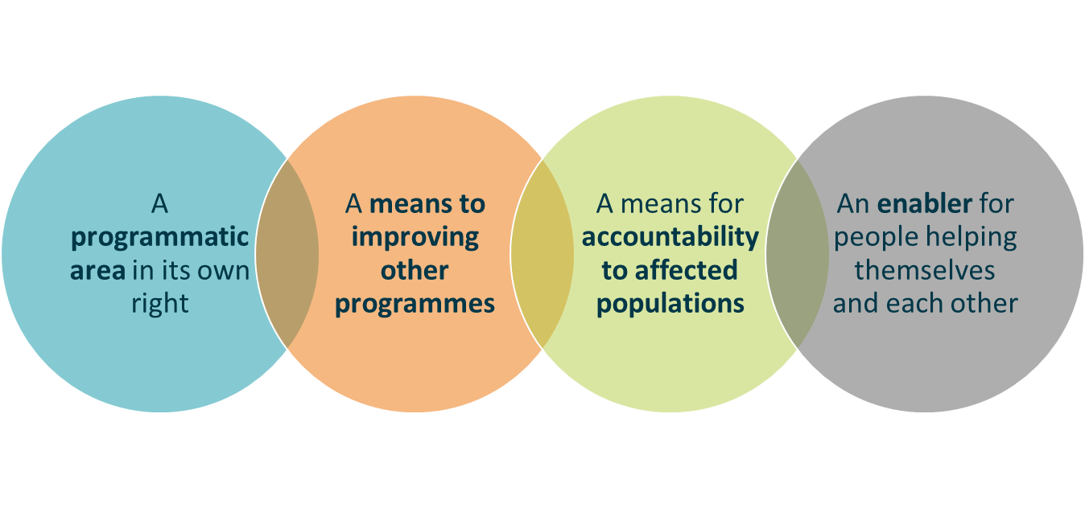
Communication and community engagement is:
an area of humanitarian action based on the principle communication is aid.
It gives priority to providing people affected by disaster with life-saving, actionable information through two-way communication channels so aid providers listen and act on people’s needs, concerns, feedback and complaints and people receiving assistance have a say in and lead decisions that affect their lives.
It also prioritises keeping people in crisis connected with each other and the outside world.
Notes:
Communication and community engagement can be:
a programmatic area in its own right i.e. the idea that information is itself aid and helps people take action. For example the development of a refugee radio stations, run by refugee for refugees.
a means to improving other programming areas such as food or shelter and for accountability to affected populations (AAP) by providing an interaction between humanitarian actors and communities. For example, finding ways to get feedback and inputs from the community to make changes to a shelter distribution plan.
an enabler for people helping themselves and each other by maintaining or getting communication systems up and running to keep people connected to each other and to diaspora that are able to provide remote support.

Slide 5

Notes:
This animation gives you the reasons why communication is aid. It gives a good overview of the issue – we will watch it now and dicuss if afterwards.
While you are watching thinking about how communication can help in a response.

Slide 6
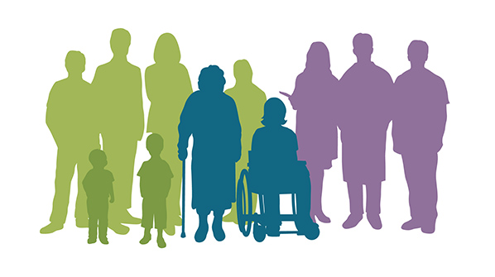
Why is communication and
community engagement important?
Notes:
GET THE GROUP TO BRAINSTORM THE ANSWERS IN PLENARY AND WRITE THEM ON A FLIPCHART.

Slide 7
Communication and community engagement is important because it…
Protects rights to
… information
… expression of opinions
... provide feedback
Reduces harm
Identifies misunderstandings
Manages expectations
Reduces conflict
Saves lives
Information saves lives
Provides psychological support
Improves effectiveness
Detects gaps
Focuses on needs
Improves efficiency
Notes:
You can categorise the different reasons under four headings, as you can see in this diagram.
If you compare with the list you came up with, I think your list may have been more detailed in fact!

Slide 8
Leadership
Participation and partnership
Information, feedback and action
Results
Commitments on Accountability to Affected People and Protection from Sexual Exploitation and Abuse
The Grand Bargain’s Participation Revolution
4. Communities and people affected by crisis know their rights and entitlements, have access to information and participate in decisions that affect them.
5. Communities and people affected by crisis have access to safe and responsive mechanisms to handle complaints.
Notes:
The importance of CCE is reflected in some global commitments:
In 2017 the IASC revised its commitments on accountability to affected people to also include Protection of Sexual Exploitation and Abuse
Leadership
Participation and partnership
Information, feedback and action
Results
In 2016 the World Humanitarian Summit during the adoption of the Grand Bargain, signatories agreed to develop common standards and a coordinated approach for community engagement and participation
In 2014 The Core Humanitarian Standard was launched, which consolidated other quality and accountability intiatives and outlines what good humanitarian action looks like for communities and people affected by crisis, and the staff and organisations involved in a response
Other commitments that also cover participation include the Code of Conduct of the Red Cross and Red Movement – signed by over 600 organisations, the Sphere Standards and the Inclusion Charter.
What this says to me is that we are very aware that this is a weakness in our approach and have repeatedly been able to identify and articulate this in global commitments – we like to rationalise the WHY.
Communications and community engagement is an approach that helps you understand HOW to achieve these global commitments.

Slide 9
Donor requirements
Partners have accountability frameworks
The perspectives, concerns, needs and priorities of the community are integrated into initiatives
Partners enhance the capacity of local communities to demand accountability from local and national authorities, as well as humanitarian organisations
Community participation as a central part of humanitarian response and that engagement with crisis affected people is a right
Partners take into account the feedback from affected people and that partners have a framework to achieve this
Obtain regular, accurate community feedback on the assistance received and the organisations providing it. Partners must demonstrate how such feedback is collected, considered, and acted upon
Notes:
It is not only humanitarian organisations who see the value, donors as well are increasingly demanding that partners show how they are accountable and the ways that feedback has been integrated into programming.
Its worth remembering here that in many organisations can be donors themselves, be it to INGOs or to local organistaions. How do our organstaions reinforce these commitments and help shift the power?
The Grand Bargain was very clear in the problem it was trying to solve – there isn't enough money to help everybody in need, and the caseload is growing by the day. So we have to be smarter and better and what we are doing – engaging the communities and building the response on their capacities is one practical way we can do that.

Slide 10

Beneficiary communication
Community engagement and accountability
Humanitarian communication
Communicating with
Communities (CwC)
What is communication and community engagement
Information for affected populations, not about them.
Communication with not only to.
Closing the feedback loop.
Community engagement
Accountability to affected people (AAP)
Communication for Development in Emergencies (C4DiE)
CDAC
Notes:
Communication and community engagement is nothing new – in fact it is a standard part of development practice. It has been around so long that is has been called a range of different names.
Every organisation calls it something different and it fits in their mandate and work slightly differently. However, what is the same is the core function of improving relationships with the community to improve the outcomes for them.
It is about useful and actionable information for the community, promoting two-way communications and dialogue, getting feedback but then providing a response back to the community.
It is worth talking briefly about the relationship between accountability and communication and community engagement – there are a lot of similarities between the two (they are both rights-based, about shifting power, ensuring a demand driven response and are people-centred approaches).
But there are also some distinct differences. Communication and community engagement is a means to achieving accountability but it also covers a broader range of activities than typically covered by accountability. For example, the provision of life-saving information is a core part of the approach, the mobilisation of a broad range of partners and therefore a significant emphasis on coordination and partnership and creating opportunities for intra-community dialogue beyond those directly affected.

Slide 11
What does good Communication and
Community Engagement look like?
Notes:
BEFORE: Divide the room into groups (try to mix up the tables as people tend to sit next to people the already know) make sure each table has marker pens and flipchart paper.
In your groups design a picture that shows what your team think good communication and community engagement in an emergency looks like. Be creative and try to show as many different elements as possible.
The example above is what a city in Western Australia identified as community engagement in their context. What would it look like in yours?
You’ll have ten minutes and make sure one of your group is ready to present your vision to the wider group.
AFTER: during the presentations make sure that there is time for questions and ask follow up question to the presenting group but also to everybody. For example, if someone drew a community meeting, ask the wider group how many people currently hold community meetings as part of their work or have held community meetings.
[This is a good opportunity to check people’s understanding of CCE – you can get the group to help self-correct during the presentations]

Slide 12
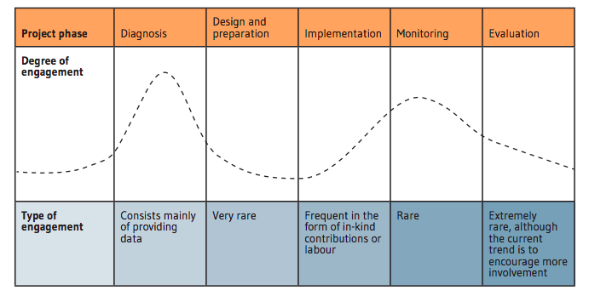
What we are aiming for
Brown, D., Donini, A. and Knox Clarke, P. (2014) Engagement of Crisis-Affected People in Humanitarian Action
Notes:
In your drawings at what stages of the project were you engaging the community?
Across the top of this graph you see the key stages of a project – the plotted line shows the usual degrees of engagement with the affected community throughout the cycle.
The diagnosis phase, what you probably know better as needs assessment and analysis is usually the highest level of engagement. The second highest is during the monitoring of programmes.
Do you agree with this graph? How does your work match up? [Plenary discussion]
What is the common characteristic of these two times in a project?
That’s right, they are both period when you are looking for inputs from the community – so they can be high levels of engagement but they can also be extractive in nature.
What we hope to achieve is indicated by this orange line.

Slide 13
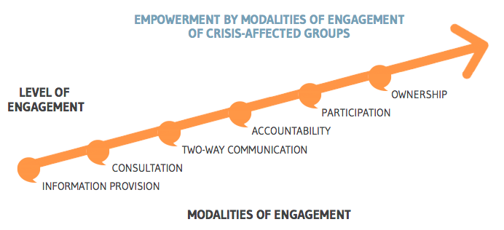
Brown, D., Donini, A. and Knox Clarke, P. (2014) Engagement of Crisis-Affected People in Humanitarian Action
Notes:
We are not just talking about the quantity, which the last slide showed but also looking at quality, which this slides reflects.
If we look then at the kinds of engagement depicted here on a sliding scale - we can see that we begin with information provision but that this is the start of a spectrum of ways of involving the community that foster participation and ownership
As we go through this session keep thinking about what ways we can accelerate our improvement towards cultivating community participation and ownership.
Put people into pairs and get them to share an example of their communication and community engagement work and where it sits on the spectrum of engagement. Ask for a few examples. Then get people to raise their hands for the stage their example is at on the spectrum. You will be able see which stage is the most common.
Try and draw out common themes of the examples shared. For example, building local capacity, taking time, trust building, inclusion, leadership, results etc

Slide 14
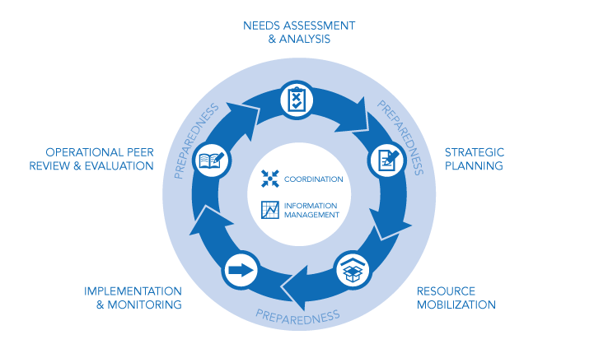
Notes:
When I look around this room I see a wealth of experience and expertise. So I am sure this diagram needs know explanation. This is the Humanitarian Programme Cycle. And although there may be slight changes in terminology, the basic stages remain the same for all programming.
This cycle will from the basis for the second half of this session that will look at what some of the ways you can communicate and engage with the affected community.
What I would like to do is to draw on some of your experience and expertise during this second half. If you have any examples about how you have either communicated with or engaged affected people, please do share these. I’d welcome people to also share, not only success stories, but also times when things didn’t work out. Our failures can be the best teacher

Slide 15
Needs Assessment & Analysis
More than a form | Hold community meetings/focus group discussions to get information beyond the questionnaire Allow people talk about their issues first before getting out the form
More than physical needs | Ask questions about people’s information needs, communications preferences and trusted sources Find out how people want to engage with, and give feedback to organisations
Notes:
Informed decision-making early on in humanitarian emergencies is challenging – there is usually little time or access to allow for a systematic assessment of affected communities. Taking these constraints into account what ways can we be better and meaning engaging the affected community during the assessment phase?
A problem shared is problem halved, so the saying goes. Giving people the space and time to talk freely about the issues they face can be both enlightening for you, and incredible reassuring for them.
The assessment is often the first interaction with the community – but stopping and listening, and this means active listening, it shows respect and helps build trust. These are two key elements in building a positive relationship with the community.
In my experience people want information about things that we, as humanitarian actors, often overlook. It is always worth asking them and not assuming you know.
Understanding how people communicate means the response can design engagement strategies that use these preferred channels and source of information.
The same is true for how people prefer to give feedback – to maximise the amount of feedback we receive we need to use preferred methods of gathering it.

Slide 16
Needs Assessment & Analysis
Seeing the invisible | Identify what role marginalised groups, such as the elderly or people with disabilities, play in the community Meet with representatives of these groups and ensure their concerns, needs and capacities are reflected in the analysis
Culture factor | Ensure implementation and utilisation of a context analysis of local culture, customs, beliefs What traditional beliefs or practices should be considered
Notes:
Different people in communities access information and communicate in different ways – their ability to communicate and access information can be dictated by social inequalities based on their gender, age, physical abilities, caste, religion or ethnicity.
These same people, who may be marginalised from ‘mainstream’ society can also often be the most vulnerable in a crisis. When you come to plan your programmes having this level of detail can enable more targeted engagement strategies that will be more likely to succeed.
You should ensure that your communication and community engagement work is not inadvertently reinforcing power imbalances in the community and doing more harm than good.
This second point was a lesson that was very apparent after the response to the Ebola outbreak in West Africa. In this crisis the international community assumed that it was a lack of knowledge that was the issue and this could be solved by mass sensitisation and awareness raising sessions. However, what they had failed to understand at first was the cultural aspect of the crisis and it was only when they listened to anthropologists that they understood the cultural and social norms were the cause of the risky behavior, not as they incorrectly assumed a lack of knowledge. For example the practices of the family washing the bodies before burial
Finding out this kind of information, is first best achieved through a desk review of existing materials could help dandify some key cultural and social issue that may play a factor in the response. During your field work you can verify if these are still factors post-crisis. Depending on the technical nature of your work you may come across these during assessment and consultation with the community when trying to understand what the underlying causes of certain behaviours are.

Slide 17
Strategic Planning
Plan for participation | Involve representatives from a cross section of the community in identifying the priorities of the response plan and throughout the programme cycle Share a simplified version of the plan with the community for validation
Build on what the community can do | Work with communities to develop their own action plans to identify the active roles they can play in the response Adapt expert solutions to the community reality. Value traditional wisdom and experiential knowledge alongside technical/scientific information and practices.
Notes:
A key premise that is common to all of the ‘people-centered’ approaches is the active role that communities play in their own recovery – their meaningful participation.
The process of planning is as important as the output as a way to get a broad range of stakeholders aligned behind a common set of goals and objectives.
One often highly contentious issue is that of selection criteria – involving the community can help a) identify the most vulnerable, b) build the community's capacity to identify these people and consider what support is needed and c) Enable the community members involved to be able to explain the criteria to other people (especially those who may be frustrated that they need to meet the criteria.
Sharing the output of the process is also really important to keep the community engaged and to see the value of their involvement. You want them to have ownership over the process and so validating with them is a key step before you start implementation.
When it comes to planning a very practical way of achieving this is to discuss with the community what their action plan would be – what capacity do they have to work on an issue and how can you support that.
For example, imagine that you have discussed the issue of water-borne disease in the camp. The community identified this as a priority and you have suggested that they promote safe water treatment in the community. Discussing how the community could work on this issue may bring out an idea to run an awareness raising campaign, which the community could arrange but they would need some technical advice on methods and also possibly some awareness raising materials.
Blending the external technical knowledge with the local is key to the success of your intervention. These communities may have been dealing with these issues for decades, if not longer, they may very well have developed their own local solutions. Finding ways to identify these and support them is best done through consultation and dialogue.

Slide 18
Strategic Planning
Listen collectively | Identify the opportunities for common platforms to aggregate and analyse feedback gathered by organisations Create ways to bring the voices of affected people into decision-making
Harmonise efforts | Identify within the plan the coordination body responsible for communication and community engagement Establish common communication and community engagement indicators across the response
Notes:
One of the key actions that humanitarian organisations committed to under the Grand Bargain was to: ‘develop common standards and a coordinated approach for community engagement and participation supported by a common platform for sharing and analysing data to strengthen decision-making, transparency, accountability and limit duplication.’ This looks at how do we, as a group deliver on collective accountability. How can the voices of the community influence decision-making at the inter-cluster or humanitarian country team level.
How do we find ways to move beyond community input into decision-making, which is far from a given in most response, to actually shifting the power to enable the communities to play am meaningful role in decision-making.
This talks directly a central coordination role to aggregate these inputs. Typically communications and community engagement would be coordinated through a technical working group that would sit within the inter-cluster or HCT. This is not always the case as it will depend on both capacity and context.
Having consistency in how we measure our outreach and engagement efforts can help us know where we are in the delivering on those global commitments and the Core Humanitarian Standard and the IASC have developed some generic indicators that can be used. We’ll make sure to include these in the list of additional resources at the end of the session. Disusing, contextualising and agreeing on these indicators can itself be a very powerful advocacy process.

Slide 19
Resource Mobilisation
Local reflects global | Document how you meet the global communication and community engagement commitments Illustrate how you will deliver on donor requirements to listen to, and act upon community feedback
Progressive partnerships | Develop partnerships with a range of groups and organisations, start with the community and an honest understanding of your organisation’s strengths and weakness. Move beyond simply implementing partnerships towards more equitable and complimentary partnerships aligned with common goals and objectives
Notes:
Aligning the work that is planned to global and donor commitments on accountability and community engagement will inevitably help in your mobilisation efforts.
Articulating the mechanisms for how that feedback can influence project design and delivery is also a powerful advocacy process to go through. Remember this is both at the organisational level but then also at the inter-agency level.
A SWOT analysis of your own organisation is the foundation for developing partnerships.
With the community at the centre work outwards to identify which organisations, groups or associations could help partner with the community to achieve the overall programme goals. Remember this might be the private sector, local media, mobile network operators, diaspora groups or other ‘non-traditional’ humanitarian actors.

Slide 20
Resource Mobilisation
Resources are more than money | Map what community resources are available (e.g. people, groups, organisations, hardware, knowledge etc.) and how they can be mobilised as part of the response Identify the potential partnerships beyond civil society that could help better engage people (e.g. local media, mobile network operators etc.)
Acting on feedback | Ensure that donors are conformable with flexibility in resource allocation based on feedback from the community Inform decision-makers that donors are expecting course corrections based on feedback
Notes:
The community has resources that can help during the response – knowing how to tap into these is about building relationships around the premise that the community is the first responder
There may be other groups that have non-financial resources that could help in the response – when looking at partnerships it important to not just consider money. For example, there could be great value in partnering with groups or organisations that have pre-existing relationships with the communities – relationships take time to establish and nurture, so working with others who already have them can save time and effort.
Factor into your discussions with donors about the need for flexibility and ensure that if you are a grant making or donor organisations that this is also reflected in your partnership agreements – not just that it is allowed but that it ids actively encouraged.
Make sure that decision-makers, both internal and external, are aware that they are expected to respond to feedback and agree on what the thresholds or criteria are for when course corrections would be made.

Slide 21
Implementation & Monitoring
Co-create content | Involve the community in the development of outreach and engagement materials Share those materials with other organisations to ensure consistency and continuity
Develop capacity | Identify and build the skills the members of the community need to play an active role in the response Support and develop staff capacity to engage the community (e.g. inter-personal communications, understanding the importance of communication and community engagement etc.
Notes:
Unless you are from the affected community, it will be hard for you to develop information products or outreach materials that effectively resonate with the community. The most effective way of developing materials is involving the community from the start. If they identify the issue as a problem, most engaging way of sharing that information with the community. This is best practice. However, it is not always possible to follow best practice – at the very least you must pre-test the material with the community before large-scale production and roll out. This can save time, money and potentially lives – a misunderstood or poorly communicated message can kill. E.g. on water treatment.
Communication and community engagement takes skills – both on the side of the community to be able to meaningfully participate. Also on the humanitarian’s side – a technical WASH expert may not have the inter-personal skills needed to effectively run a focus group discussion or community meeting.

Slide 22
Implementation & Monitoring
Active and passive monitoring | Know what to ask to find out if you are ‘doing the right things’ and if you are ‘doing things right’? Take advantage of informal monitoring opportunities in the response to enrich your formal monitoring data
Involve the community | People in the community can be the most effective monitors because of their presence, vested interest and ownership Validate the findings of your monitoring with the community
Notes:
The four main DAC criteria can be explained simply as follows: relevance and Impact – ‘doing the right thing’ and effectiveness and efficiency – ‘doing things right’;
Informal monitoring can be feedback that you receive outside of your monitoring activities. Make sure there is a way of documenting this so it can also feed into your analysis. This may be the case of explaining to staff or partners why you value this kind of feedback and ensuring when the receive it they record and report.
Community-based monitoring can be extremely effective – it can provide a very frank analysis of the success of a programme (without the inherent bias of the implementing agency asking the questions and people wanting to say nice things in the hope that more help will come or out of gratitude for the assistance provided).
The community are also there the whole time – they see things that happen long after the official monitoring visit and can give the context in which things are happening that can provide inviable information about progress.
The community will be able to tell you if you findings of your monitoring are accurate or not, or help rationalise some of the results for you.

Slide 23
Evaluation
The community knows best | Agree across clusters/sectors on appropriate level of community participation in evaluation methodologies Validate your evaluation findings with the community before finalising
It’s about people | Build a team that will be able to reflect the diverse groups within the community (consider age, gender, ethnicity, language etc.) Ensure that marginalised groups are sought out and their opinions documented
Notes:
Agreeing at the inter-agency level on the ways of engaging the communities around evaluations can help comparison of findings and also ensure consistency in approaches.
Again going back to the community with your draft findings is good parties to ensure, particularly marginalised groups, are able to validate the findings or raise their own issues.
Having the right team composition can go a long way in helping your community engagement. Consider how the community will perceive the evaluation team – think about the gender and ethnicity factors as well. Having team members who speak the colloquial language of the community helps to build that rapport and trust (without having to go through an interpreter). When we say colloquial language – we mean the language that people speak in their homes (not necessarily the official language or the one they learnt at school) the one they feel most comfortable expressing themselves in.

Slide 24
Evaluation
Process is as important as output | Choose ways to evaluate that will have the necessary rigour but also be accessible to participation – multiple methods can help triangulate data Develop and agree the TOR of the evaluation with all stakeholders, frame the evaluation as an opportunity to learn not criticise
Share and foster learning | Share findings, tools, data, lessons learned and good practices so others can learn from your experience Identify what changes in approach or programming are necessary to improve future performance
Notes:
Involving the community in the evaluation shows respect for their opinions and views, which in turn help build better relationships. It also delivers a better evaluation – one that truly reflects the community’s perspectives.
Not all of the evaluation criteria may be suitable to discuss with the community – for example you may talk about the relevance of the assistance provided with the community but a discussion about the cost-effectiveness may not be suitable
Sharing the evaluation findings and methodologies (including failures) can help the response-wide learning.
Within your team or organistaions take the time to reflect on the the evaluation and highlight what the appropriate changes in programming would be based on the findings.

Slide 25
Summary
Communication is aid - communicating with people affected by crises is one of the most important elements of humanitarian response
Communication can help people in an emergency by sharing information, helping them reduce risks and take control over their own recovery
It is essential that the right people get the right information at the right time through the right channels
Insufficient or conflicting information can cause confusion, anger or even death
Engaging communities can help design and implement better quality and more relevant programmes.
It also enhances people’s sense of well-being and can help them adapt to the challenges they face
It is also a mean for accountability to affected populations (AAP) by providing an interaction between humanitarian actors and communities.
Notes:
Communication is aid - communicating with people affected by crises is one of the most important elements of humanitarian response.
Communication can help people in an emergency by sharing information, helping them reduce risks and take control over their own recovery
Insufficient or conflicting information can cause confusion, anger or even death.
Engaging communities can help design and implement better quality and more relevant programmes. It also enhances people’s sense of well-being and can help them adapt to the challenges they face.
It is essential that the right people get the right information at the right time through the right channels.

Slide 26
OCHA COMMUNITY ENGAGEMENT VIDEO
Notes:
This animation was developed by UNOCHA and gives a good recap of community engagement.

Slide 27
www.cdacnetwork.org
@CDACN
#commisaid
Notes:
Talking points:
Follow CDAC on Twitter using the handle and hashtag
Sign up to newsletter on the website for latest news, resources, training, etc.

